Slide 1
Updating participatory Methodology for Complex User Experience design

Slide 2

Lisa Melonçon, PhD
meloncon.research@gmail.com
@lmeloncon
Tanya Zarlengo, PhD
tzarlengo@usf.edu
@Sincosz

Slide 3

@lmeloncon
(cause Tanya won’t respond)
You can
Tweet contents
Take photos of slides
@ with feedback and perspectives

Slide 4
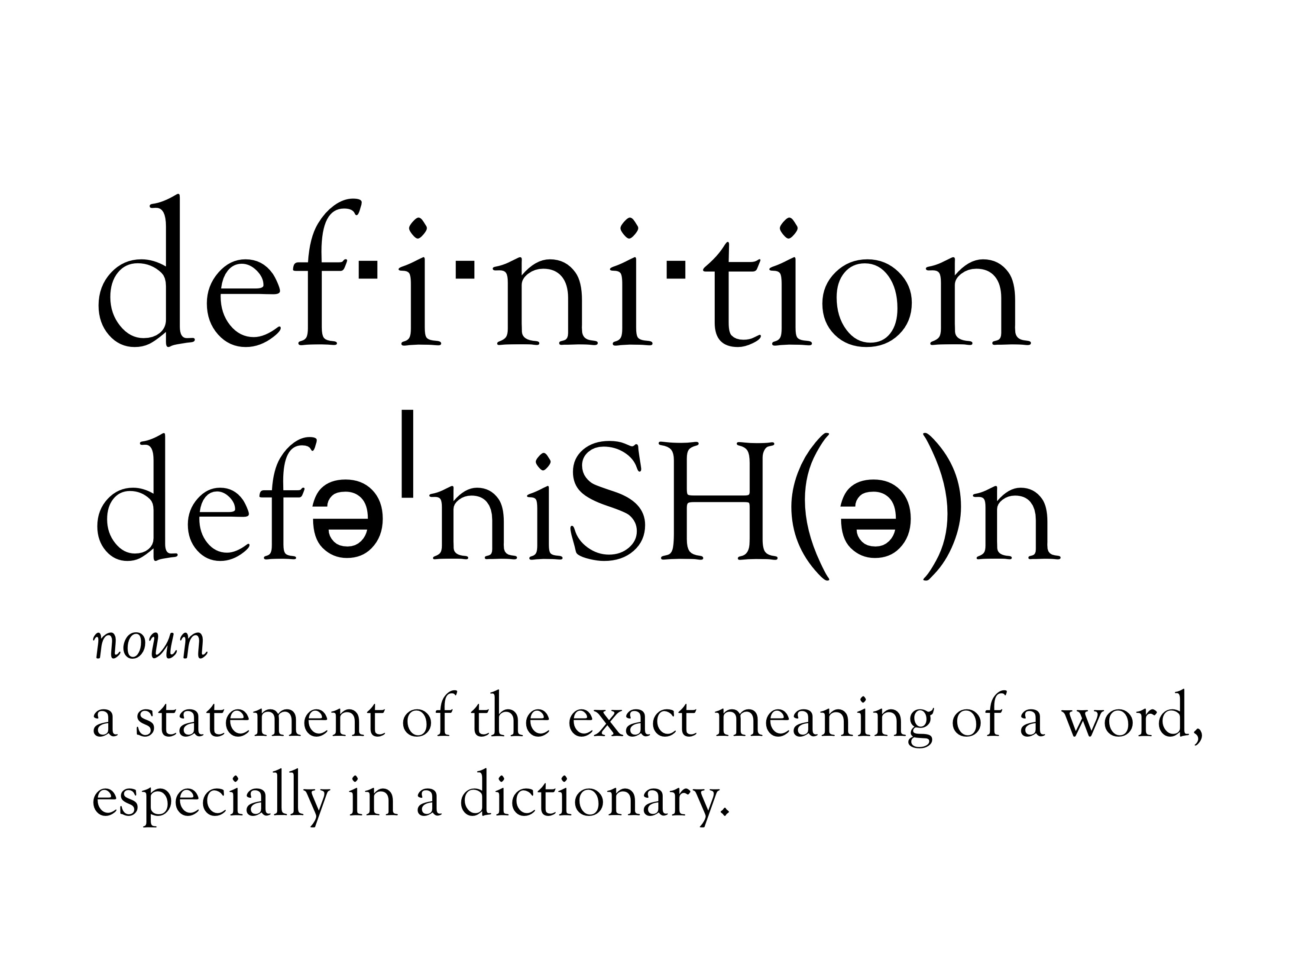

Slide 5

Notes:
User experience: combination of user’s experiences (including embodied, affective, emotional) as well as issues of usability and an eye on organizational goals for the tool/product/service
Or in the words of Nielsen and Norman: “encompass all aspects of the end-user’s interaction with the company, its services or its products” (Norman & Nielsen, n.d.).

Slide 6
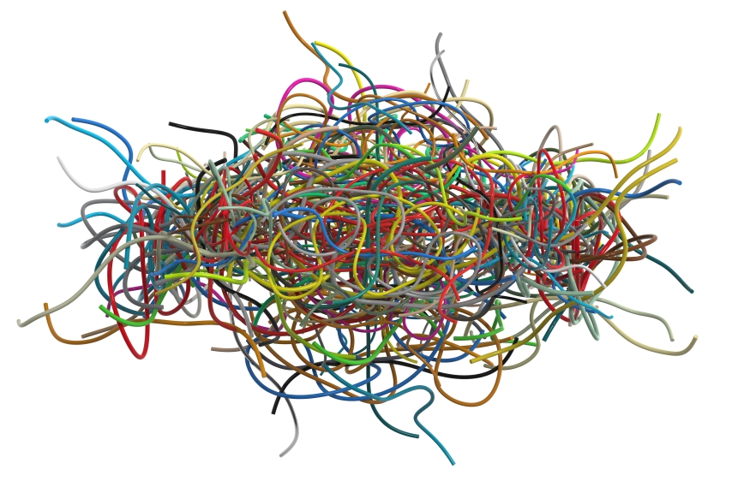
Complexity
Notes:
Complexity: many tasks related to information retrieval and applications via technology have a dimension of complexity that traditional approaches to user experience and usability do not fully account for. Ensuring we think in terms of this complexity we felt we needed to expand the participatory approaches often used in user experience in deliberate ways to account for the diversity of users and the complexity of tasks.

Slide 7

Intuitive
Notes:
St.Amant’s work over the last couple of year, particularly his 2019 work highlights the importance of cognitive prototype and script theory. In this work he moves to emphasize that to design anything visual there is a greater need to consider cognitive dimensions. The emphasis on cognition helps us in TPC to gain insights into how the brain processes information.
In UX and participatory design there is an assumption of visual elements without an overt and direct emphasis on it. We want to had the visual explicitly because it is through the emphasis on the visual that we can get at issues of understanding the shadowy concept of intuitive.

Slide 8
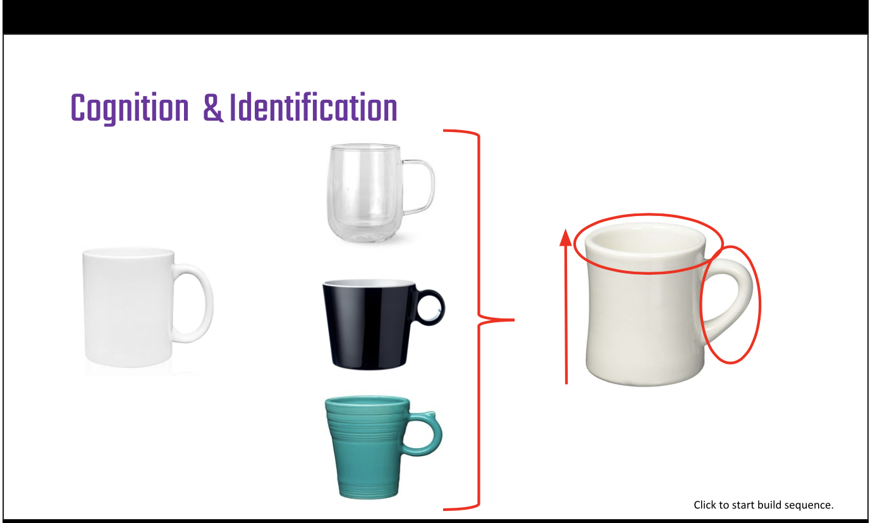
Notes:
This idea of intuitive is seen in this image of the coffee cup. St.Amant uses this image as a way to explain his own emphasis on visuals. We have added the intuitive language to his theory.
So I want you to remember the image of all of these coffee cups as a moment where you can cognitively understand based on prior knowledge and your cognitive dimensions that although they look different they are similar and would perform similar functions. This theory uncovers and gives a concrete dimension to the abstract concept of what intuition really is when it comes to interfaces or any visualization that we think will be intuitive to our users.

Slide 9

Tool Building
Notes:
Super quick overview of the fact we had this tool that

Slide 10
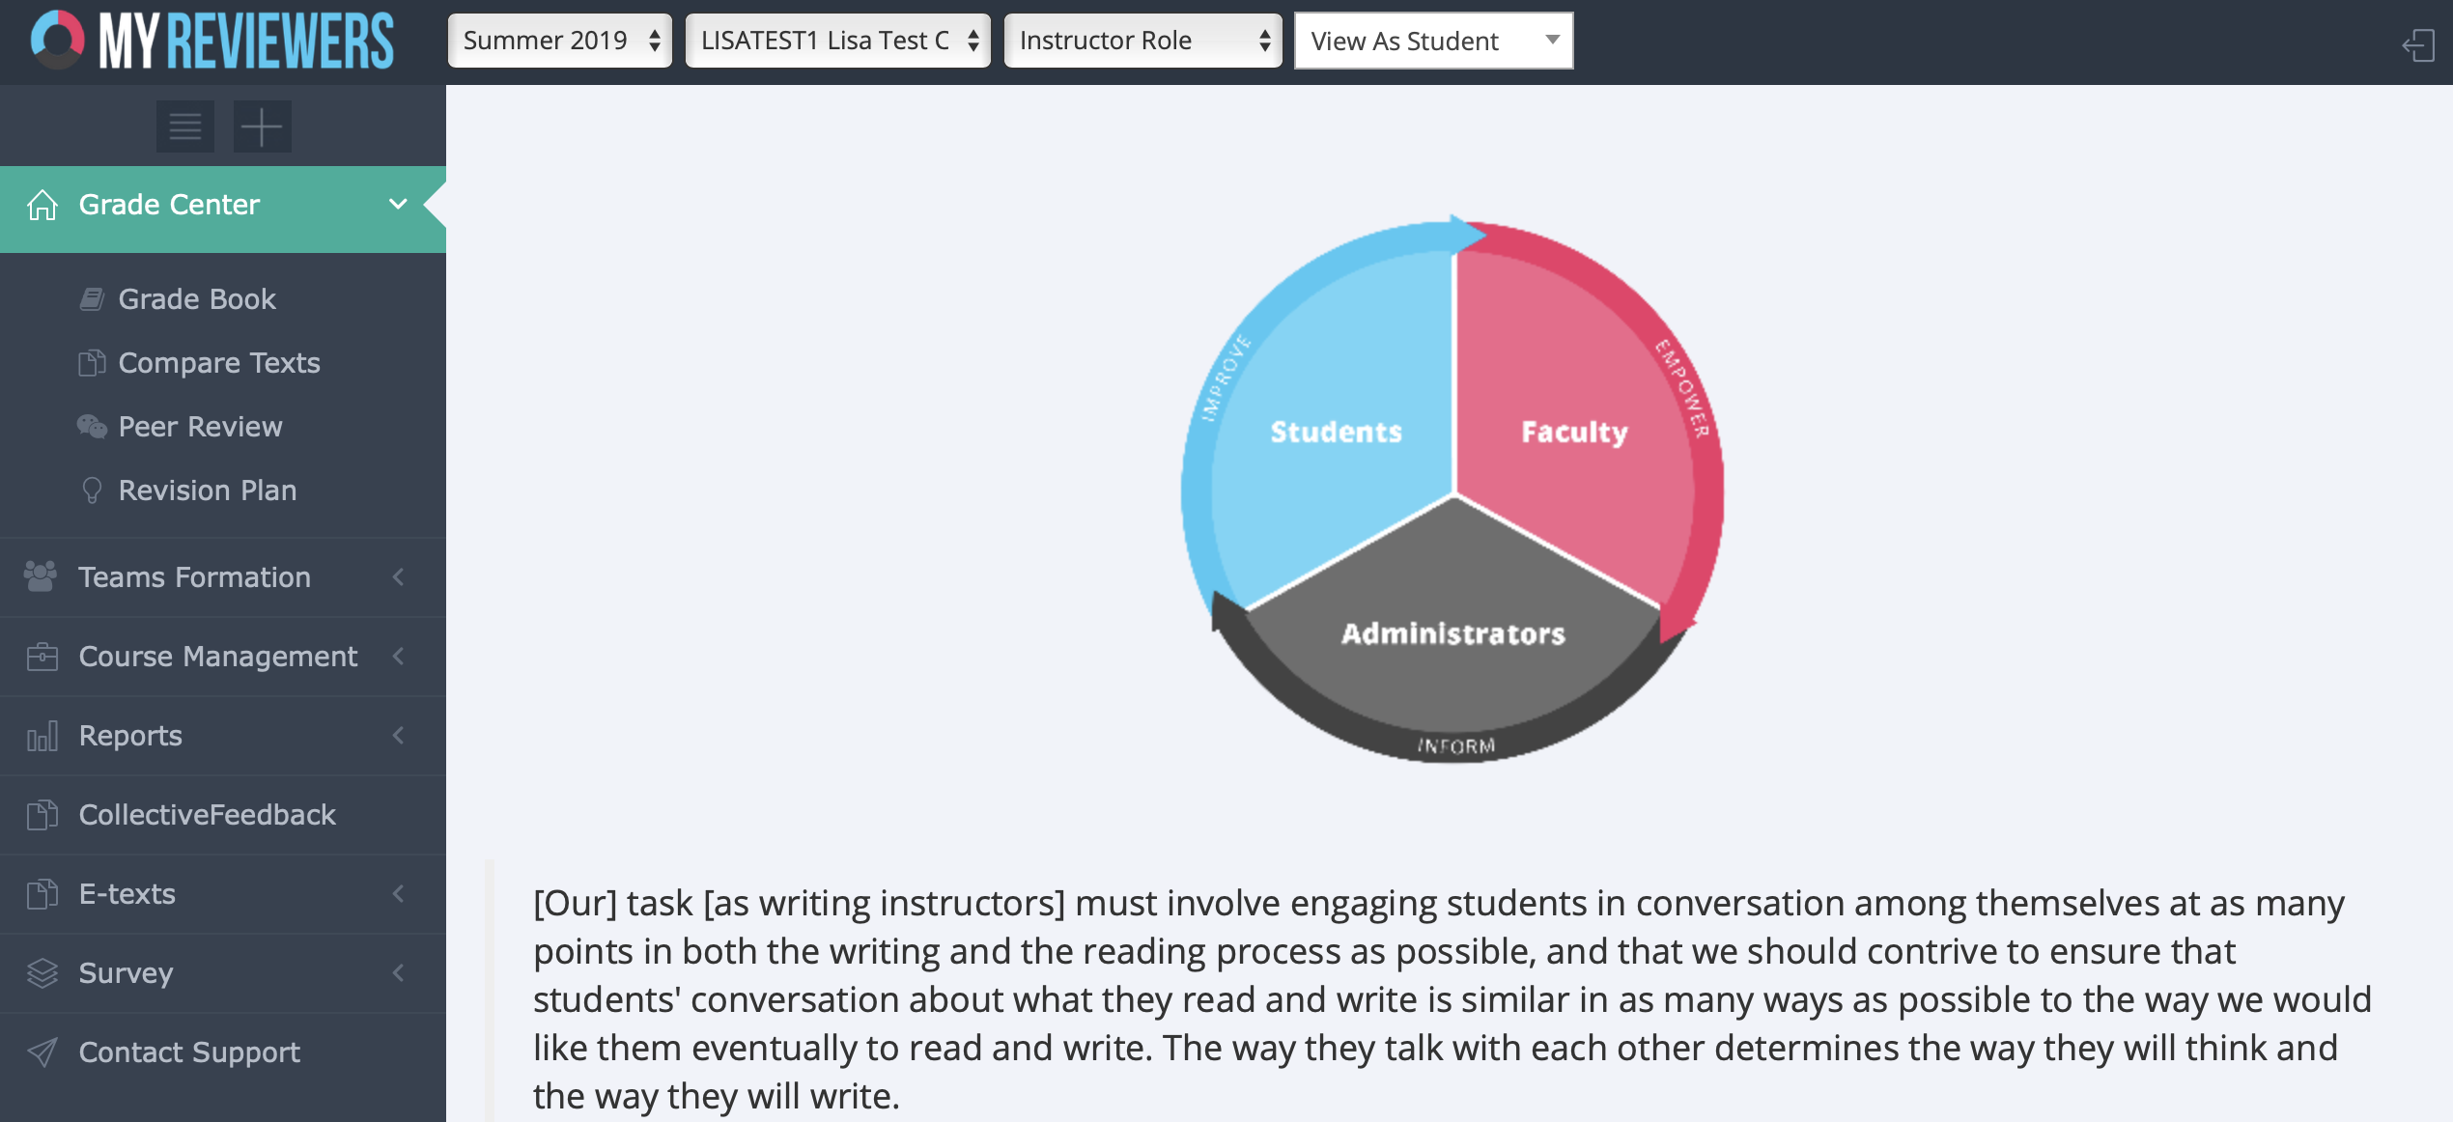
Notes:
Tanya
Brief overview that we had this thing—MyR—that we had to update and get rid of this tool because it wasn’t working for both writing programs.

Slide 11

Notes:
Tanya
Provide a definition of the tool with pedagogical value.

Slide 12
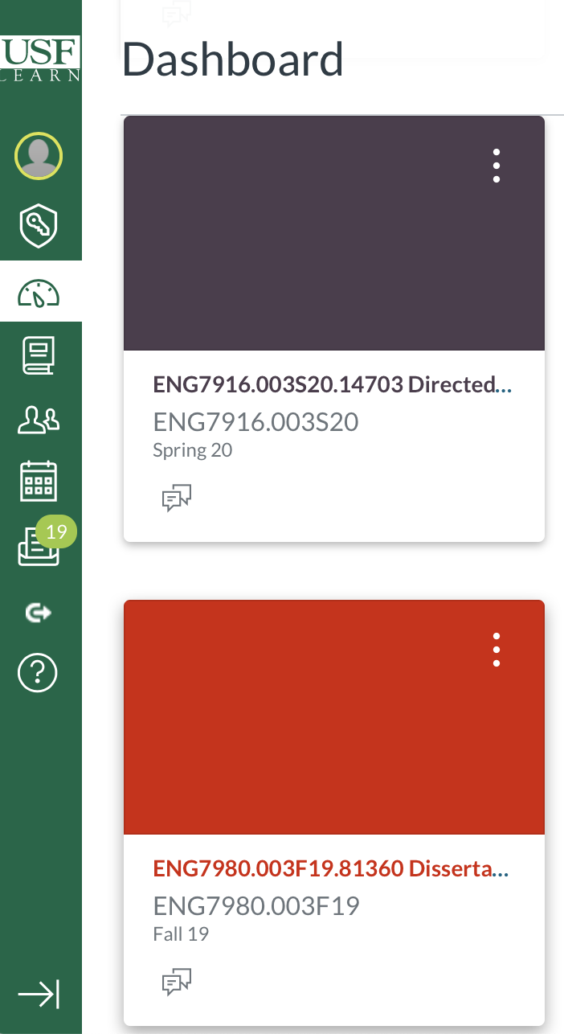
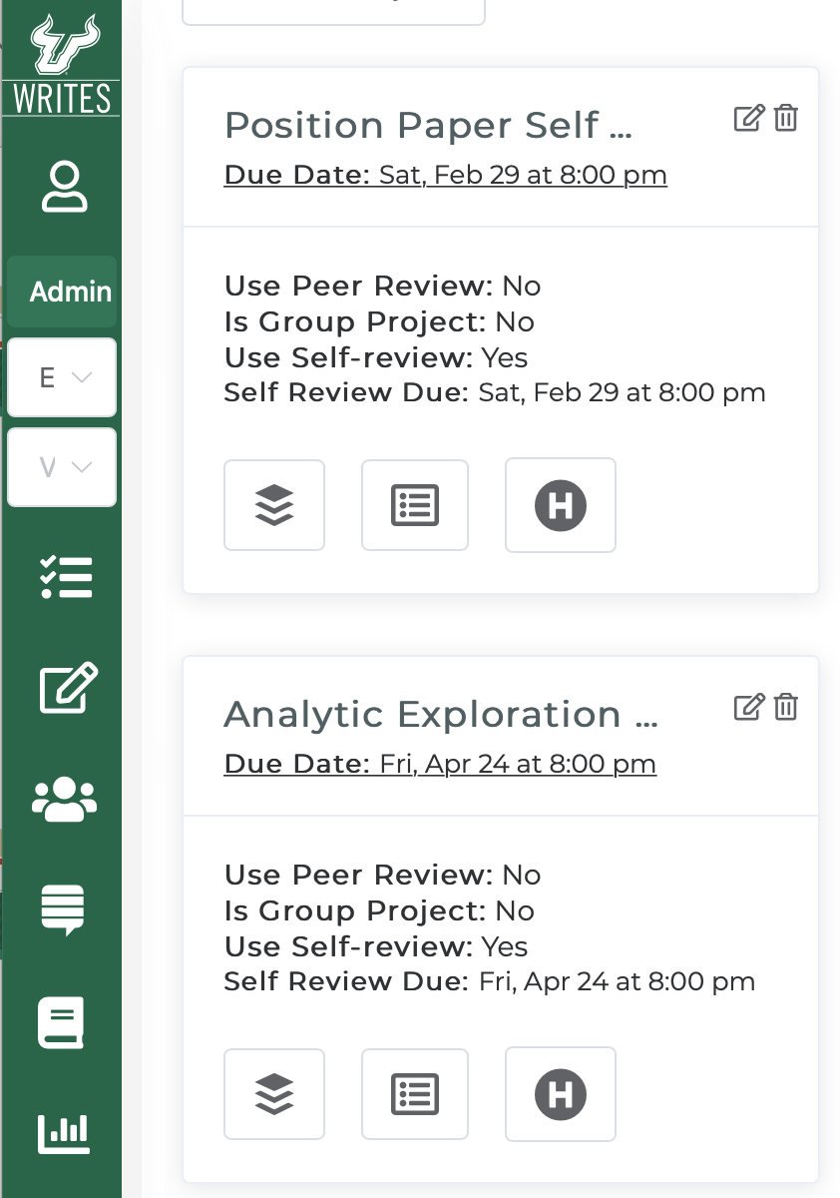
Notes:
Comparison of the USF Canvas Interface on the left and the USF Writes interface on the right.
Discussion of the visual similarities that draw on the cognitive visual prototype theory of St.Amant

Slide 13
Notes:
Tanya
Just a quick look at this slide shows the start visual differences of how we created the new tool using the prototype of existing visual design.

Slide 14

Usability
How effectively, efficiently, and satisfactorily a user can interact and/or use a “thing”
Notes:
Tanya
We did traditional user testing with a diverse set of users with all computer literacy and technological literacy dimensions. These tests were meant to determine whether the new interface and functionality would work.
We did iterative testing throughout the development cycle.

Slide 15

Intuition Defined
Notes:
One major finding is this concept of intuition. We are better able to define in clear visual terms what makes interfaces intuitive.
With rare exception all of our users were able to intuitively navigate and use the USF Writes system through St.Amant’s cognitive visual prototype theory.
We can pinpoint what makes something intuitive and the evidence suggests that our building of the tool by using cognitive prototypes users understood have virtually eliminated support tickets how to navigate the tool. With over 5000 students logged in and using the tool this term (Spring 2020) we have no support tickets.

Slide 16

Notes:
Participatory methodology : a framework of methods and methodological orientations that put an emphasis on the people and their participation.

Slide 17

Notes:
Through the incorporation of St.Amant’s work, we were able to not only add the importance of the visual dimension, it ensured that we focused on including the prior knowledge of participants in a more sophisticated way.
Because focusing on the the visual and trying to match the user’s cognitive prototypes made us understand participation differently which was most exemplified by a blind user.
This led us to expanding the idea of participatory methodology or updating it to be more inclusive. The original configuration most oft cited back to Spinuzzi does not adequately consider the complexities of the “ways people perform their everyday activities” (p. 163) and perpetuates “big brother knows it all” attitudes toward users.

Slide 18
Inclusive Participatory
Methodology

Slide 19
an ideological orientation that recognizes and incorporates the experiences and knowledge of diverse participants, including those with varying degrees of physical and mental abilities, as well as those with varying backgrounds and knowledges.

Slide 20

Implications
Provides a much needed update and expansion of participatory methodology
Includes an emphasis on visual experience within user experience
Notes:
- Shifting to inclusive participatory design makes clear distinction

Slide 21
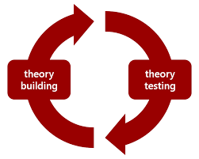
Implications
Proves St.Amant’s take on cognitive prototype theory
Adds an explanatory and descriptive approach to intuitive design
Notes:
- Shifting to inclusive participatory design makes clear distinction

Slide 22
Inclusive participatory methodology that attends to visual cognition can create intuitive interfaces that increases user experience.
Notes:
Summary slide

Slide 23

Notes:
/

Slide 24
Lisa Melonçon meloncon.research@gmail.com
Tanya Zarlengo tzarlengo@usf.edu

