Slide 1
AI approaches to TC
The REUL Lab and NLP strategies for disseminating complex information
David Young, Georgia Institute of Technology

Slide 2
Background on the REUL Lab
Started in 2016 and sponsored through the Ivan Allan College (IAC) Digital Integrative Liberal Arts Center (DILAC) grant.
Studies human engagement with complex contractual information
Emphasizes machine-assisted translation/simplification

Slide 3
Projects in the REUL Lab
Past Projects
  Project 1: Automated EULA Analysis Tool
  Project 2: Iconographic Presentation of EULAs
  Project 3: “Bite-Sized” EULA Tool
Current Project
  Text classifier using machine learning algorithms

Slide 4
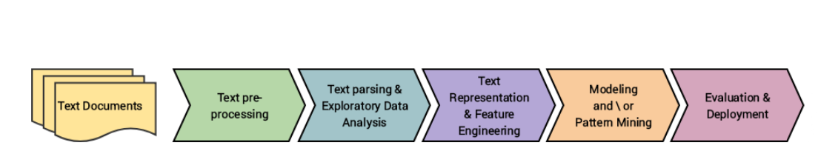
Typical workflow for NLTK projects

Slide 5
Approach to parsing meaning
Machine learning requires structuring unstructured content then extracting features that a computer can identify in new texts
Extracting features from a text requires human insight via coding, but we have also used topic modeling to assist feature identification and extraction
Both human coding and topic modelling facilitate the text parsing/exploration of data and prepare our training set for the classifier

Slide 6
Topic modeling
“Topic modeling is a type of statistical modeling for discovering the abstract “topics” that occur in a collection of documents.” (Li, https://towardsdatascience.com/topic-modeling-and-latent-dirichlet-allocation-in-python-9bf156893c24)
  Assumes that documents are made of topics and topics are made of co-occurring words
  Also assumes that word order does not matter in identifying topics
Our approach uses Latent Dirichlet Allocation (LDA) to create topic models in Python

Slide 7
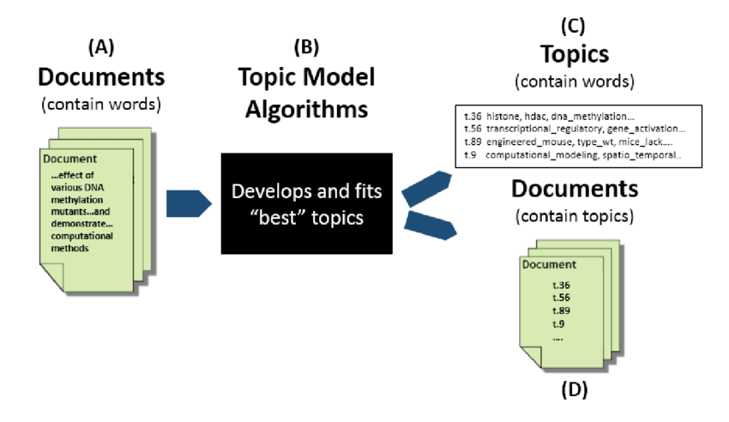
Topic modeling

Slide 8
Why use topic modeling?
Our data set is large in human terms: 50+ EULAs (testing on User-Generated Content sections)
Topic modeling provides an exploratory framework for processing large data sets
Probabilistic statistics provide latent themes in minutes as opposed to hours (or even weeks)

Slide 9
Method
Import 50 UGC sections from video game EULAs
Pre-process text to remove stop words, punctuation, words that appear more than once, etc.
Create combined corpus and dictionary
Tune model parameters (e.g. iterations, passes, corpus, etc.)
  For example, we removed adjectives and adverbs in favor of identifying relationships between nouns and verbs

Slide 10
Preliminary results
Uncleaned corpus
Cleaned corpus
 | Topic 1 | Topic 2 | Topic 3 | Topic 4
Label | Licensor actions? | License? | Licensor actions? | User actions?
Features | post | modify | display | harass
 | provide | worldwide | upload | damage
 | use | distribute | privacy | destroy
 | submit | post | know | method
 | remove | reproduce | transmit | location
 | make | warrant | submit | issue
 | know | make | data | redeem
 | license | disclose | distribute | purchase
 | Topic 1 | Topic 2
Label | Ownership | Licensor actions
Features | provide | post
 | law | modify
 | copyright | transmit
 | work | hereby
 | license | distribute
 | royalty | property
 | medium | create
 | remove | party
 | limit | provide
 | distribute | material
 | perform | term

Slide 11
Reflection on ideation in a TC lab
Machine learning approaches aren’t a substitute for human understanding
Implementing effective algorithms requires deep rhetorical understanding of corpora
Interdisciplinary collaboration requires breaking down boundaries in disciplinary knowledge
  Evidenced by Jay and Abigail working outside CS and LMC to solve complex problems. Also, includes my own introduction to CS approaches to solving language problems.

Slide 12
Paths forward
Our next step is to translate the identification of these features to a feature extraction class and use a Naïve Bayes Classifier to start supervised machine learning of EULA corpora.
We are also experimenting with methods for displaying this information visually once we can reliably classify documents.

Slide 13
Questions?
We welcome any questions, suggestions, and comments!

