Slide 1
Cross-disciplinary Vaccine Education through a
Campus-Community Partnership
MICHAEL J. KLEIN Ph.D.
kleinmj@jmu.edu

Slide 2
A rhetorically grounded, cross-disciplinary approach to health communication can assist agencies in informing their constituents about vaccines.

Slide 3
The Course
Writing in the Health Sciences – upper-division undergraduate course
The course draws students from:
  professional writing major
  minors in medical humanities and substance abuse education
  honors students from numerous majors
The course functions as a community-engaged learning course.
Notes:
What makes this different from a traditional client project is that the students are not primarily technical writing students. The seventeen students, eight of whom were honors students, studied in eight different fields: biology, biotechnology, health sciences, kinesiology, media arts, nursing, psychology, and technical communication.

Slide 4
The Clients
Healthy Families: Page and Shenandoah Counties (HF)
Program in JMU’s Institute for Innovation in Health and Human Services
“Empowers families by connecting them to community resources and offering in-home services”
The Central Shenandoah Health Center (CSHD)
One of 35 health districts that comprise the Virginia Department of Health
“Protect and promote the health and well-being of residents in the Central Shenandoah Valley”

Slide 5
The Objective
The two clients wanted to educate their audience about vaccines in general (HF) and the flu vaccine in particular (CSHD)
  Compliance to immunization requirements in Virginia has dropped slightly over the last several years (from 90% to 84%)
  Flu vaccination rate of 55% for Virginia over the past decade
Wanted to inform, not persuade
Notes:
While just one in a string of historical debates dating back to the early 19th century, the current debate about the efficacy and safety of vaccines, especially for infants and children, began with the Wakefield article in The Lancet in 1998. Wakefield and his team described “intestinal abnormalities” in all 12 children vaccinated with the MMR (measles, mumps and rubella) vaccine, as well as postulating a link with autism for those vaccinated. The article was later retracted by The Lancet in 2010, as the UK’s General Medical Council found that Wakefield acted unethically.
Wakefield, A., Murch, S.A., Linnell, J., Casson, D., Malik, M. (1998). Ileal-lymphoid-nodular hyperplasia, non specific colitis, and pervasive developmental disorder in children, The Lancet, 351, 637-641. doi:10.1016/S0140-6736(97)11096-0.
Trickle, N. (2010, January 28). MMR scare doctor ‘acted unethically’, panel finds. BBC News. Accessed 08/24/2019.

Slide 6
The Solution
Have students in the Writing in the Health Sciences class form cross-disciplinary groups to work with clients
Each team would be comprised of students from a range of disciplines: humanities (design and technical communication), science (biology, biotechnology, health sciences, kinesiology, and nursing) and social science (psychology)
Notes:
What I emphasized to the students was that they needed to rely on one another to be subject-matter experts. They would not know how to do everything asked of them: e.g., research, formulate a response, create a document. Rather, only by working together could they meet the needs of their client.

Slide 7
The Deliverables
HF – Create talking points/script home visitors (and others) can use in talking with parents to help them decide if they are prepared for the roadblocks not immunizing can bring, and how they will protect their children if they are unimmunized- looking long term.
CSHD – Create a digital PSA about common myths and facts about the influenza vaccine to provide community members with scientific information about the vaccine so community members can make an informed decision when deciding whether to get the vaccine.

Slide 8
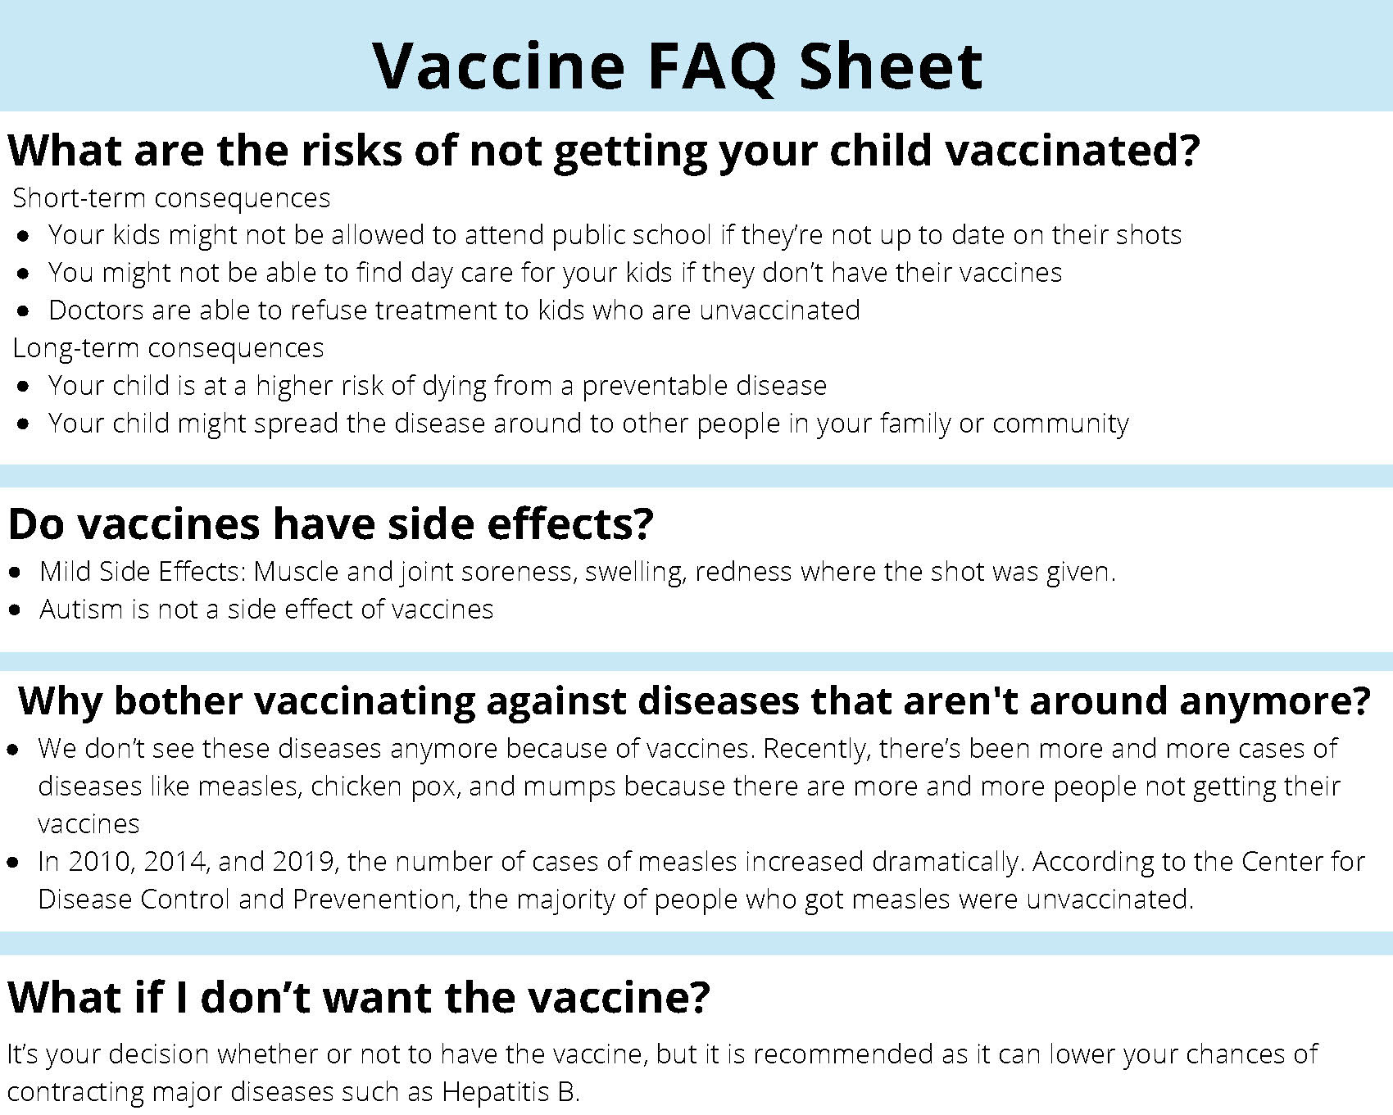
HF Vaccine FAQ

Slide 9

CSHD Digital PSA

Slide 10
The Outcomes
The Good
Peer Instruction
Career Preparation
Diverse Perspectives
Notes:
There were three primary benefits for the students that came out of this experience.

Slide 11
The Outcomes (cont.)
The Not-So Good
Communication Breakdown – internal and with the client
Navigating Multiple Audiences
Notes:
While there were positive outcomes based upon a cross-disciplinary approach, some familiar problems arose.

Slide 12
Thank you!

