Slide 1
Ethical Responsibilities for Communicators in the Climate Debates
Jean Goodwin
SAS Institute Distinguished Professor
of Rhetoric & Technical Communication
jegoodwi@ncsu.edu

Slide 2
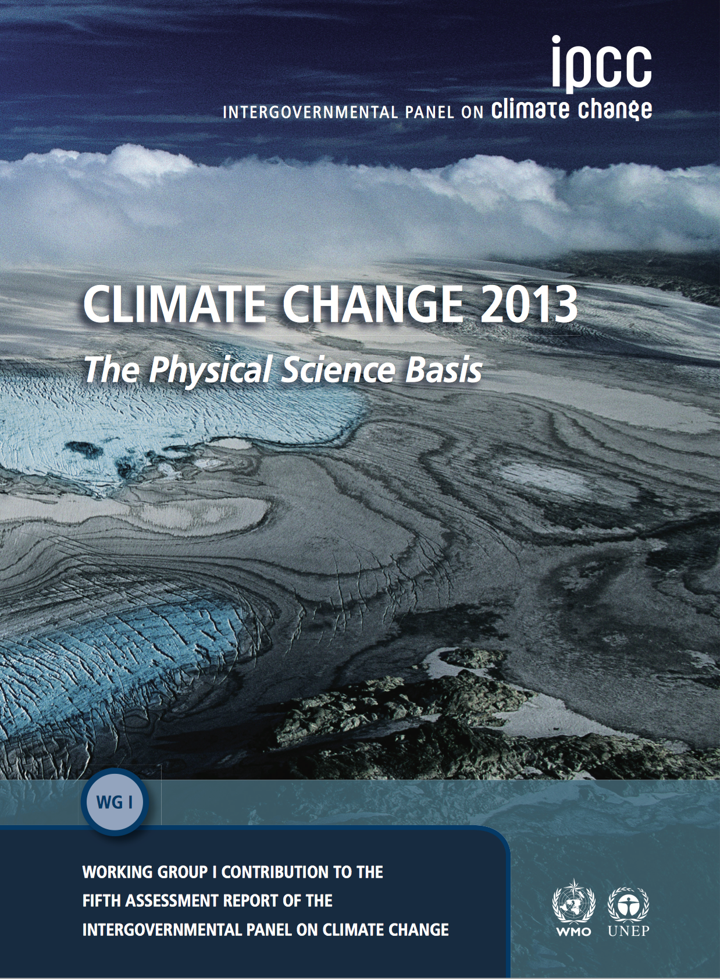

Slide 3
1535 pages
Jameson, D. A. (2000). Telling the investment story: A narrative
analysis of shareholder reports. Journal of Business
Communication 37(1), 7-38.
Rude, C. D. (1997). Environmental policy making and the report
genre. Technical Communication Quarterly, 6(1), 77-90.
Souther, J. W. (1985). What to report. IEEE Transactions on
Professional Communication, PC-28 (3), 5-8.
Wegner, D. (2004). The collaborative construction of a
management report in a municipal community of practice: Text
and context, genre and learning. Journal of Business and
Technical Communication, 18(4), 411-451.

Slide 4
Headlines
Summary for Policymakers
Technical Summary
Chapters
Annexes
Supplementary Material

Slide 5
55 words
Warming of the climate system is unequivocal…(2.4…)
Headlines
Summary for Policymakers
Technical Summary
Chapters
Annexes
Supplementary Material

Slide 6
Warming of the climate system is unequivocal…(2.4…)
Headlines
4,700 words
•
Summary for Policymakers
For the longest period when calculation of regional trends is sufﬁciently complete (1901 to 2012), almost the entire globe has experienced surface warming (see Figure SPM.1). {2.4}
Technical Summary
Chapters
Annexes
Supplementary Material

Slide 7
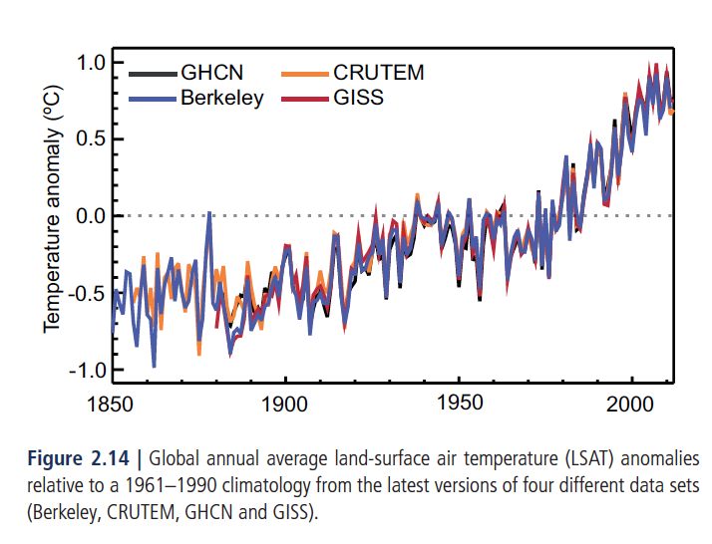
Warming of the climate system is unequivocal…(2.4…)
Headlines
Summary for Policymakers
Technical Summary
85,000 words
2. Observations: Atmosphere & Surface
2.4 Changes in Temperature
2.4.1 Land Surface Air Temperature
2.4.1.2 Diurnal Temperature Range
Chapters
…Regionally, Makowski et al. (2008) found that DTR behaviour in Europe over 1950 to 2005 changed from a decrease to an increase in the 1970s…
Annexes
Supplementary Material

Slide 8
5,000 pages
Headlines
Synthesis Report
WG 1 Report
WG 2 Report
WG 3 Report
Summary for Policymakers
Technical Summary
Executive
Summary
Sections
References
Chapters
Annexes
Supplementary Material
1535 pages

Slide 9
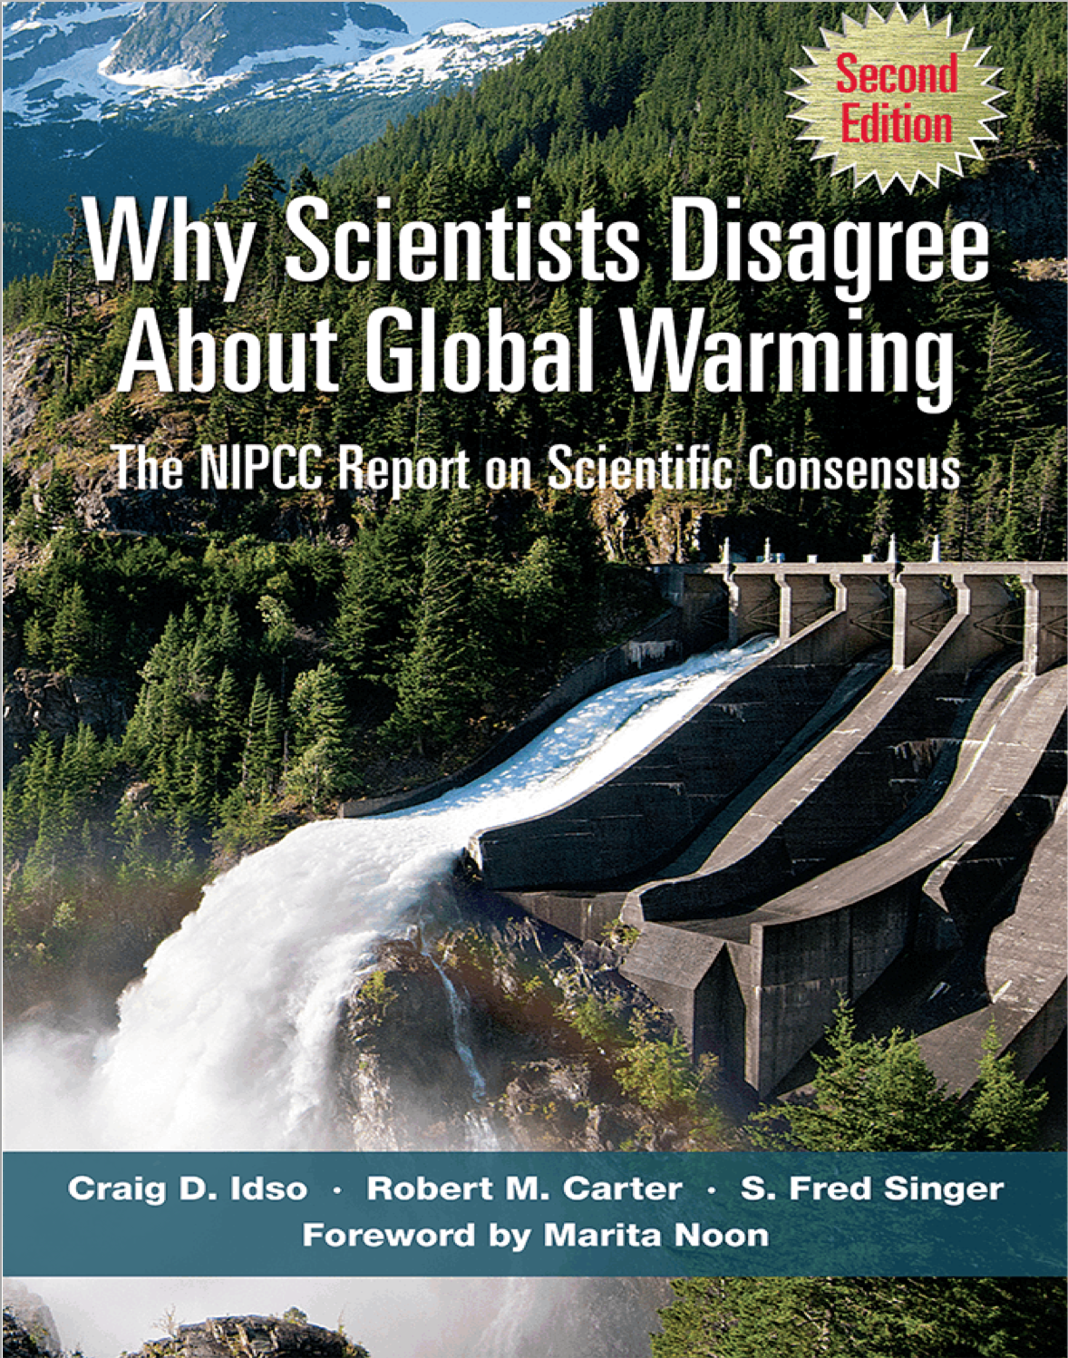
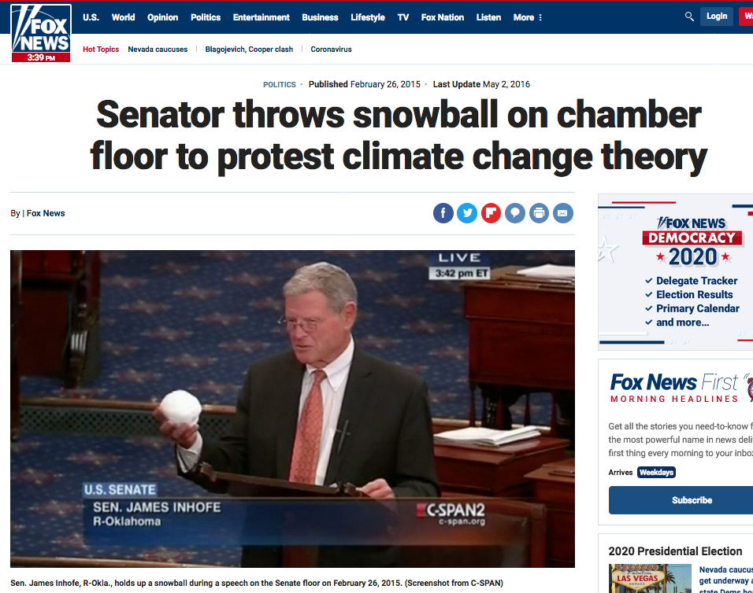
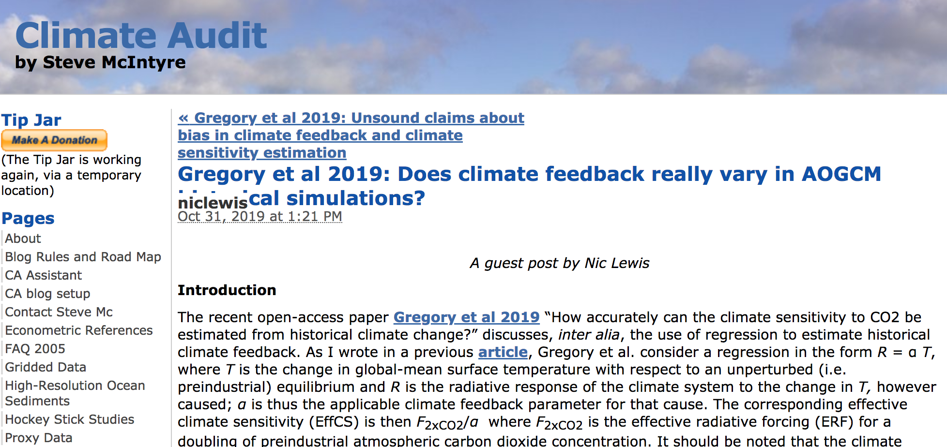
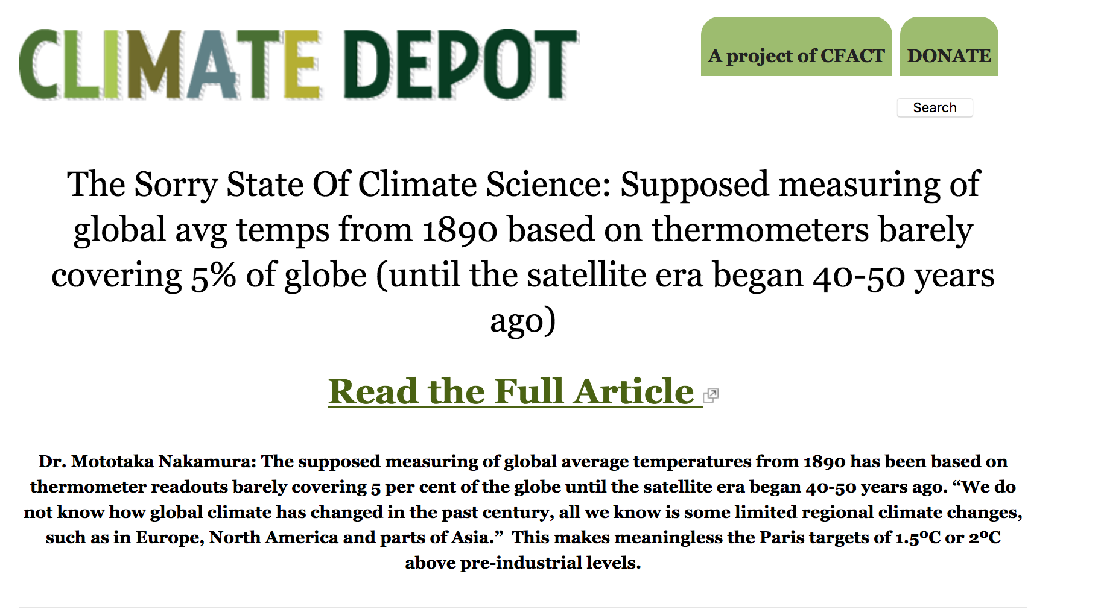
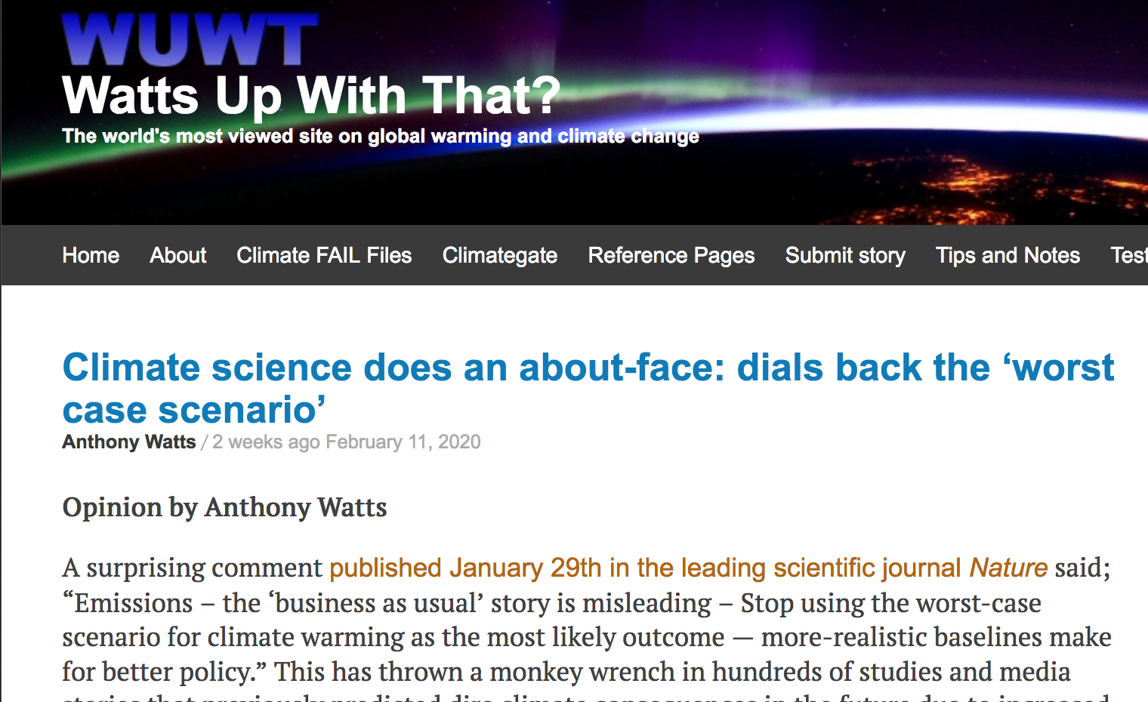


Slide 10


Slide 11
Within a context of controversy…
…how does this vital report secure an appropriate reception?

Slide 12
Rhetoric

Slide 13
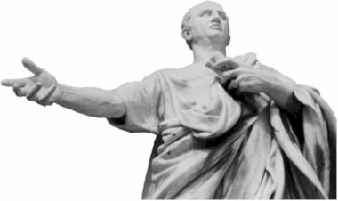
Quousque tandem abutere, Catalina, patientia nostra
Rhetoric

Slide 14
Ethos
Quousque tandem abutere, Catalina, patientia nostra
Rhetoric

Slide 15
Ethos
Is he a doctor?
Is he a good doctor?
Is he my doctor?
“Epistemic Vigilence”
Sperber, D., Clément, F., Heintz, C., Mascaro, O., Mercier, H., Origgi, G., & Wilson, D. (2010). Epistemic vigilance. Mind & Language, 25(4), 359–393.

Slide 16
Ethos
phronesis
Is he a doctor?
Is he a good doctor?
Is he my doctor?
arete
eunoia
“Epistemic Vigilence”
Sperber, D., Clément, F., Heintz, C., Mascaro, O., Mercier, H., Origgi, G., & Wilson, D. (2010). Epistemic vigilance. Mind & Language, 25(4), 359–393.

Slide 17
Ethos
How does a communicator secure an appropriate reception?
atechnic ethos, “inartistic”
—drawing on resources given in the context
entechnic ethos, “artistic”
—establishing the conditions for its own reception

Slide 18
Ethos
How does a communicator secure an appropriate reception?
atechnic ethos, “inartistic”
—drawing on resources given in the context
entechnic ethos, “artistic”
—creating the conditions for its own reception

Slide 19

Artistic Ethos & Speech Act Theory
Argumentation theory: Normative pragmatics
Goodwin, J. (2011). Accounting for the appeal to the authority of experts. Argumentation, 25, 285–296.
Goodwin, J. (2010). Trust in experts as a principal-agent problem. In C. Reed & C. W. Tindale, Eds, Dialectics, Dialogue and Argumentation: an Examination of Douglas Walton's Theories of Reasoning and Argument, 133–143.
Kauffeld, F. J. (2009). What are we learning about the arguers' probative obligations. In S. Jacobs (Ed.), Concerning argument (pp. 1-31). Washington, D.C.: National Communication Association.
Gricean analysis of speaker meaning
Stampe, D. (1967). On the Acoustic Behavior of Rational Animals. Photocopy. University of Wisconsin-Madison. Madison, WI.
Assurance account of testimony
Moran, R. (2006). Getting told and being believed. In J. Lackey & E. Sosa (Eds.), The Epistemology of Testimony (pp. 272-306). Oxford: Clarendon Press.
Trust
Ensminger, J. (2001). Reputations, trust, and the principal agent problem. In K. S. Cook (Ed.), Trust in society (pp. 185-201). New York, NY: Russell Sage Foundation.
Pettit, P. (1995). The cunning of trust. Philosophy and Public Affairs, 24(3), 202-225.

Slide 20


How can the Report create the conditions for its own reception?

Slide 21
openly undertake
responsibilities
to the audience

Slide 22
openly undertake
responsibilities
to the audience
conspicuously fulfill
those responsibilities

Slide 23
openly undertake
responsibilities
to the audience
conspicuously fulfill
those responsibilities
Audience can reason:
“The communicator would not
- make themselves vulnerable
- use such efforts
unless they really are trying to help us.”

Slide 24
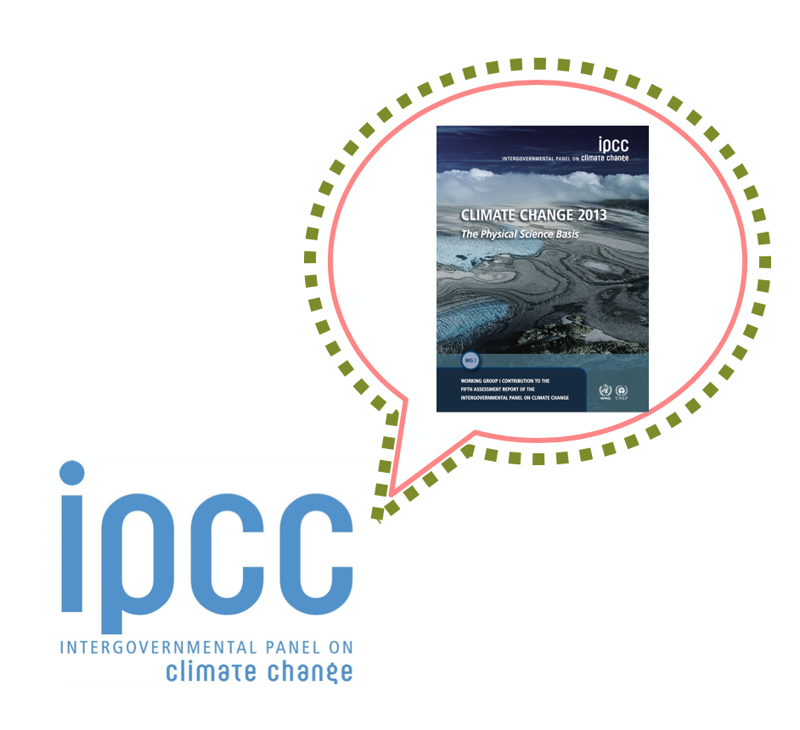
“The role of the IPCC is to assess on a
comprehensive, objective, open and transparent
basis the…information relevant to understanding the scientific basis of risk of human-induced climate change.”
—Principles Governing IPCC Work (2013)xxx
undertake
responsibilities
“focused on those aspects of the current understanding of the science of climate change that were judged to be most relevant to policymakers.”
—WG 1 AR5 Preface

Slide 25
“The role of the IPCC is to assess on a
comprehensive, objective, open and transparent
basis the…information relevant to understanding the scientific basis of risk of human-induced climate change.”
—Principles Governing IPCC Work (2013)xxx
Headlines
Summary for Policymakers
Technical Summary
Chapters
Annexes
fulfill
responsibilities
Supplementary Material
1535 pages

Slide 26
“The role of the IPCC is to assess on a
comprehensive, objective, open and transparent
basis the…information relevant to understanding the scientific basis of risk of human-induced climate change.”
—Principles Governing IPCC Work (2013)xxx
Headlines
Summary for Policymakers
Technical Summary
Chapters
Annexes
fulfill
responsibilities
Supplementary Material

Slide 27
“The role of the IPCC is to assess on a
comprehensive, objective, open and transparent
basis the…information relevant to understanding the scientific basis of risk of human-induced climate change.”
—Principles Governing IPCC Work (2013)xxx
Headlines
accountable
empowers the reader to assess the Report
Summary for Policymakers
Technical Summary
Chapters
Sidebars
References
Annexes
fulfill
responsibilities
Supplementary Material

Slide 28
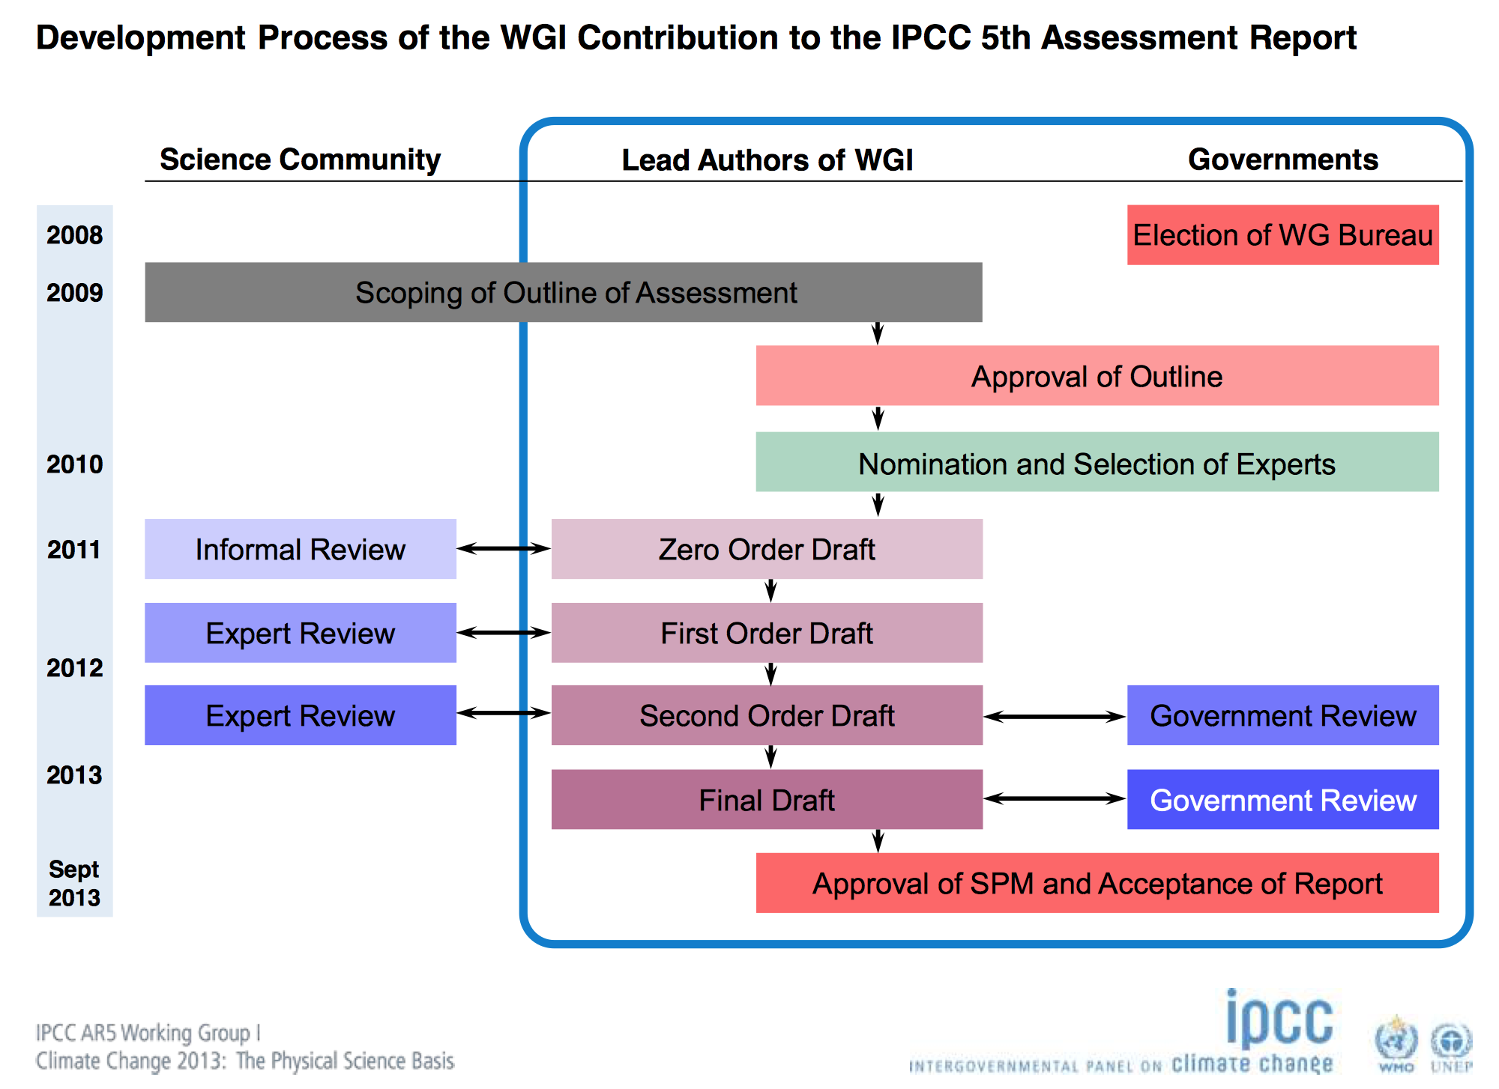
“The role of the IPCC is to assess on a
comprehensive, objective, open and transparent
basis the…information relevant to understanding the scientific basis of risk of human-induced climate change.”
—Principles Governing IPCC Work (2013)xxx
fulfill
responsibilities

Slide 29
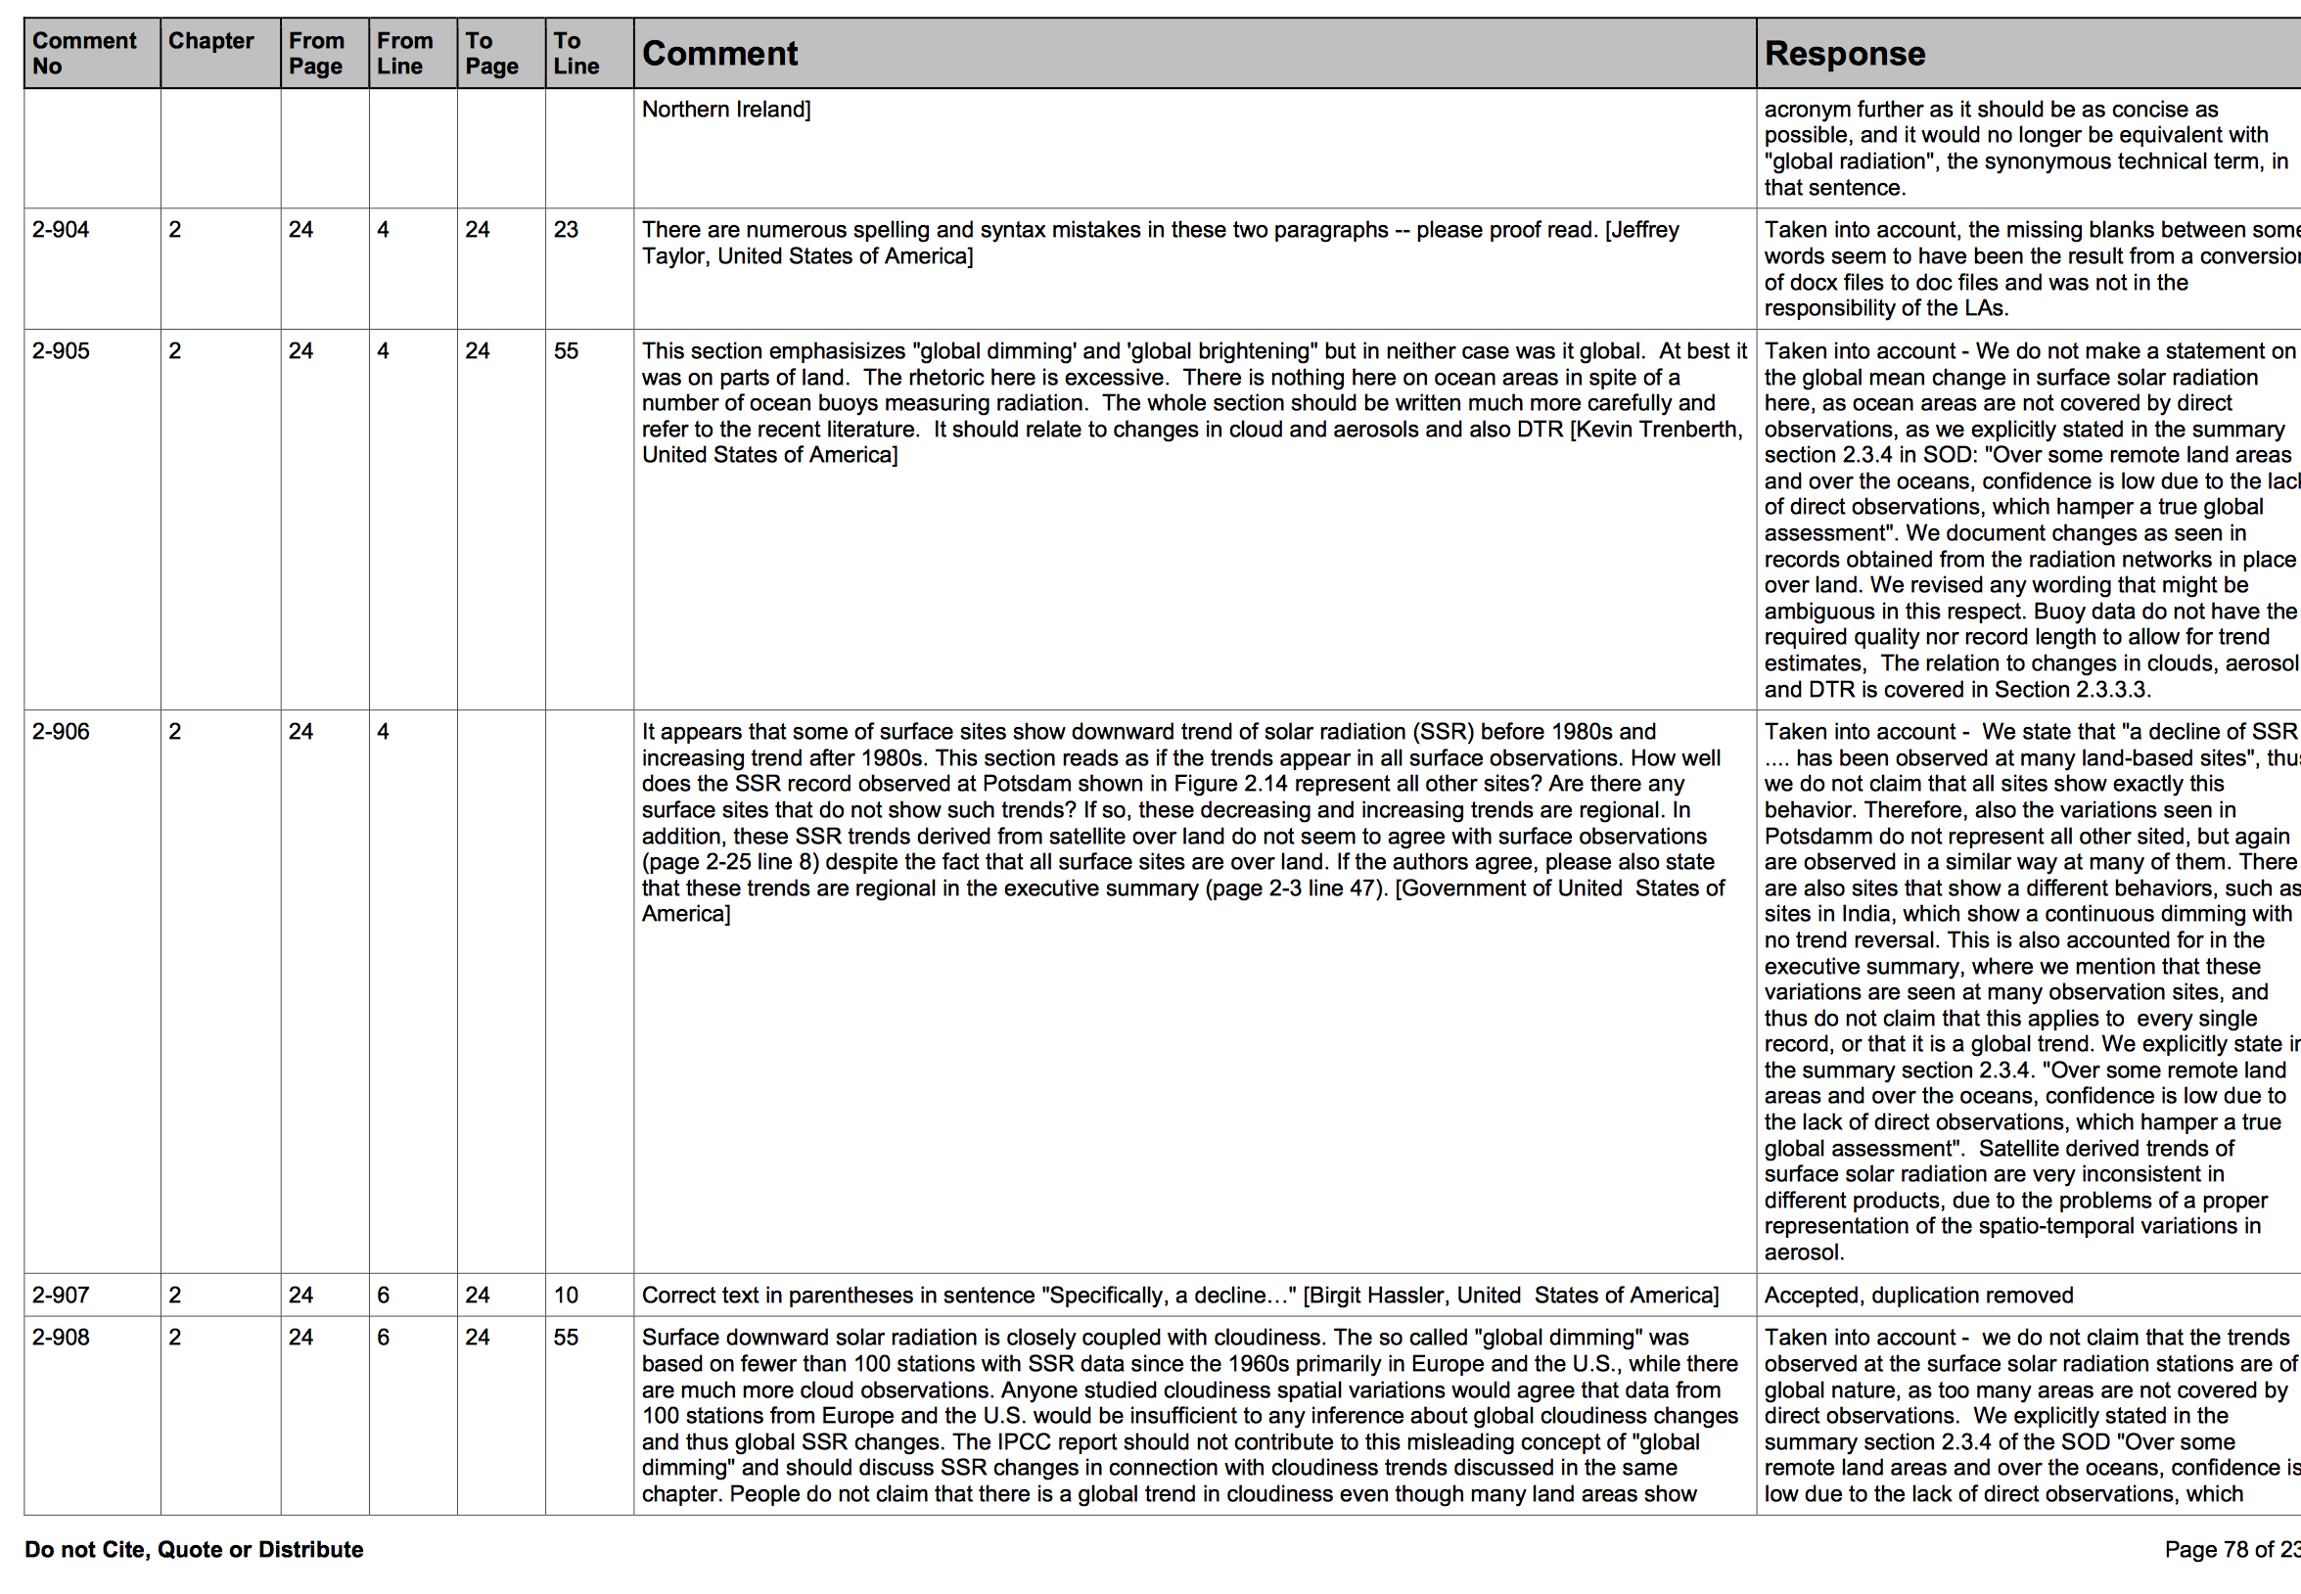
235 pages for one of two reviews for just this chapter

Slide 30
“The role of the IPCC is to assess on a
comprehensive, objective, open and transparent
basis the…information relevant to understanding the scientific basis of risk of human-induced climate change.”
—Principles Governing IPCC Work (2013)xxx
undertake
responsibilities
fulfill
responsibilities
Result: communication robust
against objections.

Slide 31
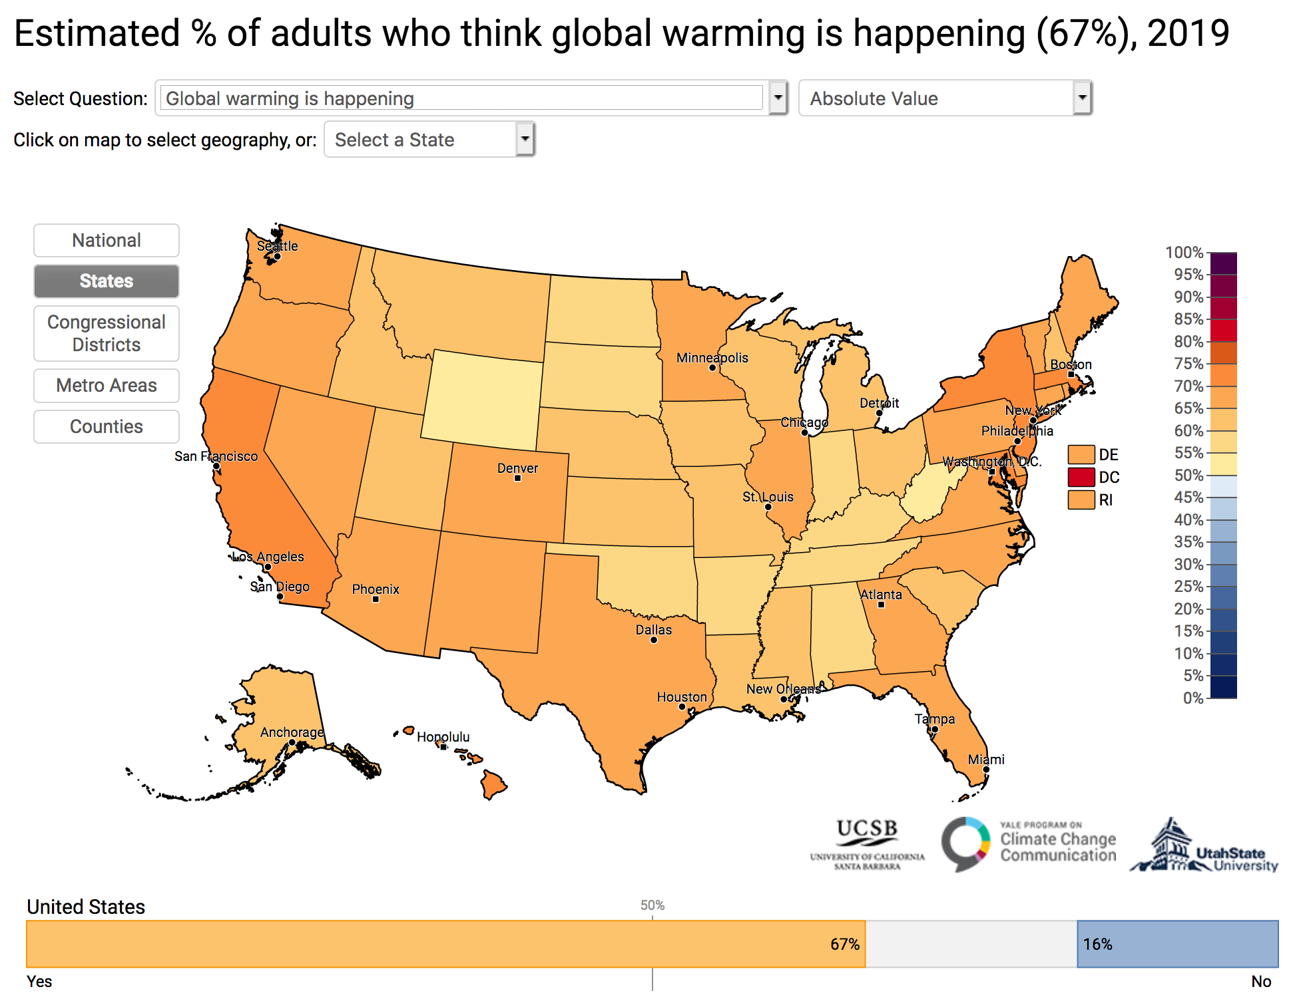
VA 69%
NC 66%
https://climatecommunication.yale.edu/visualizations-data/ycom-us/

Slide 32
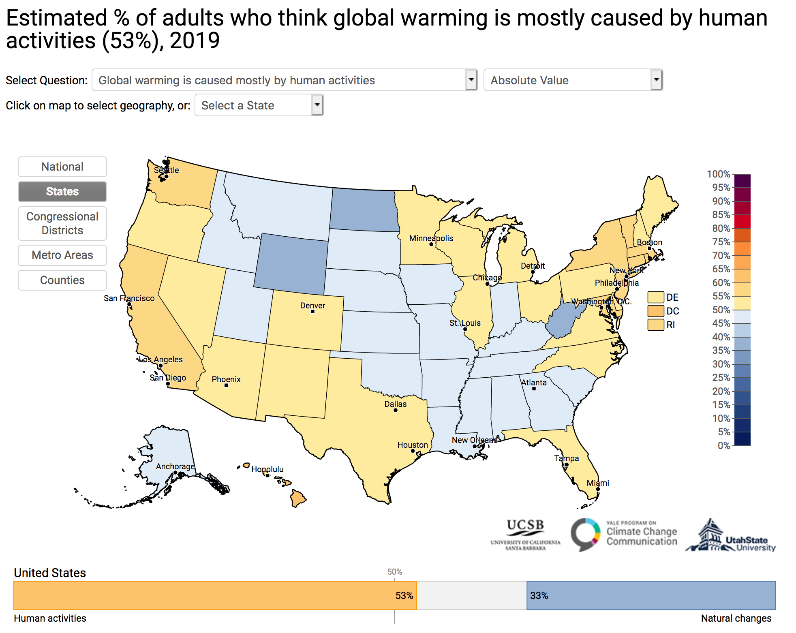
VA 55%
NC 51%
https://climatecommunication.yale.edu/visualizations-data/ycom-us/

Slide 33


Slide 35
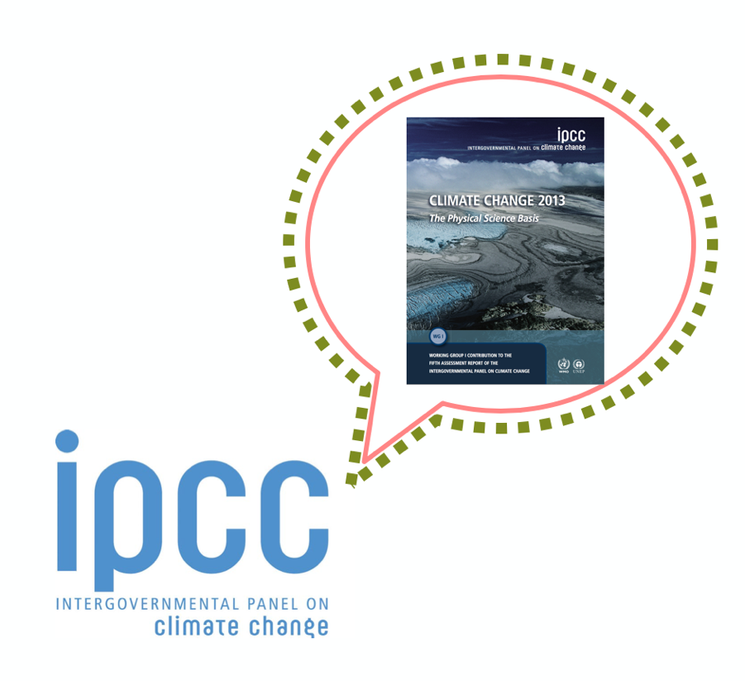
undertake
&
responsibilities
fulfill

Slide 36
undertake
&
responsibilities
fulfill
“artistic” ethos—
a document that creates conditions of trust for its own reception

Slide 37

“Information designers need to step back from the glow of the screen to see that they are not so much designing stand-alone information products as much as they are creating artifacts that enable relationships among people.”
Karen Schriver
In Albers, M. J., & Mazur, M. B. (Eds.). (2014). Content and complexity: information design in technical communication. Routledge.

Slide 38

ethics
form
function
climate
reporting
Genre

Slide 39

ethics
form
function
reporting
Genre

Slide 40
ethics
form
function
reporting
saying
proposing
advising
demanding
testifying
accusing
exhorting
gossiping
Genre

Slide 41
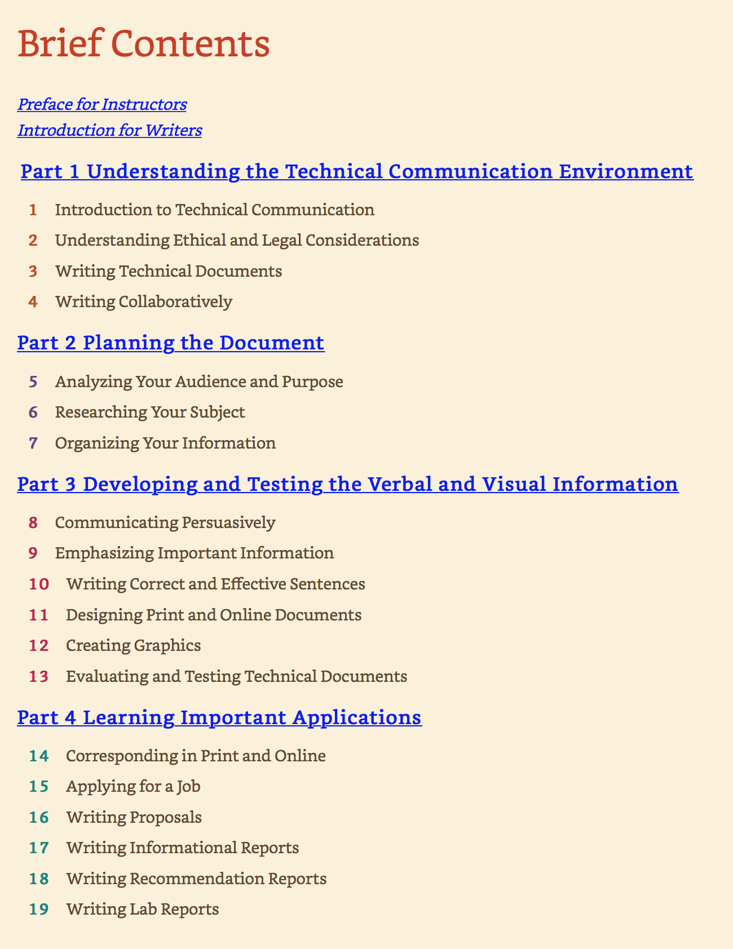
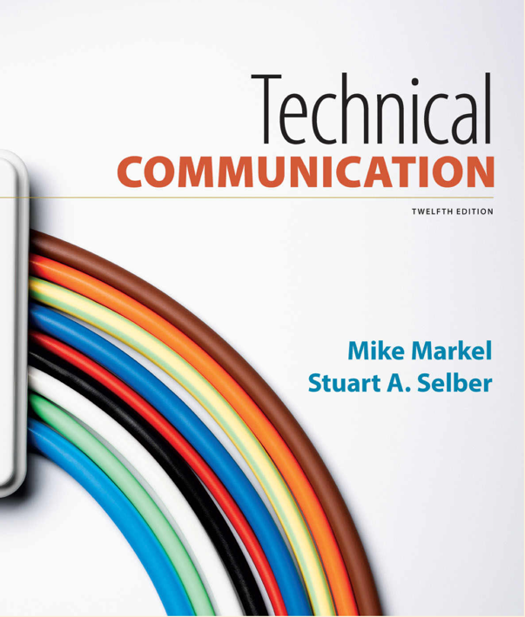
Ethics
Responsibilities

Slide 42
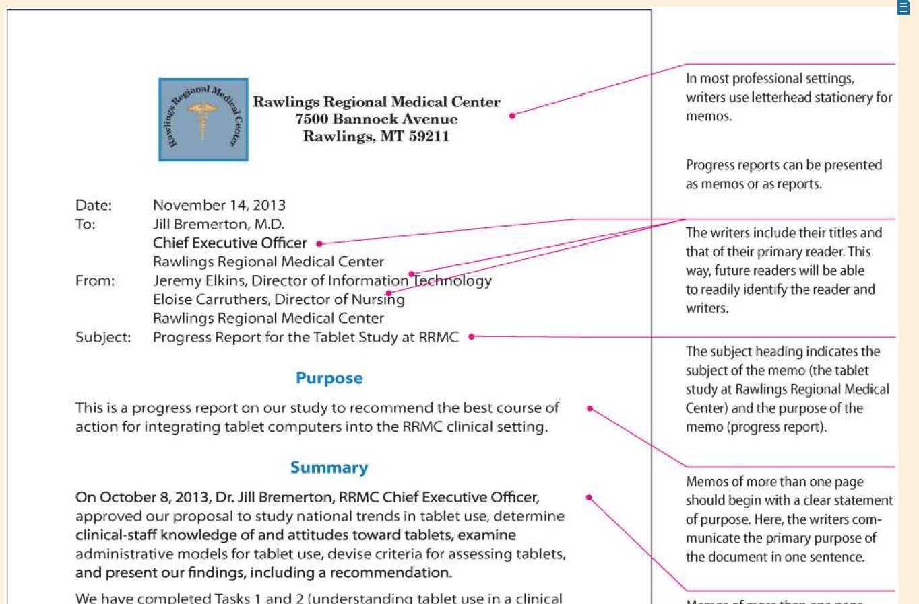

Slide 43
Undertaking, Promise,
Commitment

Slide 44
Ethical Responsibilities for Communicators in the Climate Debates
Jean Goodwin
SAS Institute Distinguished Professor
of Rhetoric & Technical Communication
jegoodwi@ncsu.edu

