Slide 1
Qualitative analytics & research justice

Slide 2
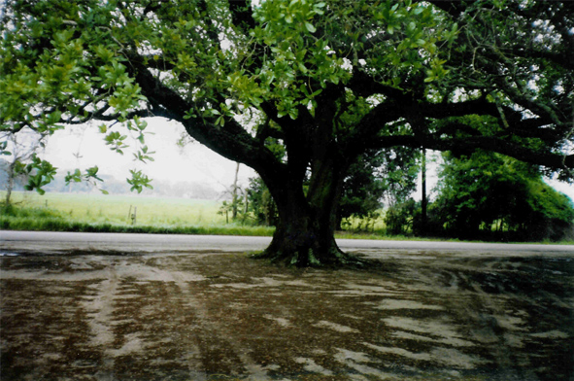
Lisa Melonçon, PhD
Professor, Technical Communication
Chair, Department of English
meloncon.research@gmail.com
803-370-0008
http://tek-ritr.com

Slide 3

what constitutes usable information in complex systems?
Notes:
Picking up on the specific question in the call that intersects with my own ongoing concerns about research methodologies, methods, and practices. I’ve been talking about these three things in every SCCI presentation I’ve given and since I was at the first one and have only missed one think that’s a lot of years focused on in depth reflection and reflexivity about something we all do.

Slide 4
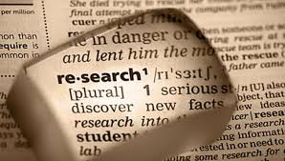
Notes:
Research in TPC Is split between 21% programmatic/pedagogical; 30% empirical; the remaining half is textual/rhetorical/theoretical. This analysis from 2011-2015 and the preliminary data from 2015-2020 aligns closely the same.
So as a field, we’ve relied on data a lot and have started to do more work with larger data sets. Some representative citations are
Frith, J. (2016). Big Data, Technical Communication, and the Smart City. Journal of Business and Technical Communication, 31(2), 168-187. https://doi.org/10.1177/1050651916682285
Boettger, R. K., & Palmer, L. A. (2010). Quantitative Content Analysis: Its Use in Technical Communication. IEEE Professional Communication, 53(4), 346-357. http://ieeexplore.ieee.org http://ieeexplore.ieee.org/xpls/abs_all.jsp?isnumber=5625052&arnumber=5625098
Graham, S. S., Kim, S.-Y., DeVasto, D. M., & Keith, W. (2015). Statistical Genre Analysis: Toward Big Data Methodologies in Technical Communication. Technical Communication Quarterly, 24(1), 70-104. https://doi.org/10.1080/10572252.2015.975955
Also see the Journal of Writing Analytics
See too the https://www.manifestno.com, which is a feminist look at data that is vitally important.
Walter, M., & Andersen, C. (2013/2016). Indigenous Statistics: A Quantitative Research Methodology. Routledge.

Slide 5

Big Data and analytics in TPC
Notes:
To simultaneously build and expand on on this type of research, TPC needs to consider new methodological approaches to how and to what we consider data and analytics.

Slide 6

what constitutes usable information in complex systems?
What does “usable information” mean as evidence in research?
Notes:
I’ve always taken the “complex systems” part of the work we do as teachers and scholars as a given since the majority of research is done within this framework and we are helping students learn how to interact within these frameworks. So for me the question shifted….

Slide 7

data
objective
Notes:
For some of us the evidence is data. Here I use data to mean both quantitative things, which it is usually associated with, but also textual data that we may code or interview data or narratives or anything that becomes part of our understanding of our research question and the results and findings.
This is an assumption or rather a guiding part of my own methodological orientation that will likely be met with mostly zero resistance here. Since information, data, and evidence is not objective but rather put together deliberately and (thoughtfully) for a convincing argument.
See Markham, A. N. (2013). Undermining 'data': A critical examination of a core term in scientific inquiry. First Monday, 18(10). http://journals.uic.edu/ojs/index.php/fm/article/view/4868
Also see http://medicalrhetoric.com/symposium2020/plenary-session/data/

Slide 8

Notes:
Two things happened that really made me start thinking of data differently.

Slide 9

Notes:
So while the first thing was related to a super micro-localized situation with student data and the ethics related to it.

Slide 10
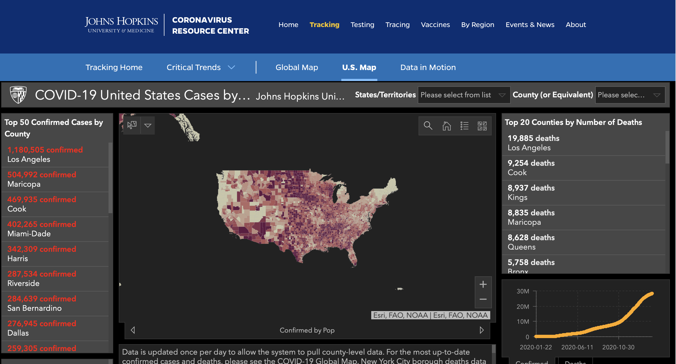
Notes:
The second is how general research questions and the answers to them can port across contexts. This is the johns Hopkins dashboard for COVID 19 data. And calling to mind the Voss Dragga study of ethical use of visuals and how that argument is foundational to the one I’m making. That is the need for a term in research to guide the ethical use and information design of data.

Slide 11
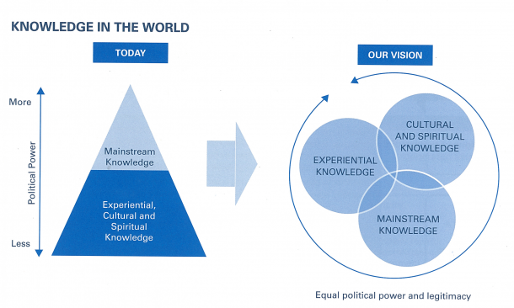
RESEARCH JUSTICE
Notes:
The history of the term research justice that I follow is one of he the Data Center: Research for Justice. This center forwarded ”research justice” as a “strategic framework and methodological intervention that seeks to transform structural inequities in research.” The framework is meant to shift the creation of knowledge production from one based in inequitable power structures to one is centered on justice and differing forms of evidence, data, and “knowledge.”
Image is from the Data Center: Research for Justice copyright in 2010
Jolivétte, A. J. (Ed.). (2015). Research Justice: Methodologies for social change. Polity Press.

Slide 12
makes academic and other authoritative knowledge relevant
democratizes research to what knowledge (read data) is legitimate and valid
Notes:
Research justice as a methodological framework that encompasses qualitative analytics ensure that
Eda, H. (2015). Disasgter justice: Mobilizing grassroots knowledge against diaster nationalism in Japan. In A. J. Jolivétte (Ed.), Research justice (pp. 95-108). Polity Press.
p. 106

Slide 13
Qualitative Analytics
Notes:
I first used this term out loud in Summer and Fall of 2018. I was struggling with why I kept pushing back so hard on some of the initial ideas for USF Write. While seemingly paradoxical it’s actually a term that brings into focus TPC’s long standing engagement with both humanistic and social science research methodologies. It highlights the necessity of a qualitative dimension within quantitative work.

Slide 14
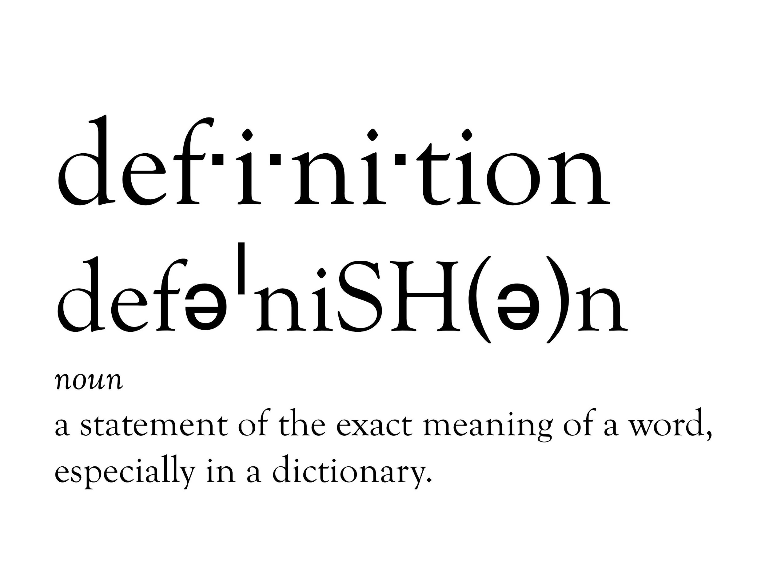

Slide 15
Analytics is the systematic computational analysis of data. It typically discovers meaningful patterns.

Slide 16
Qualitative…..
Concepts
Opinions
Experiences
Notes:
Typically means that researchers are working with non quantitative data. It also h
concepts, opinions, or experiences

Slide 17
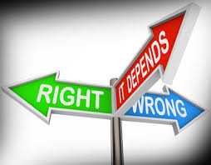
ethical praxis as situational, embodied, and relational
Notes:
And other ethical considerations related to data and analytics.
See for example ethical praxis as situational, embodied, and relational. Melonçon, L., Molloy, C., & scott, J. B. (2020). Ethics in praxis: Situational, embodied, relational. Rhetoric of health & medicine, 3(4), 430-436.
Aligns with qualitative analytics because of the contextual nature of ethics in practice

Slide 18
Qualitative Analytics
Is a methodological, ethical orientation that necessitates researchers consider and care for the embodied experiences that exist behind and in the analytic patterns of data.
Notes:
Is a methodological, ethical orientation that necessitates researchers consider and care for the embodied experiences that exist behind and in the analytic patterns of data.
Melonçon, 2021

Slide 19
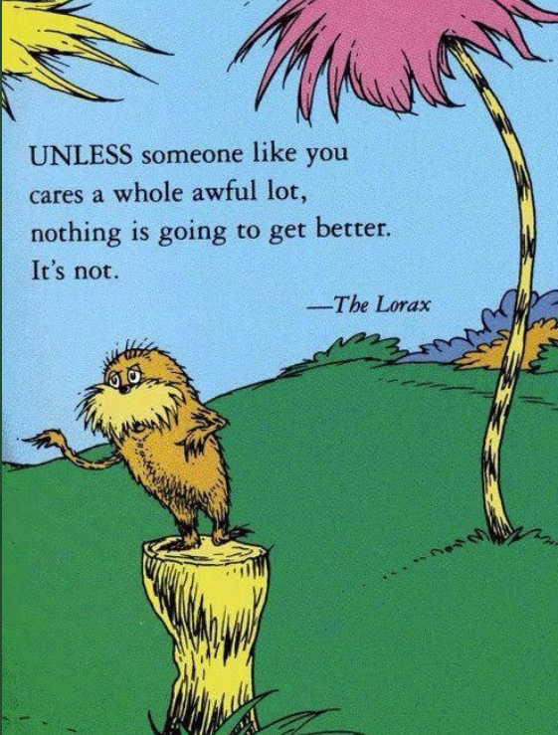
Qualitative Analytics
Becomes a form of
Research Justice

Slide 20
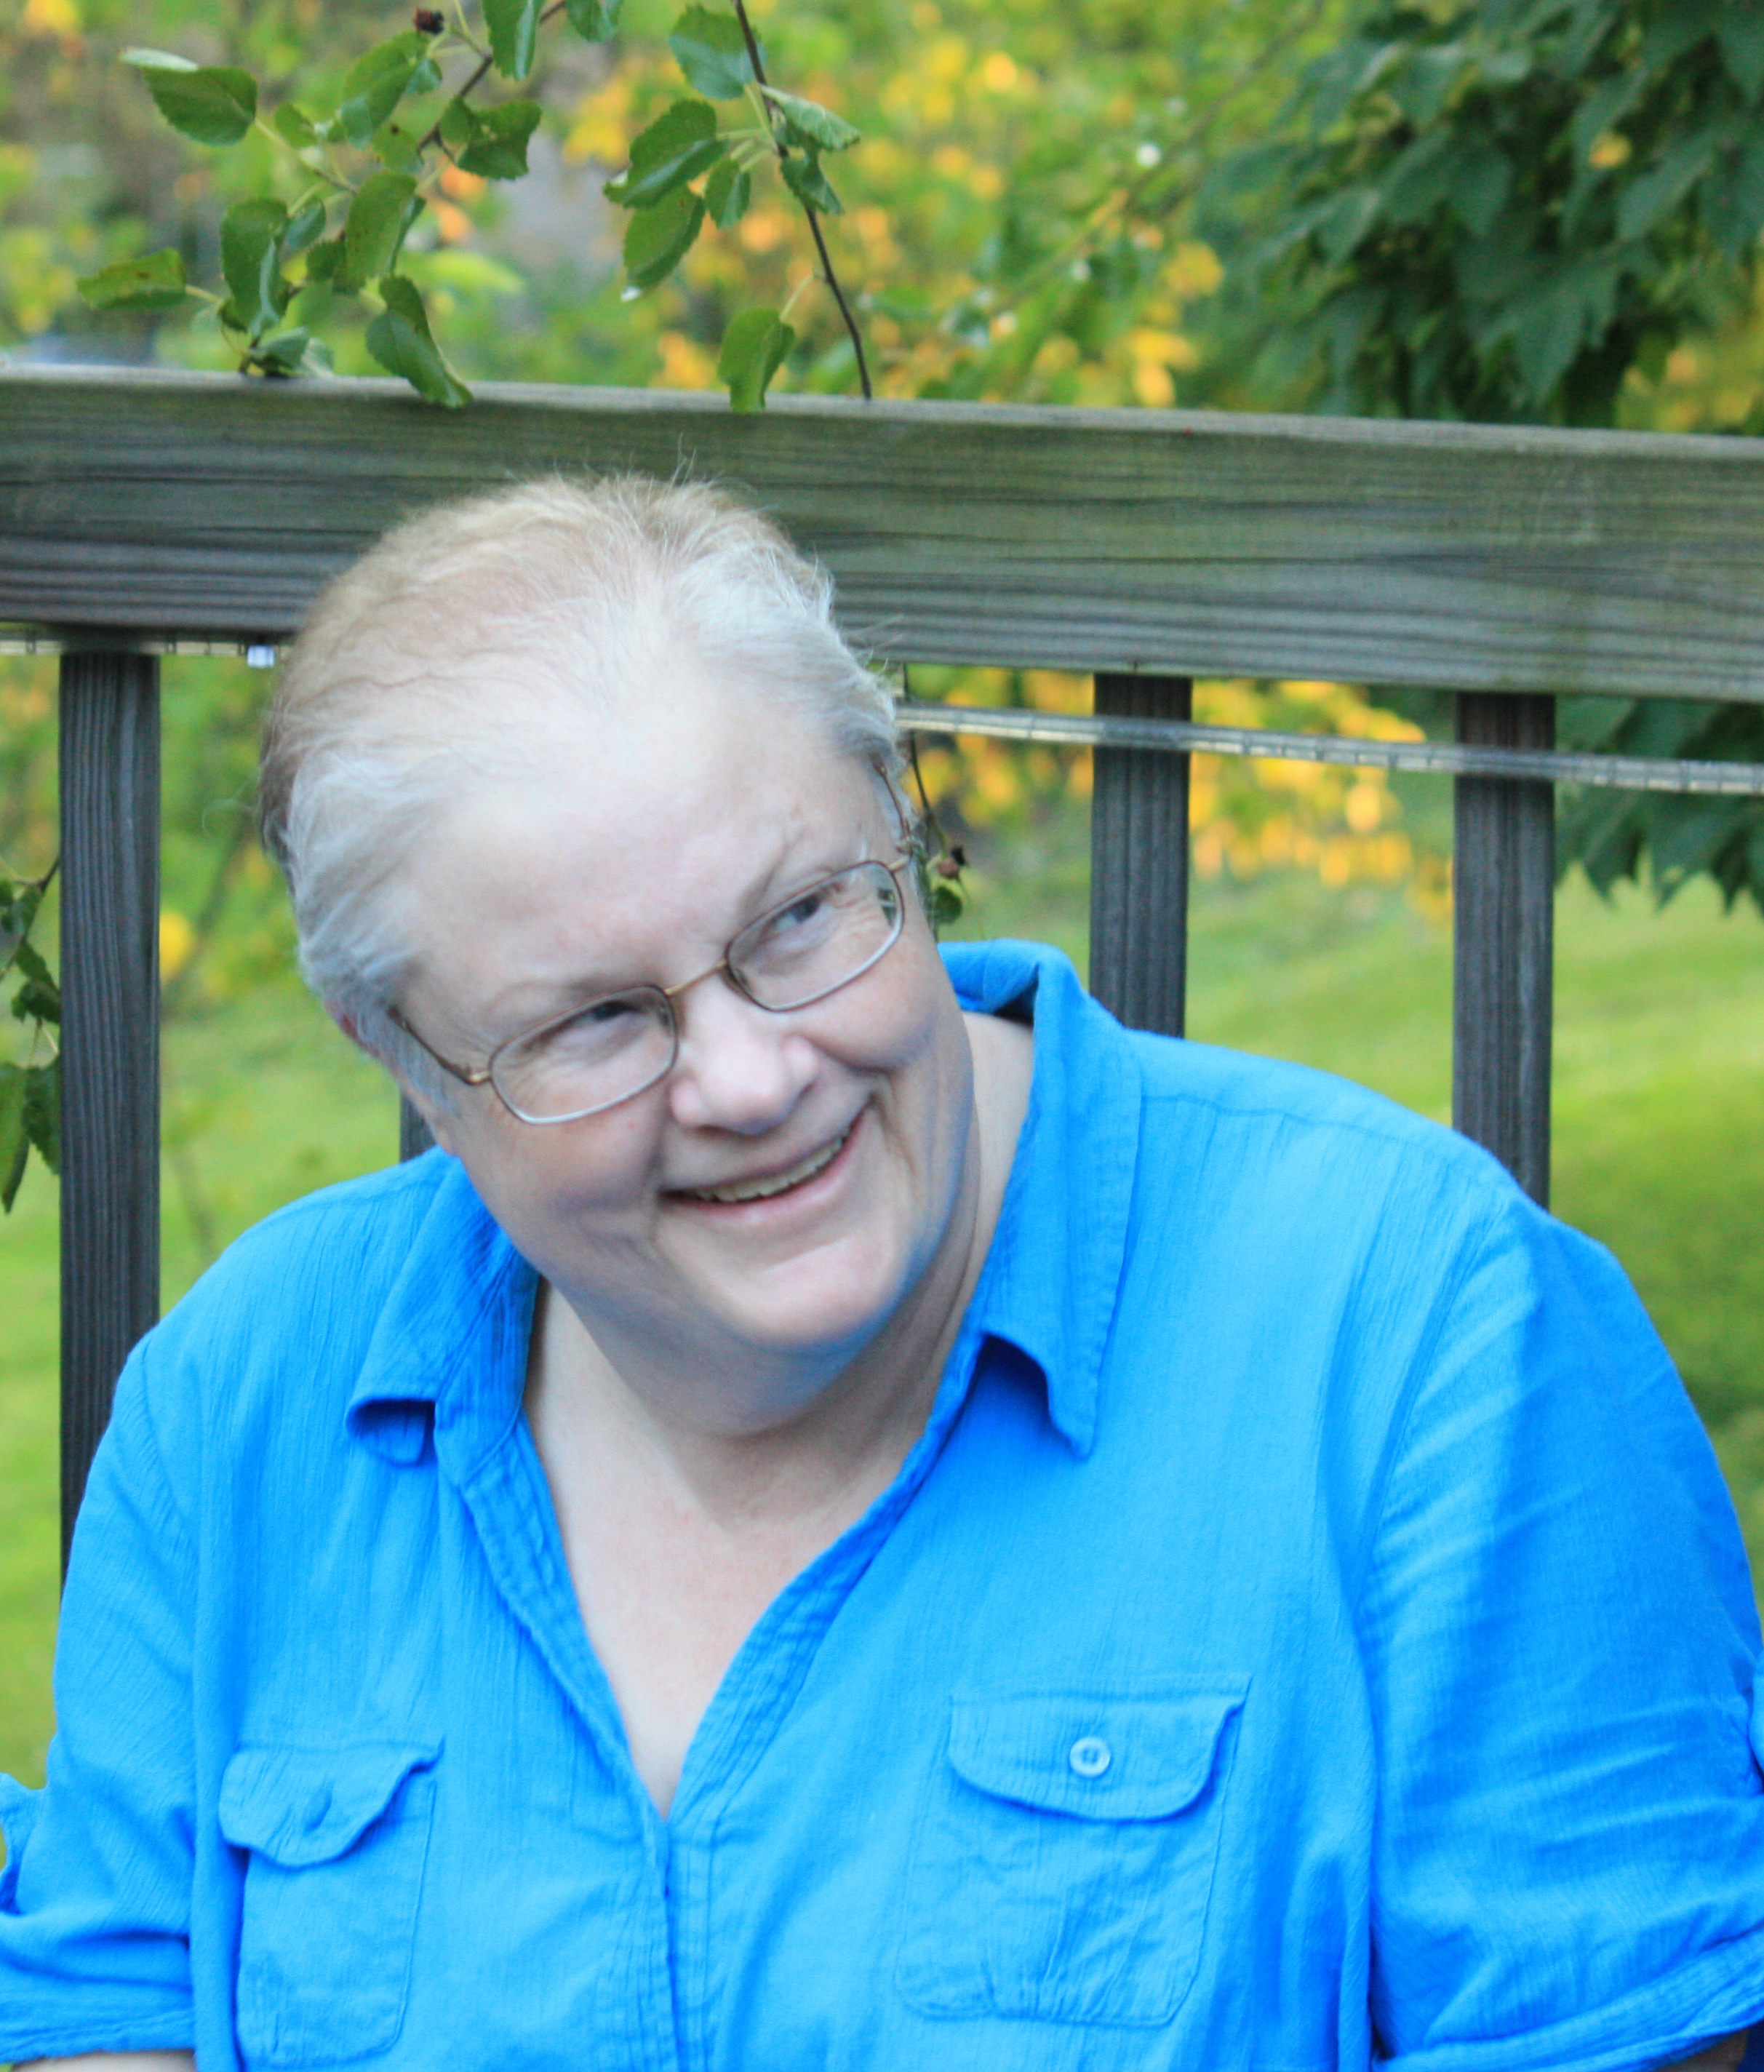
“what should guide our research choices is not simply an expectation of internal coherence, but a self-conscious reflection as to their consequences as well”
Notes:
Debs, Mary Beth. (1993). Reflexive and reflective tensions: Considering research methods from writing-related fields. In Rachel Spilka (Ed.),
Writing in the workplace: New research perspectives (pp. 238–252). Southern Illinois University Press.

Slide 21
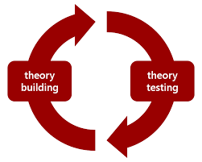
What does all this mean?
Expands research approach to analytics
Starts data gathering and analysis within a justice framework

Slide 22

Highlights research justice as a key framework into TPC
Expands approach to ethics within research practice
Notes:
- Shifting to inclusive participatory design makes clear distinction

Slide 23
Discussion Questions
What standards do you hold for evidence? When is data believable, reliable, or trustworthy to you and can you describe how you make those decisions?
What do you see as the strengths and barriers of a term and application of qualitative analytics?
How might qualitative analytics expand user experience research, particularly participatory and community led research practices?
Notes:
Questions for participants to consider about the content presented.

Slide 24

Notes:
Questions or comments about the concepts and ideas presented.

Slide 25
LISA MELONÇON
MELONCON.RESEARCH@GMAIL.COM

