Slide 1
Florida’s COVID-19 Data and Surveillance Dashboard
JD Applen
University of Central Florida
Department of English

Slide 2
Rebekah Jones was dismissed from her position as architect of Florida’s COVID-19 Data and Surveillance Dashboard for “insubordination” because she refused to alter several datasets.
Asked to manipulate data to show that there was a 10% positive rating or less for tests when there was an 18% positive rating at the time of her firing. This would allow Florida officials to open some counties up again. At the time of Jones’ firing, the Florida DOH COVID-19 website only showed that 2 of the 67 counties in Florida had met the 10% number.

Slide 3
Rebekah Jones’ Background was not that of an epidemiologist. Instead,
She is Ph.D. Candidate in the Department of Geography at Florida State University.
Masters from LSU in Geography and Mass Communications, Cum Laude.
Syracuse University, BA Geography, Newspaper and Online Journalism, Cum Laude.
Global Information Systems (GIS) Certification Insitute. GISCI Certificate.
“Jones said that her website ‘will always be under construction,’ and ‘we look forward to hearing from the community about what they would like to see on their dashboard.’”

Slide 4
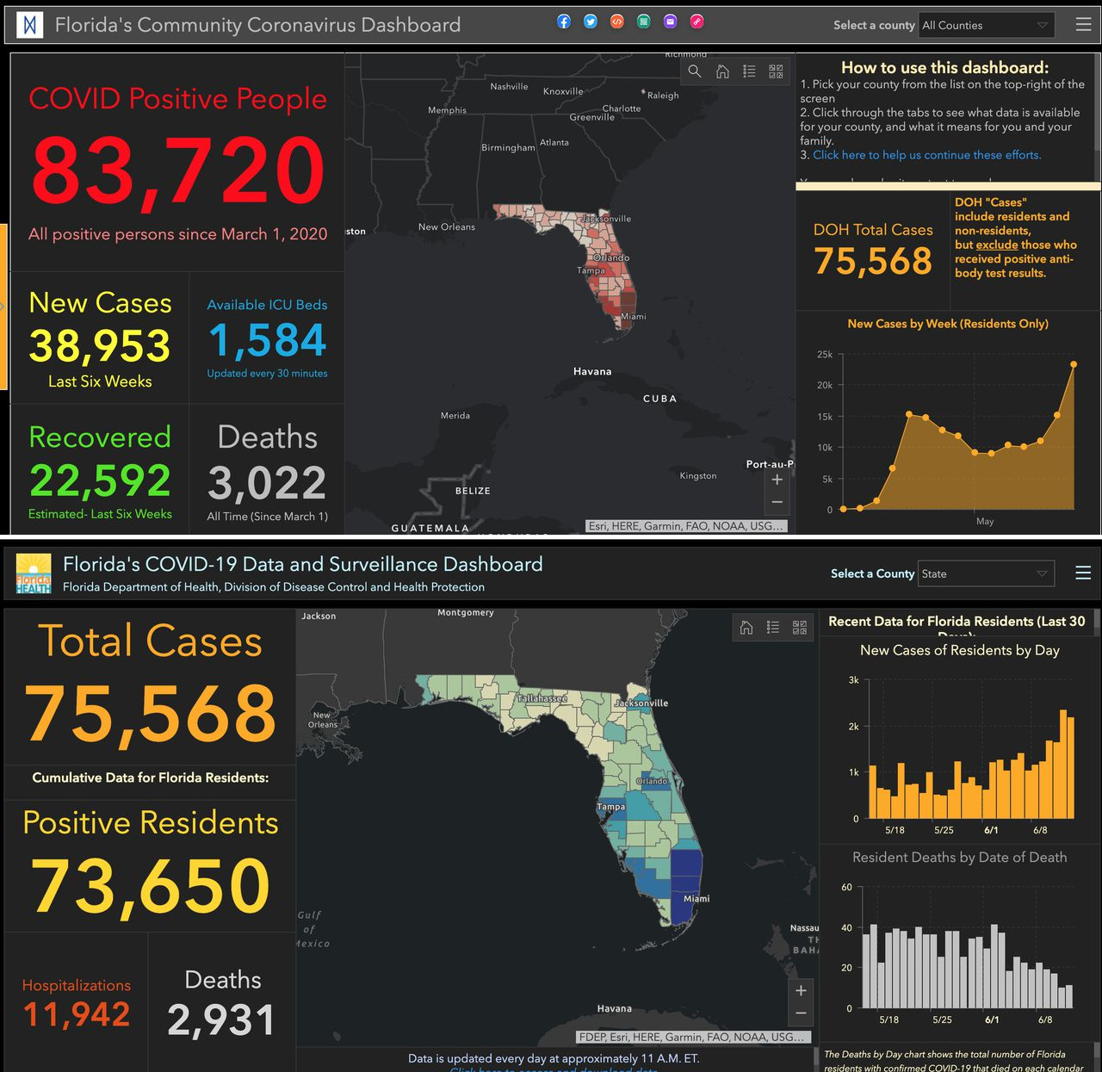

Slide 5
Jones thought that it was misleading to count people who were tested multiple times for COVID as one unique individual, whereas others did as this practice indicated fewer positive results in the overall population.
The State of Florida used the phrase “total people tested” to indicate how many tests were actually provided (NPR).
Con: This makes it sound like more individual Floridians overall were tested and received negative results. Someone could get tested three times and counted as three individual Floridians, not one. This would imply that a smaller proportion of all Floridians had COVID.

Slide 6
Jones thought that those tested positive for the COVID antibodies should be included with the positive tests for the virus,
Pro: Jones says the state’s numbers are lower because "cases are not currently created for those who receive positive antibody test results, and so DOH excludes them from that total. We show the total number of people who have definitive lab results showing they have or have had Covid-19 regardless of the type of test.”
Con: It is misleading. Viral counts indicate current infections. Antibody positives indicate previous infections.

Slide 7
In recording deaths from COVID, non-residents who die or are hospitalized in Florida should be counted, not just in-state residents, according to Jones.
Pro: Many out-of-state residents live in Florida for many months. Counting in-state and out-of-state residents is a more accurate reflection of Florida’s overall population.
Con: When an out-of-state resident dies in Florida passes away from COVID, their death might be recorded in two states.

Slide 8
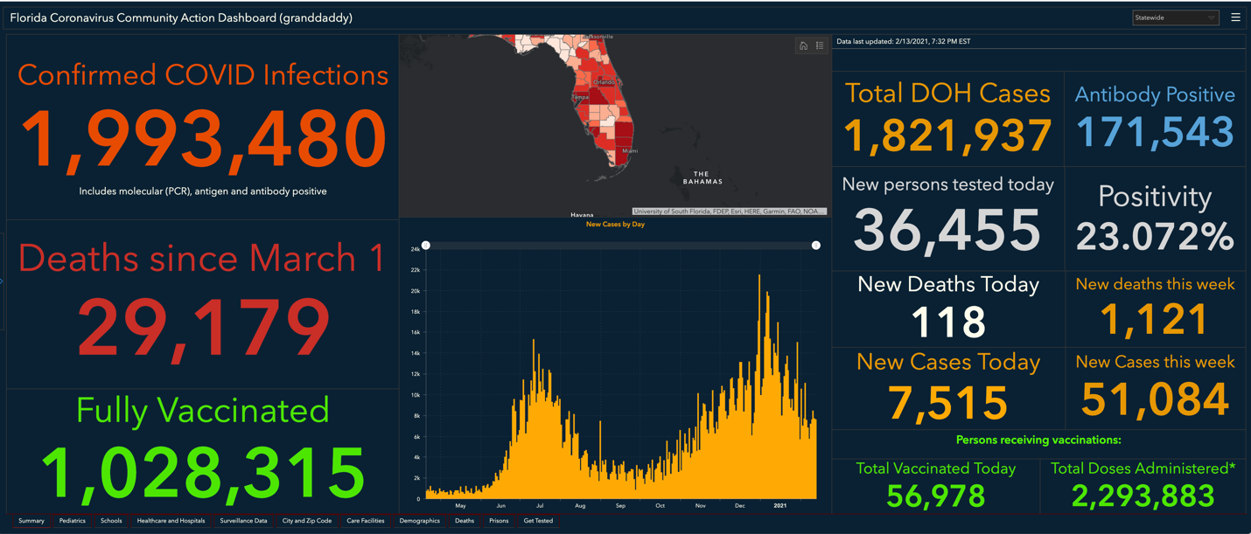

Slide 9
By applying Graham’s functional stasis analysis to the events that led to Jones’ dismissal, can we identify the essential data involved and then learn how to communicate it by unpacking the discursive movement between the public, technologists, and politicians.
. . . . typical taxonomic approach to stasis theory is structural—it isolates individual stases from the flow of the argument. . . . . functional stasis analysis seeks to capture the dynamic and often nested relationship among stases within the flow of debate. (S. Scott Graham p. 143, 2015)

Slide 10
Annemarie Mol
“I investigate knowledge incorporated in daily events and activities rather than knowledge articulated in words and images and printed on paper” (Mol 32).
“. . . . if an object is real it is because it is part of a practice: it is a reality enacted” (Mol 44).
When a clinician enacts arteriosclerosis, they are asking about and considering symptoms that a patient tells them about.
When a pathologist enacts arteriosclerosis, it is through looking a cross section of an artery that might be clogged.

Slide 11
By examining the practices that Jones enacted as a data scientist as opposed to a trained epidemiologist, what Danielle DeVasto would call “referred” expertise, or “expertise at one remove” (2015), we can look at her actions and the enactments of others affected how they communicated complex information.
In Jones’ case, her practice, the way she did epidemiology was presenting information as her experience as a geographer, journalist, and data scientist.

Slide 12
Questions
How might different stakeholders and professionals work together to understand how to identify essential risk assessment data when they occupy different professional spaces?
How might one’s politics get in the way of a scientific judgment?
How might one’s obligation to the public be built into deciding what kinds of information should be conveyed to the public?
How can individuals work together to define what is meant by usability/ user experience and what constitutes usable information in complex systems?

