Slide 1

Employing a Mixed-methods Approach to Examine Multiple Usabilities that Shape UX
10th Annual
Symposium on Communicating Complex Information
By, Jessica Lynn Campbell

Slide 2







Usability
Usability metrics
Effectiveness
Efficiency
Satisfaction
Usability dimensions
Content and information provided
User interface / delivery medium

Slide 3
User Experience (UX)
“’User experience’ encompasses all aspects of the end-user's interaction with the company, its services, and its products.”
-Don Norman and Jakob Nielsen

Slide 4
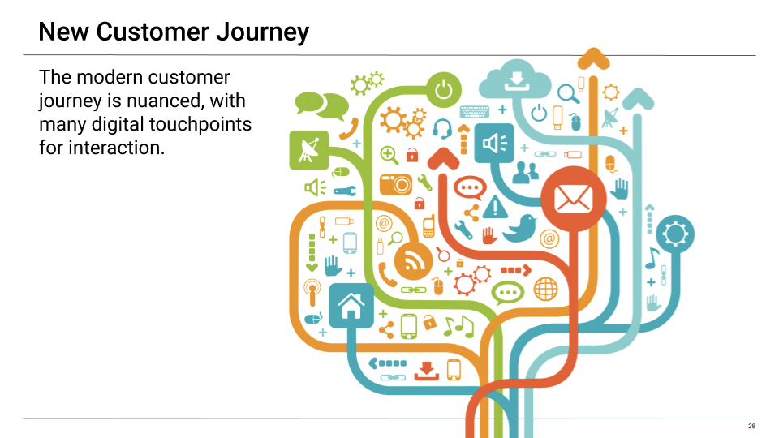
User Experience (UX)
User Experience (UX) Processes
The UX is nuanced with multiple digital touch points and interactions between humans and technology.
Each individual component of UX can (and should) be evaluated for usability.

Slide 5
Multiple Usabilites Shape UX
Usability qualities – these are taken from the definition of usability:
  Effectiveness
  Efficiency
  User satisfaction
Usability dimensions – these are values of the artifact or object of one’s investigation:
  Content / information provided
  User interface
UX components – these are the processes or series of encounters and interactions that users have with various stakeholders and technologies that are designed by the service provider that provide the foundational basis of a user experience. Every touch point or interaction a user has with technology or a human is an opportunity for usability to be assessed.

Slide 6
Key Steps to Designing a Mixed-methods Usability Study
Develop your research questions: What insight do you want to gain by evaluating usability? How will you apply your findings? What are the implications of your study?
Define the usability variables of inquiry: What qualities, dimensions, or processes do you want to evaluate?
Identify usability metrics: How will you measure usability? What data will you collect? Will you collect quantitative or qualitative data? How will you analyze the data? How do you consider usability success?
Select the most suitable, feasible, and valuable usability testing methods that will allow you to capture the usability metrics you desire.
Use, reuse, modify, innovate usability testing methods that are best suited for your object of analysis.

Slide 7
Benefits of Mixed-methods
Rigor of Research
Allows researchers the flexibility to select and/or modify the best methods for their particular study.
Encourages interdisciplinary research.
Encourages continuous usability improvement via iterative design processes.
Implications of Findings
Gain a more holistic understanding of usability.
Ability to identify specific areas or functions where usability problems occur.
Ability to better depict the impact of usability on UX.
Ability to triangulate data.

Slide 8
Here’s Just 1 Mixed-methods Framework for Evaluating Usability
Research Questions
What rhetorical content, information, and design strategies are currently used in telemedicine interfaces?
When described a particular health-related scenario, in what context of use are potential telemedicine users most likely to access a specific telemedicine communication? Put another way, where might a potential telemedicine user be when accessing the telemedicine provider website, and where might a potential telemedicine user be when accessing the telemedicine provider mobile interface?
How effective and usable are telemedicine interfaces and communications from the consumer perspective? Are users able to find and comprehend the information they need to perform certain actions and activities?
How likely are potential telemedicine users to access and use a telemedicine service following their interaction with and engagement with the telemedicine providers’ communications?
Are potential telemedicine users able to perform a telemedicine consultation following their interaction with the telemedicine provider communication or interface? Which telemedicine provider communication is most effective at mediating users’ activities to reach the goal of performing a telemedicine consultation?
1. Content Analysis
2. Remote Usability Study (using a Survey)
3. Think Aloud Usability Testing (+ Retrospective User Satisfaction Questionnaire)

Slide 9

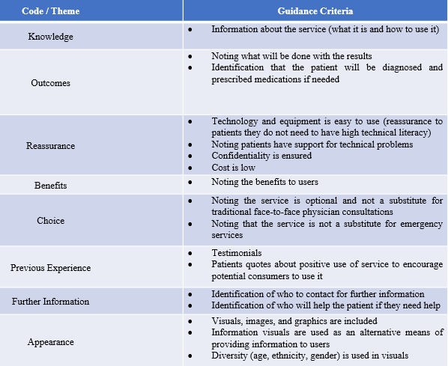

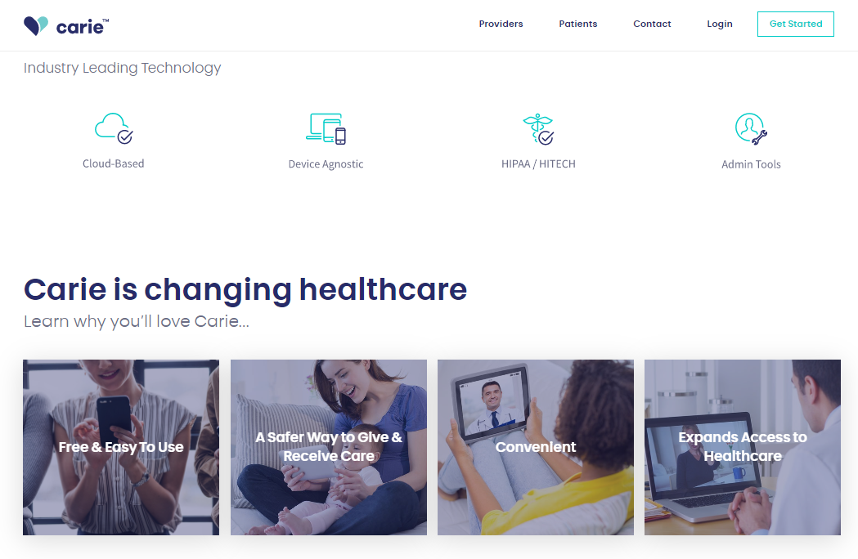



Methods – Part 1 – Content Analysis
Units of Analysis
Codebook
+ = Yes / - = No
+
Benefits
# of screen transitions
Readability = 6th grade or less!

Slide 10
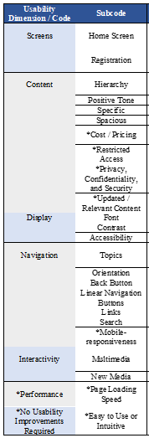
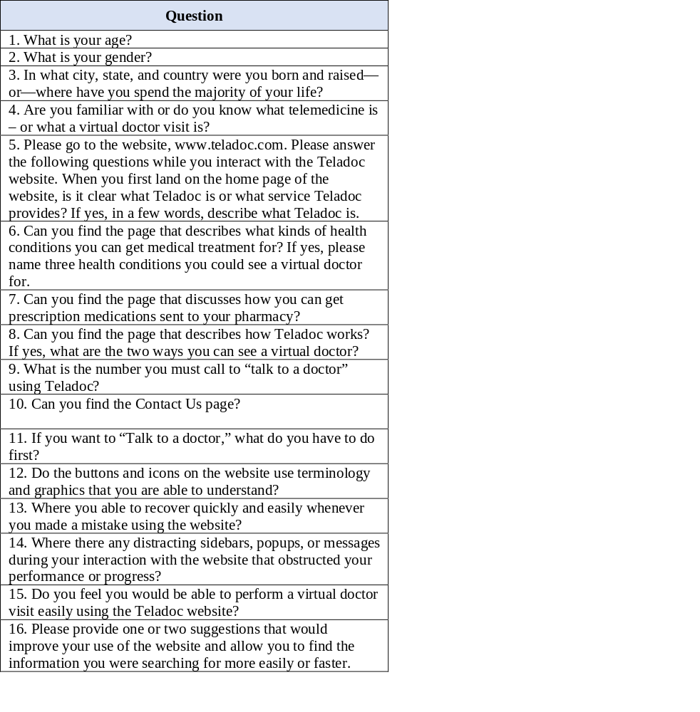
Methods – Part 2 – Remote Usability Testing
Examples
Recruited 50 participants from Amazon Mechanical Turk
  Large, heterogenous population
Developed a Telemedicine Website Usability Survey (TWUS)
  Representative tasks a part of the activity system
Measured Task Completion Success
Participants offered suggestions to improve the usability
Example of User Feedback
Home Screen – “Maybe making the member and businesses section separate from another instead of all kind of mixed together on the home page.”

Slide 11
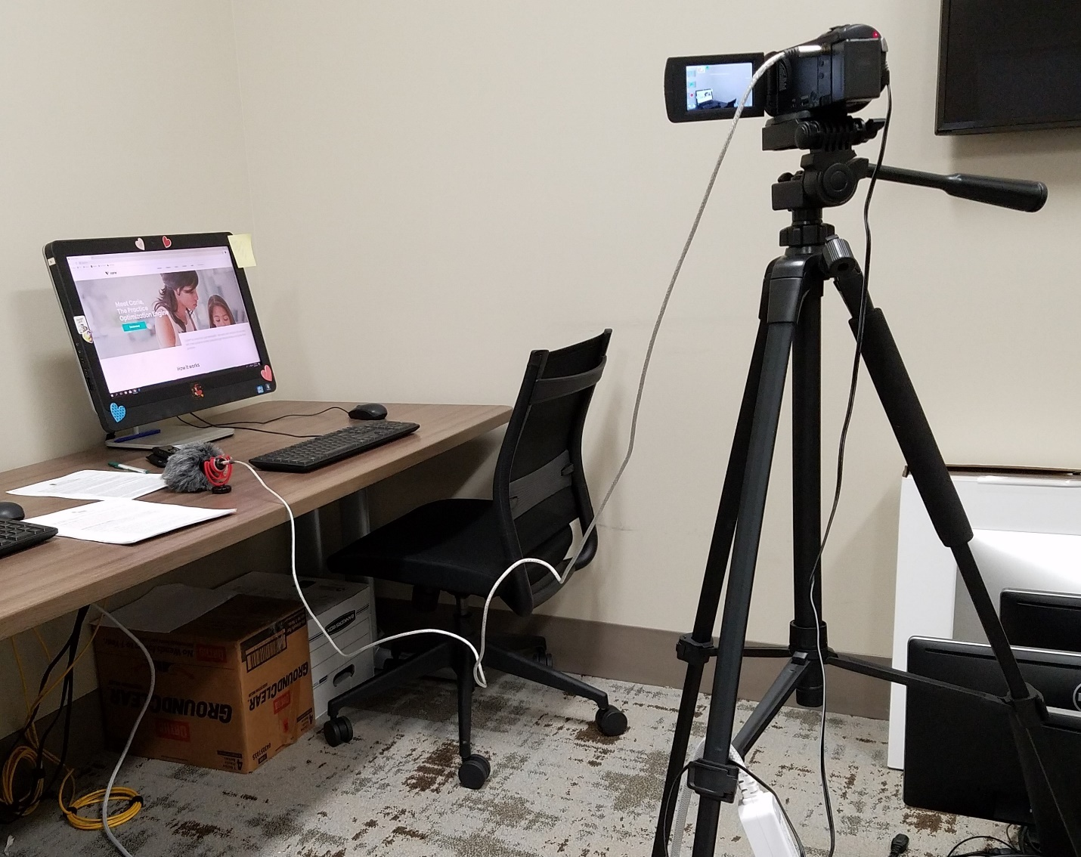
Methods – Part 3 – Think Aloud Usability Testing
Think alouds allow one to understand users’ cognitive processes as they interact with technology and is a way to identify usability problems.
Selection of representative users
  Undergraduate students (feasible)
Selection of context (study environment)
  Computer laboratory at UCF
Study Design
  Between subjects

Slide 12

Methods – Part 3 – Think Aloud Usability Testing
Selection of Units of Analysis
  2 Variables = Context of Use
Selection of representative tasks
  Illness vignettes
Video and Audio Recordings and Data Analysis in Nvivo
  Coding of usability issues
Retrospective Telemedicine Interface Usability Questionnaire (TIUQ)
  User satisfaction
Navigation - I’m not exactly sure how to find if my criteria meets the health conditions. I'll try the Frequently Asked Questions.
Desktop Computer
Smartphone

Slide 13
Key Takeaways for Usability Practitioners & Researchers
Mixed-methods are optimal for usability studies:
Develop your research questions.
Define the usability variables of inquiry.
Identify usability metrics.
Select the most suitable, feasible, and valuable usability testing methods.
Leverage interdisciplinary theories and methods and adapt your testing approach in order to be able to gain the most useful insight.

Slide 14
Questions for Discussion
What methods would complement one another in a usability study?
Given the need to collapse barriers between academic research and industry practices, how can we (as an academic/technical communicator community) form strong connections with industry practitioners to be able to collaborate to perform UX/usability research?
What other disciplinary insight can we draw from to perform more rigorous investigations?
Contact: jessicalynn@embarqmail.com or jessicalynncampbell1@gmail.com

