Slide 1
Comparing COVID-19 Messaging between Public Health Twitter Accounts and African American Organizations in the Southeast
Cristy Kennedy & Sara Doan, Ph.D. | Kennesaw State University
SCCI | February 22, 2021

Slide 2
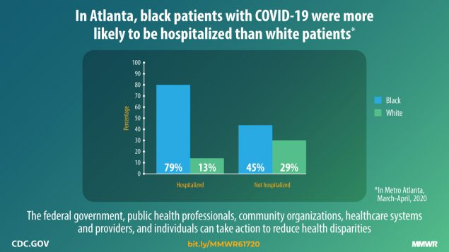
During COVID-19, African Americans in the United States have seen hospitalization rates three times higher than the national average (Soucheray, 2020).
Notes:
6925e1.COVID-19 Racial Disparity: African Americans May End Up In Hospital More Often : Coronavirus Updates
https://www.kff.org/report-section/covid-19-racial-disparities-in-testing-infection-hospitalization-and-death-analysis-of-epic-patient-data-issue-brief/
Characteristics Associated with Hospitalization Among Patients with COVID-19 — Metropolitan Atlanta, Georgia, March–April 2020 | MMWR

Slide 3
Situating Our Project
African American communities rely heavily on social media sites such as Twitter for health information (Brown, 2019; Muvuka et al., 2020).
While Twitter has potential to spread misinformation about COVID-19, it also has potential to reach diverse audiences via state and public health organizations (Hope, 2020; Kouzy et al., 2020; Walwema, 2020).
Their communities have created personalized ecosystems for information regarding COVID-19 (González-Padilla & Tortolero-Blanco, 2020).

Slide 4
Research Questions
“What behavioral health messages about COVID-19 do African American men ages 18-24 find most credible and effective?”
“What changes can public health organizations implement when creating and distributing COVID-19 health information to better serve and connect with African American men ages 18-24?”

Slide 5
Data Collection
Data from Twitter was collected using specific keywords and by searching the most frequently visited health organizations in GA, AL, and SC.
African American health organizations were found using the keywords "Black," "African American," and "COVID-19."
Once data was collected it was categorized into three buckets; AA health organizations, public health organizations, and state health organizations.
The data was then analyzed using NVivo 12 software.

Slide 6
Findings: Round 1 Coding
African American health organizations on Twitter shared the common theme of clarifying misinformation and false theories about COVID-19 that were circulating within Black communities.
While public health organizations focused on prevention and spread, state health organizations focused on statistics and tips.​​
Although race-specific issues regarding COVID-19 were mentioned by African American health organizations, most accounts still used statistics from the CDC in the same manner as public and state health organizations.

Slide 7
Example: COVID Black on Twitter
With over 4,000 followers on Twitter, @COVIDBLK has created a "personalized ecosystem" (González-Padilla & Tortolero-Blanco, 2020) pertaining to COVID-19 in African American communities.
@COVIDBLK emphasizes the importance of vaccine rollout, while sharing infographics and statistics from public health agencies such as the CDC.
Users are constantly reminded that being young is not an effective form of disease prevention and that restaurants are still unsafe.
@COVIDBLK compares the United States' COVID-19 progress to other countries, stressing the importance of intersectionality within health information.

Slide 8
Next Steps
IRB approval for 3 focus groups with African American men on the KSU campus.
Connecting with data Dr. Doan collected with two psychology professors.

Slide 9
Discussion Questions
What health contributions have African American Twitter accounts made to their communities that state Twitter accounts could not have made?
What criteria would you use to assess posts promoting preventive health behaviors, especially in the Southeast?
How can social media sites prevent future miscommunication of health information even within small communities?

Slide 10
References
Brown, N. M. (2019). Methodological cyborg as black feminist technology: Constructing the social self using computational digital autoethnography and social media. Cultural Studies, Critical Methodologies, 19(1), 55–67. https://doi.org/10.1177/1532708617750178
González-Padilla, D. A., & Tortolero-Blanco, L. (2020). Social media influence in the COVID-19 Pandemic. International Braz j Urol, 46(suppl 1), 120–124. https://doi.org/10.1590/s1677-5538.ibju.2020.s121
Hope, L. (2020). Protecting pandemic conversations: Tracing Twitter’s evolving content policies during COVID-19. Journal of Business and Technical Communication, 105065192095839. https://doi.org/10.1177/1050651920958393
Kouzy, R., Abi Jaoude, J., Kraitem, A., El Alam, M. B., Karam, B., Adib, E., Zarka, J., Traboulsi, C., Akl, E., & Baddour, K. (2020). Coronavirus goes viral: Quantifying the COVID-19 misinformation epidemic on Twitter. Cureus. https://doi.org/10.7759/cureus.7255
Muvuka, B., Combs, R. M., Ayangeakaa, S. D., Ali, N. M., Wendel, M. L., & Jackson, T. (2020). Health literacy in African-American communities: Barriers and strategies. HLRP: Health Literacy Research and Practice, 4(3), e138–e143. https://doi.org/10.3928/24748307-20200617-01

Slide 11
References cont.d
Price-Haywood, E. G., Burton, J., Fort, D., & Seoane, L. (2020). Hospitalization and mortality among Black patients and white patients with Covid-19. New England Journal of Medicine, 382(26), 2534–2543. https://doi.org/10.1056/NEJMsa2011686
Soucheray, S. (2020, August 14). US blacks 3 times more likely than whites to get COVID-19. Center for Infectious Disease Research and Policy. https://www.cidrap.umn.edu/news-perspective/2020/08/us-blacks-3-times-more-likely-whites-get-covid-19
Walwema, J. (2020). The WHO Health Alert: Communicating a global pandemic with WhatsApp. Journal of Business and Technical Communication, 105065192095850. https://doi.org/10.1177/1050651920958507

