Slide 1
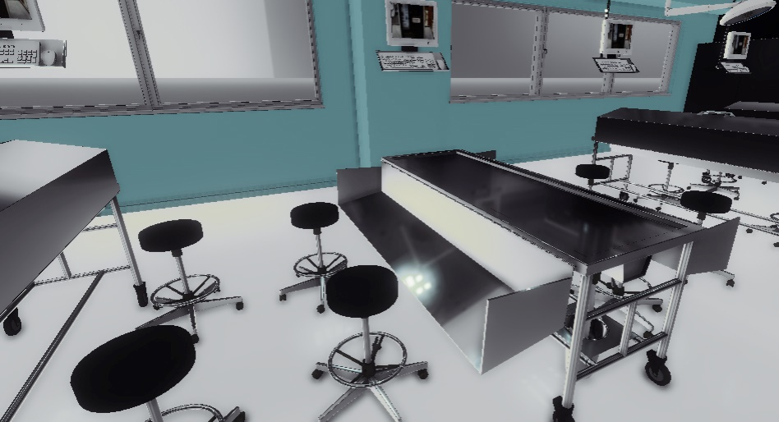
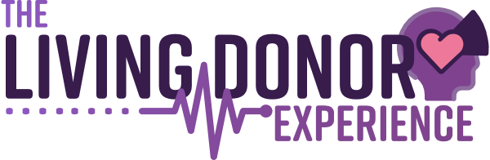




Designing Living Donor Narratives to engender Anatomy Lab Learner Empathy
Content Warning: This presentation includes discussions & depictions of deceased persons and bodies, dissection, and viscera within an educational laboratory setting.
Presenter: Carrie Elzie, PhD, Associate Professor of Pathology and Anatomy – EVMS
Co-Presenter: Holly Tenaglia, Doctor of Nursing Practice Student Researcher – VMASC
Co-Presenter: Alex Nielsen, Capabilities Lab Coordinator, Lead Project Scientist – VMASC

Slide 2
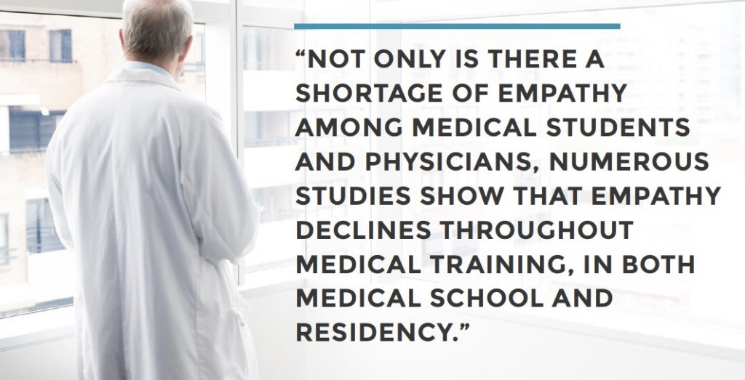

Slide 3
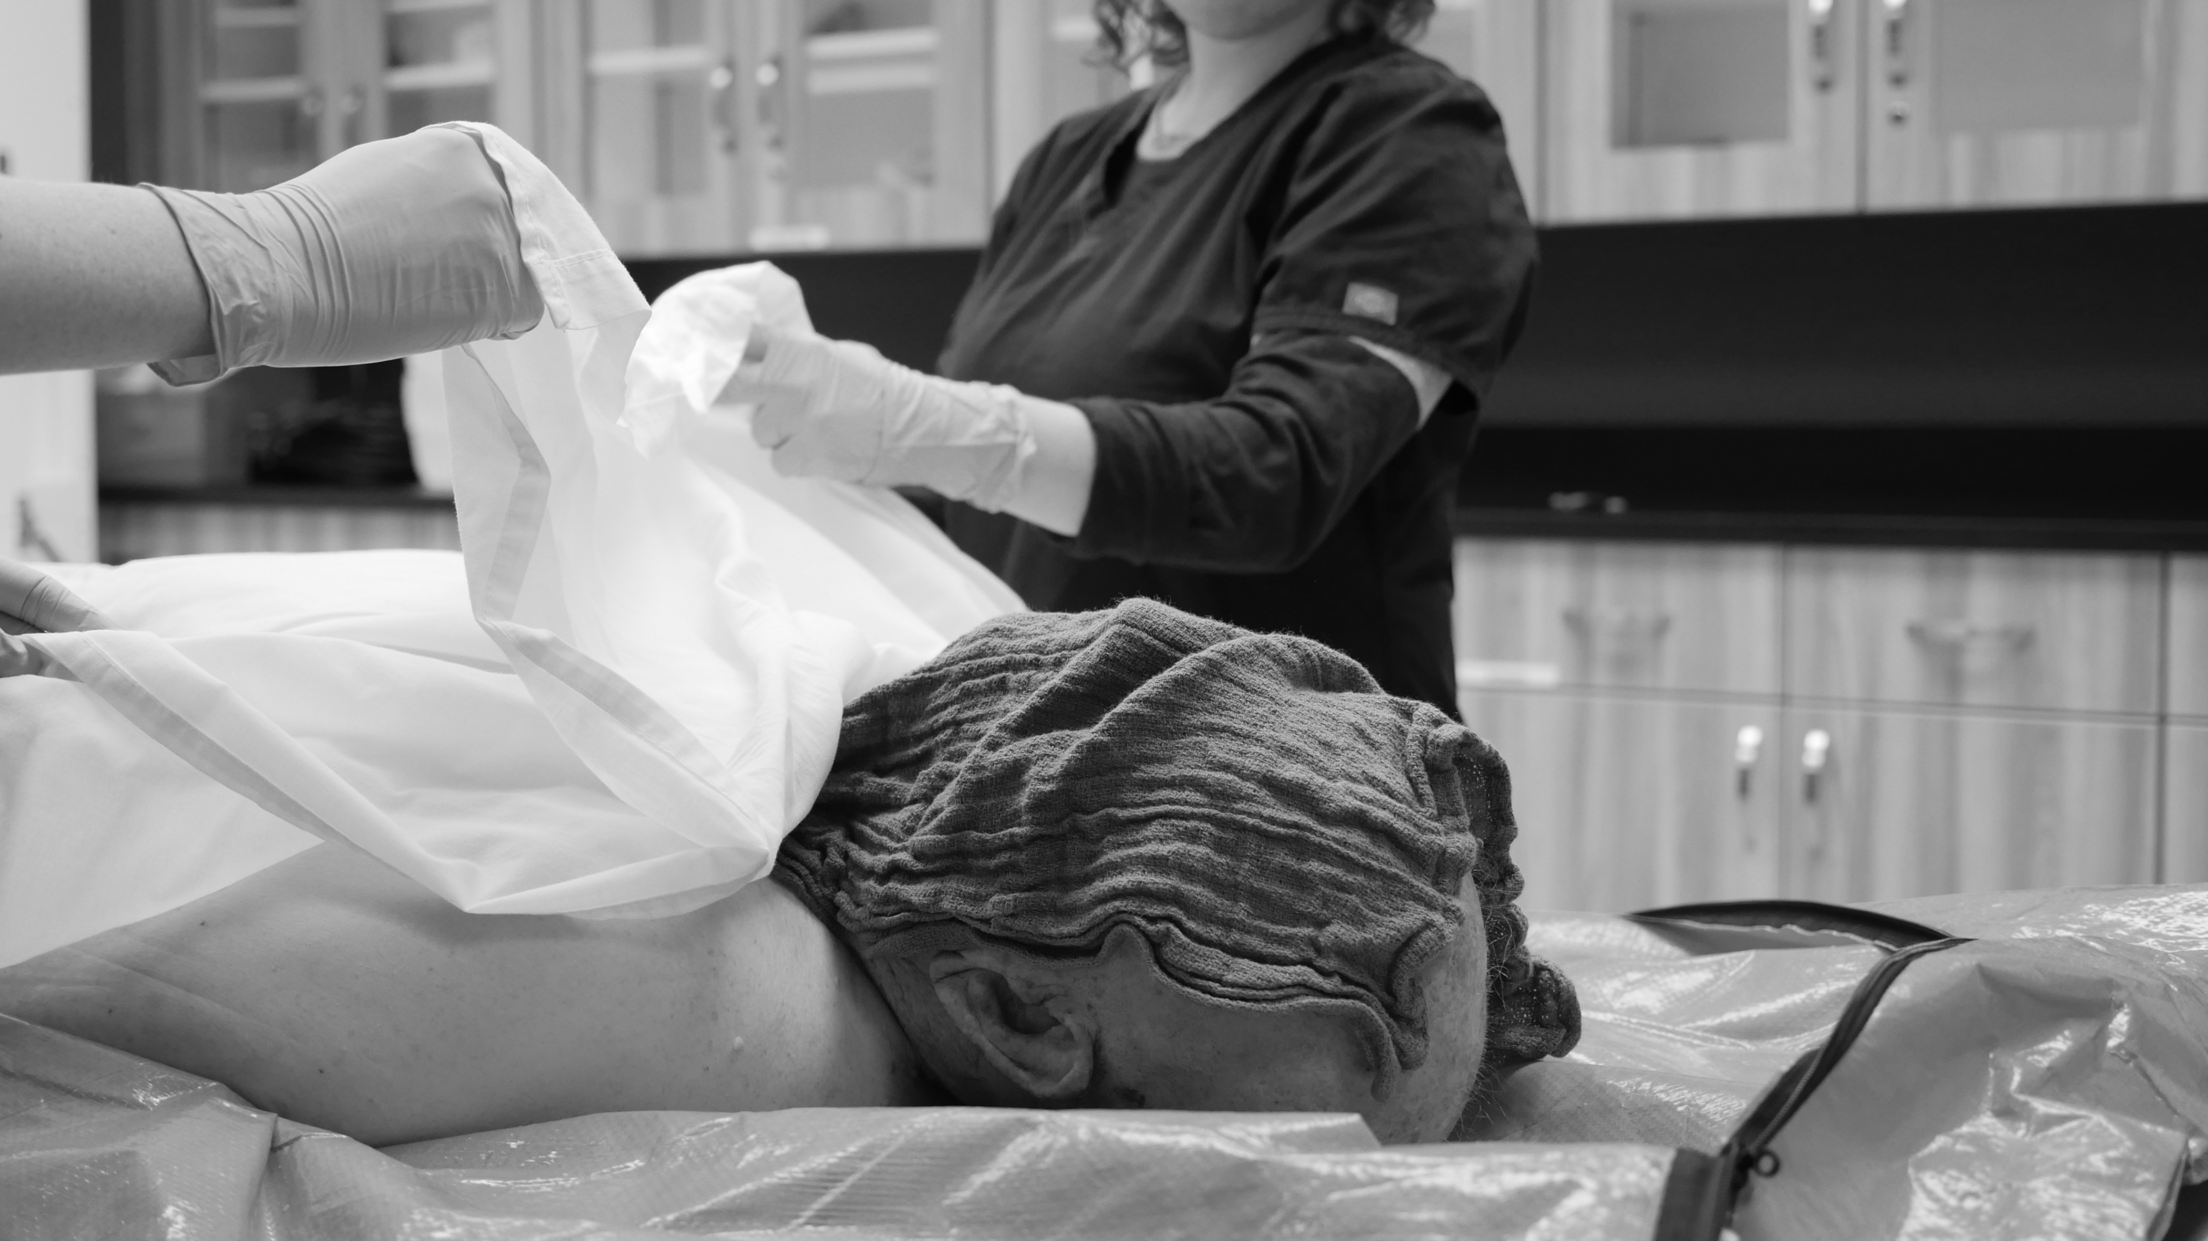
Problem:
Each year in the United States, more than 100,000 students begin their education inside a lab dissecting a cadaver to learn human gross anatomy.
APATHY & DEHUMANIZATION = Professionalism issues

Slide 4
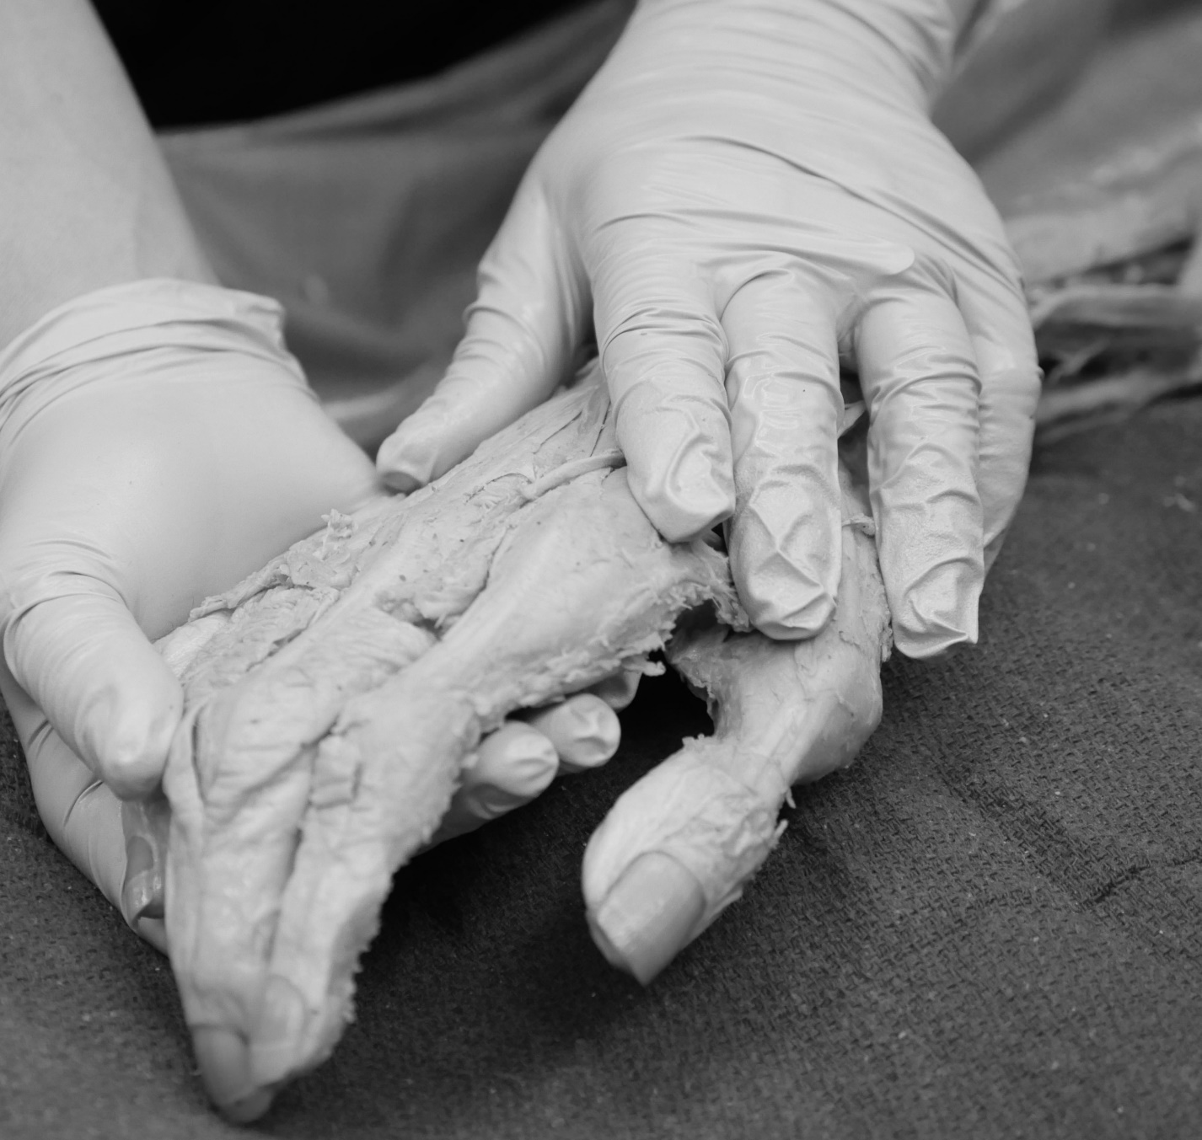
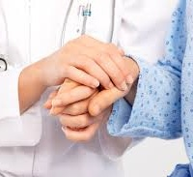
Narrative medicine:
“Medicine practiced with the skills of recognizing, absorbing, interpreting, and being moved by the stories of illness" – Dr. Rita Charon
GOAL :
Utilize technology in the delivery of the life stories of an anatomical donor to engender empathy and humanism within gross anatomy
Model the Student-Cadaver Relationship after the Physician-Patient Relationship
Associate the donor bodies with the various
lived experiences of the donor, including a sense of humanity and the values of the donor.
Enhance perpetual value of donor gifts through digital tools which broaden training value, usability, and “evergreen” teaching utility of anatomy labs.

Slide 5
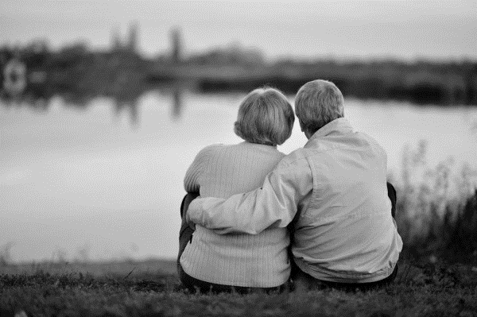
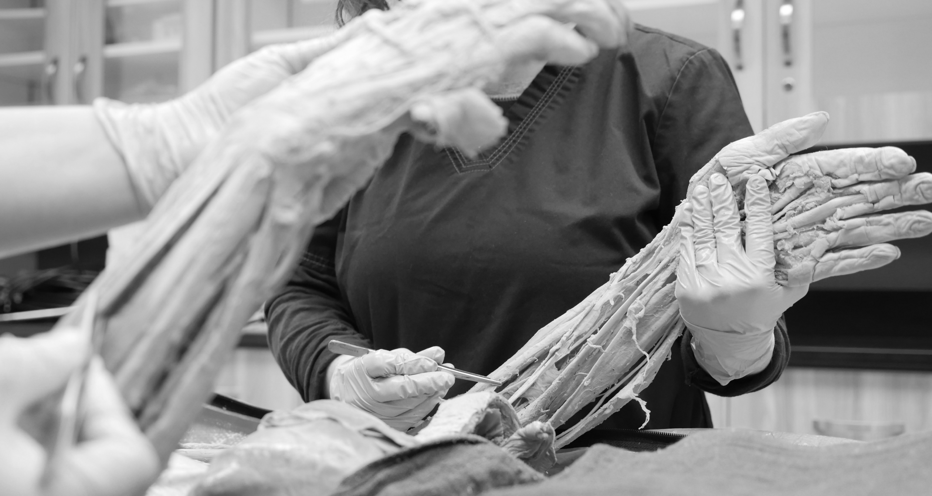
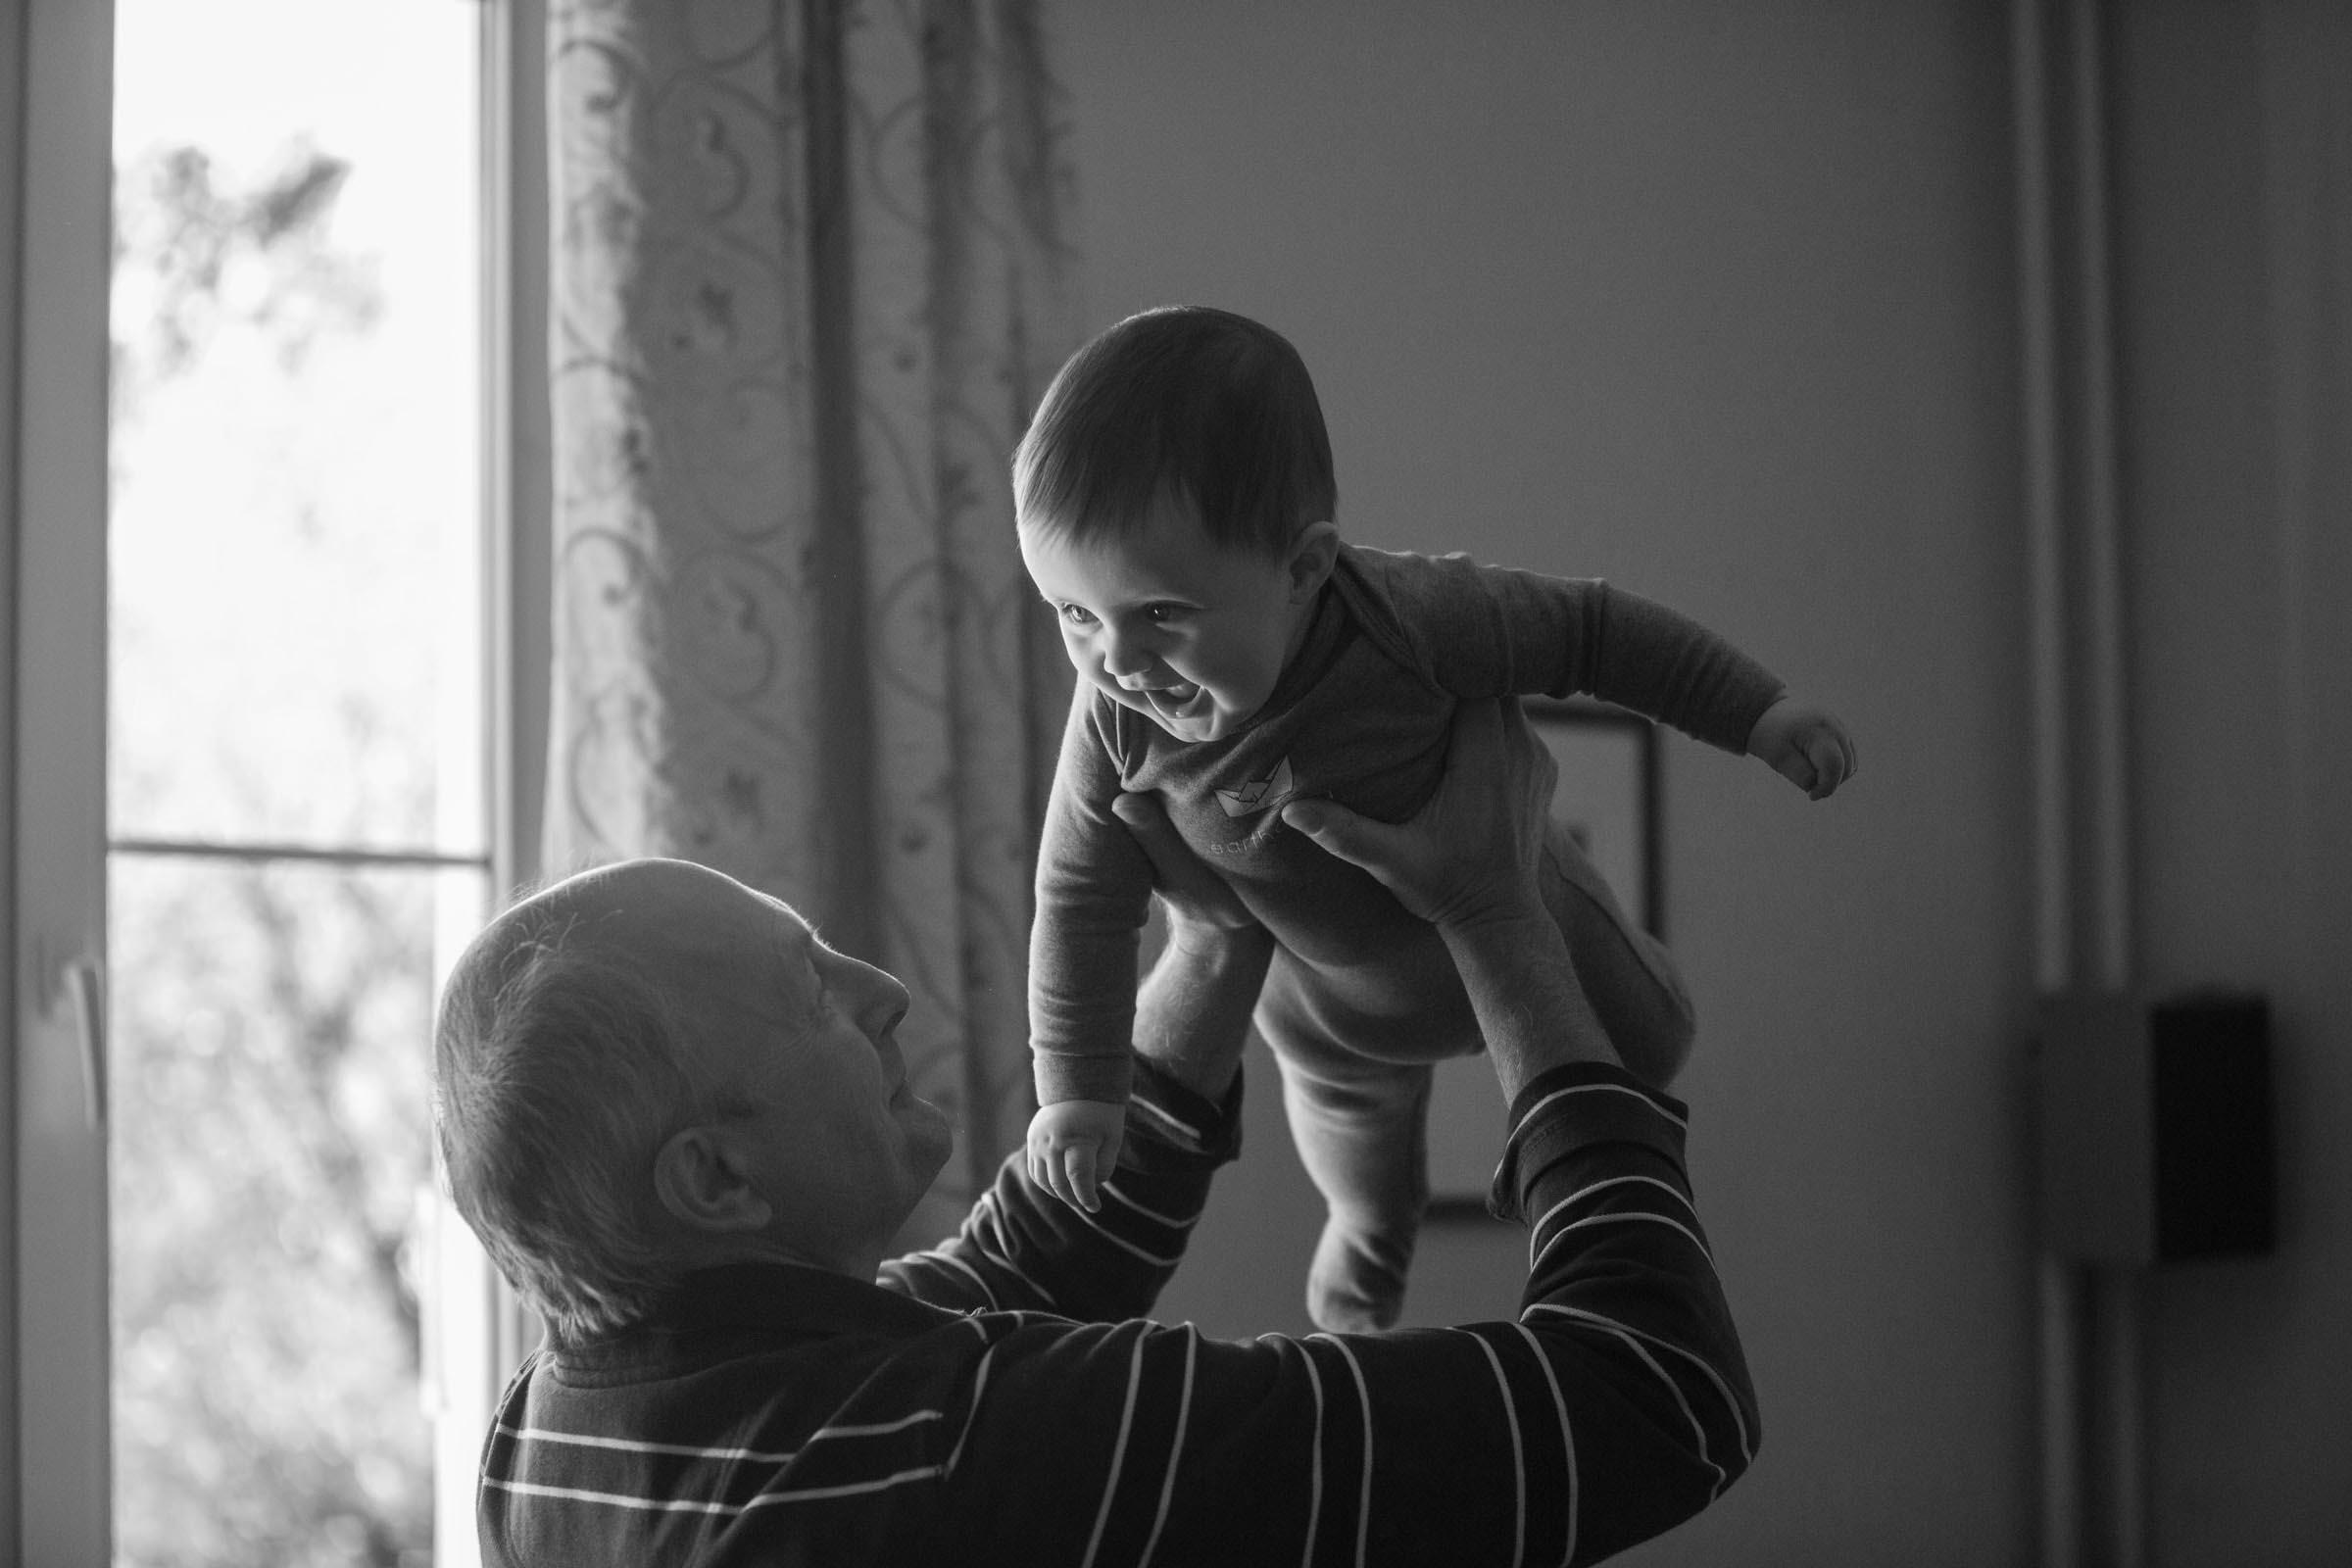

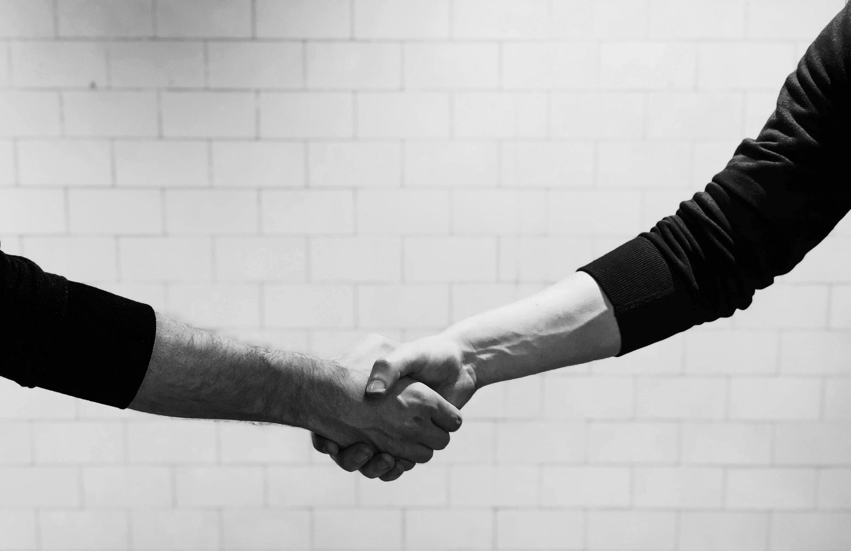
“My arms may not be as strong as they once were either. Regardless of their strength, they were always there to hold and protect the ones I loved. For decades they have been a comforting place for my wife to always retreat. They cradled my boys protectively when they were born and kept the monsters at bay when they were young.”

Slide 6
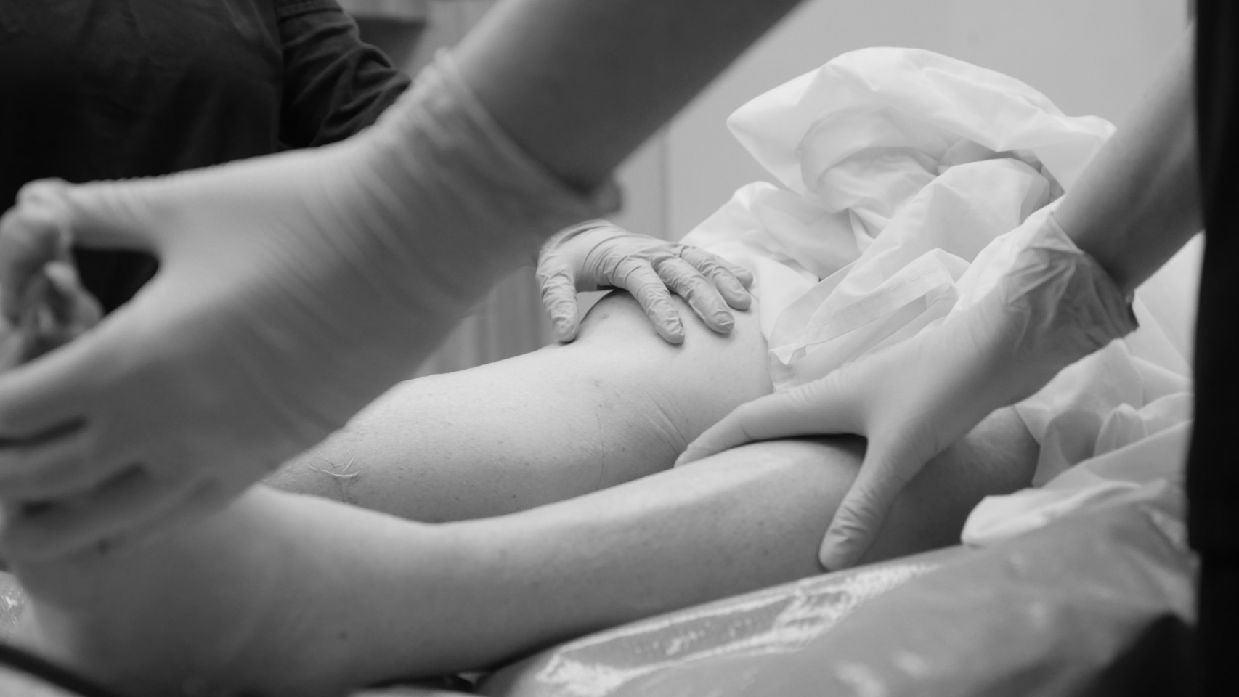
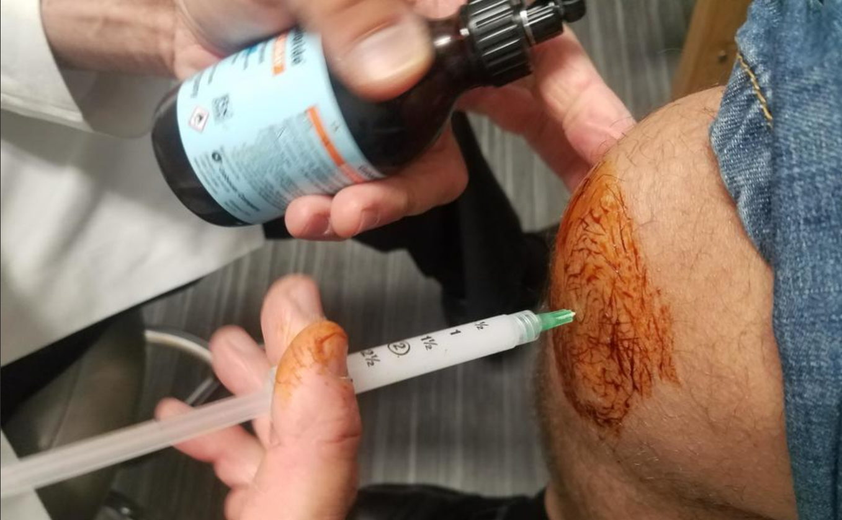
Process Model
Short-term objective: students gain appreciation for patient’s narrative situated across the body
Long-term objective: students demonstrate increased empathy applied to their medical practice with future patients
Process objective: creation of a multi-modal living donor experience (generating narrative, imagery, and AR/VR anatomical exploration) that increases student empathy.
Rationale
Visual media and storytelling have been used to help physicians and medical students better understand and empathize with experiences of patients and family members^{1, 2}
The anatomy dissection course is a platform to develop professional values such as empathy, respect and coping skills^{3,4}
The means by which students come to terms with their cadavers has broad significance for later interactions with patients⁵⁻⁸
Students crave their donor’s information, and when not given it (which is often the case) make up their own stories^{9,10}
Notes:
Kumagai, A. K. A conceptual framework for the use of illness narratives in medical education. Academic Medicine vol. 83 653–658 (2008).
Dosani, F. & Neuberger, L. Anatomy and humanity: Examining the effects of a short documentary film and first anatomy laboratory experience on medical students. Anat. Sci. Educ. 9, 28–39 (2016).
Weeks, S. E., Harris, E. E. & Kinzey, W. G. Human gross anatomy: A crucial time to encourage respect and compassion in students. Clin. Anat. 8, 69–79 (1995)
Warner, J. H. & Rizzolo, L. J. Anatomical instruction and training for professionalism from the 19th to the 21st centuries. Clin. Anat. 19, 403–414 (2006).
Penney, J. C. The Evolution of a Medical School Curriculum in Death and Dying. J. Palliat. Care 3, 14–18 (1987).
Coulehan, J. L., Williams, P. C., Landis, D. & Naser, C. The First Patient: Reflections and Stories About the Anatomy Cadaver. Teach. Learn. Med. 7, 61–66 (1995).
Sukol, R. B. Building on a tradition of ethical consideration of the dead. Hum. Pathol. 26, 700–705 (1995).
Rizzolo, L. J. Human dissection: An approach to interweaving the traditional and humanistic goals of medical education. Anatomical Record vol. 269 242–248 (2002).
Druce, M. & Johnson, M. H. Human dissection and attitudes of preclinical students to death and bereavement. Clin. Anat. 7, 42–49 (1994).
Wear, D. Cadaver talk: Medical students’ accounts of their year-long experience. Death Stud. 13, 379–391 (1989).

Slide 7
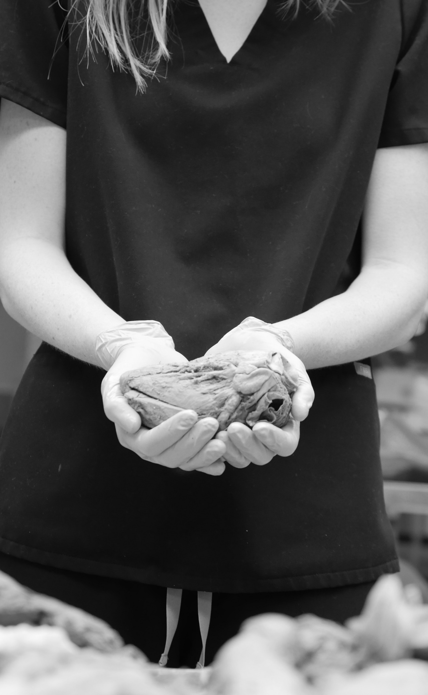
Design Context & Informational Challenges
Difficulty balancing narrative structures with pedagogical needs
Every body is different, every story is different
Respecting privacy and dignity for both donors and their loved ones
Scalability and feasibility of either information solicitation or design
Our Research Approach
Auto-ethnography: Anatomy Lab students created self-reflections regarding their own anatomy and bodily histories
  thematic analysis showed predominate responses of self-appreciation/self-perception and practical/utility
Comparative Empathy: Students are completing reflections upon their donor’s anatomy pre- and post-exposure to prototype donor stories
  Measure level of emotional responses in reflections after exposure to multimodal narratives
Focus groups: Currently planned with student, faculty, and donor groups
  exploring narrative and imagery prototypes, collection process, feasibility, and acceptability

Slide 8
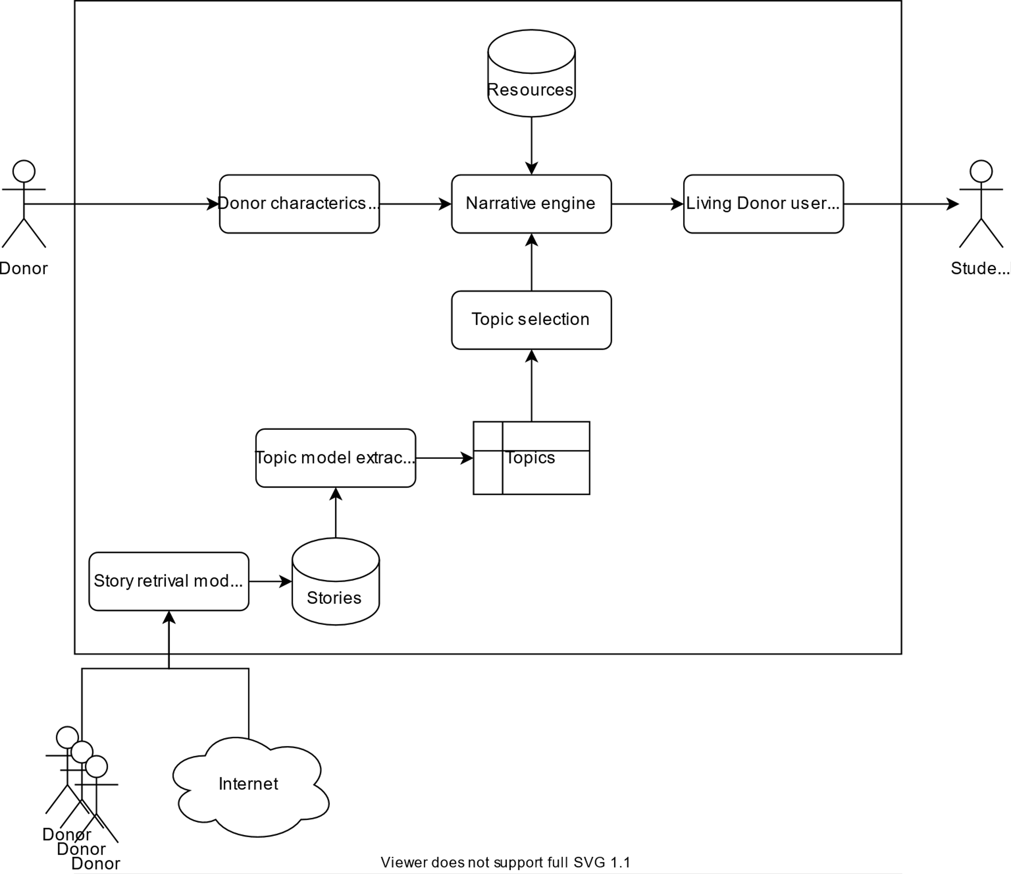
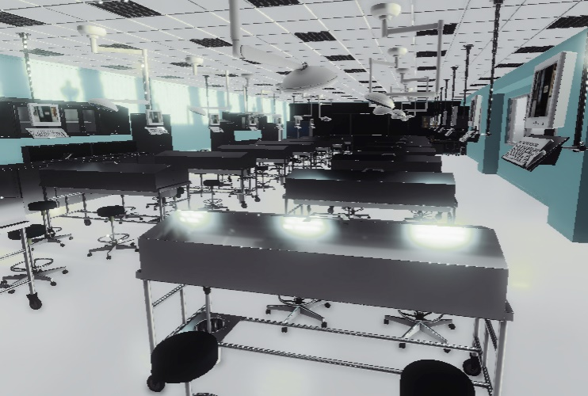
Structured Architecture & Prototyping

Slide 9
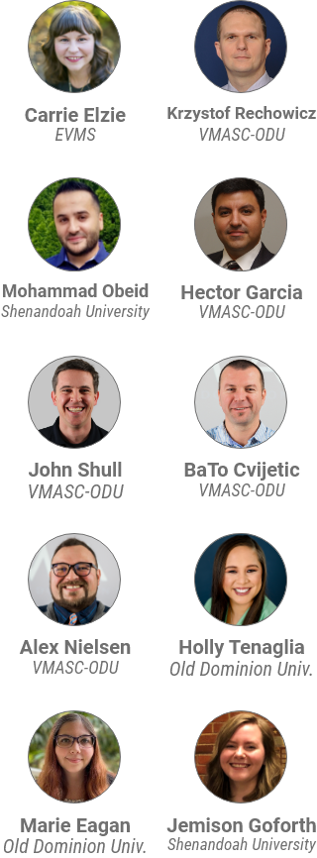
Multi-Disciplinary UX-oriented Team, Design Process, and Testing Plan
Team-wide UX process: Researchers and students worked closely with project scientists including developers, designers, and UX specialists to focus on experience-centric approaches throughout the ideation, design, and testing process.
Persona Development and discovery: Students were tasked with creation and curation of various user personas to explore interconnectedness of needs and points of friction across the entire process, from candidate solicitation through return of remains to family.
MVP-oriented testable design: Researchers have designated Minimum Viable Products at scale to deliver assessable prototypes to users and focus groups throughout the project
Iterative Testing: Design and documentation of multiple MVPs oriented towards testing across entire design process via focus groups, moderated testing, cohort-scale pilots
  Complete: Powerpoint-based single-donor multimodal narrative
  In Development: Structured experiential VR anatomy lab preparatory environment
  Upcoming: Semi-automated narrative elements assembly through topics-based narrative modeling
  Upcoming: Robust narrative engine generating donor-based content across anatomy lab experiences

Slide 10
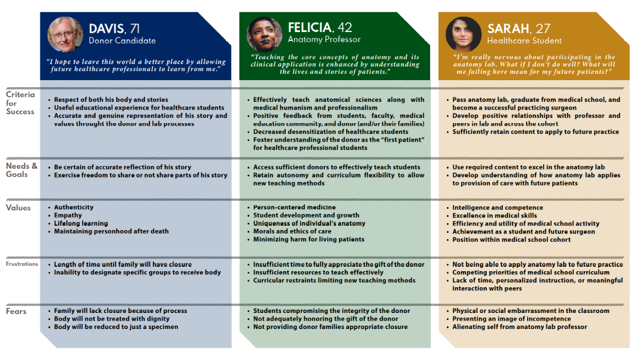

Slide 11
Ongoing UX challenges
Working with a multidisciplinary, student-centric team, building shared design language and framework of ethics & values in design (UD doesn’t work, ID doesn’t quite work, etc.
Differentiating the User Experience and the Customer Experience
  Exploring the notion of users absent within the final system and the premise of honoring absent users in design
  Conceptualizing a latent image of a user external to the process but internal to the ethical frame and content of the project
Customer Experience may be a better framework here, because it conceptualizes pre-user onboarding, post-use stance, and product perception across both the user base and the non-users (van de Sand et al. 2020). What does the user/customer journey map tell us after the user has died?
Difficult Questions
What does it mean to have user touchpoints post-mortem?
How does a persona who passes away during the process inform experience from a perspective of ethics?
How do we explore collaborative ethics utilizing a digital empathy model, and what is the nature of the collaborative experience between living and non-living users (Moon et al 2008)?
Moon, J. H., Lim, S. T., Park, C. L., Lee, I. S., & Kim, J. W. (2008). Conceptual Study on User Experience in HCI: Definition of UX and Introduction of a New Concept of CX (Co-Experience). Journal of the HCI Society of Korea, 3(1), 9-17.
van de Sand, F., Frison, A. K., Zotz, P., Riener, A., & Holl, K. (2020). The Intersection of User Experience (UX), Customer Experience (CX), and Brand Experience (BX). In User Experience Is Brand Experience (pp. 71-93). Springer, Cham.

Slide 12

Anatomical Lab Images by Kyle Zeltmann
THANK YOU!

