Slide 1

Mobile UX in an Age of Multiplying Devices: Challenges, Frameworks, and Unanswered Questions
Presenters:
Dr. Guiseppe Getto
Associate Professor, East Carolina University
Dr. Jack T. Labriola
Assistant Professor, Kennesaw State University
Dr. Suzan Flanagan
Assistant Professor, Utah Valley University

Slide 2
The Big Problem
1
There is UX within communication design literature (i.e., Spinuzzi, 2005; Simmons & Zoetewey, 2012; Potts, 2013; Sun 2013; just to name a few)
But little mobile UX (Mendoza, 2013; Punchoojit & Hongwarittorrn, 2017; Verhulsdonck, 2017)
And we don’t have: explanations for dealing with the increasingly complex array of devices ranging from large outdoor displays to tiny screens on wearables

Slide 3

Problem Space #1: Mobile Onboarding
2
What it is
the process of acclimating users to a mobile usage environment quickly and efficiently
Load app
Do task / walkthrough
Use app
Love app forever

Slide 4
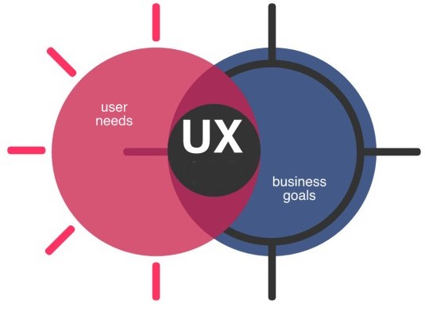
Problem Space #1: Mobile Onboarding
3
In reality

Slide 5
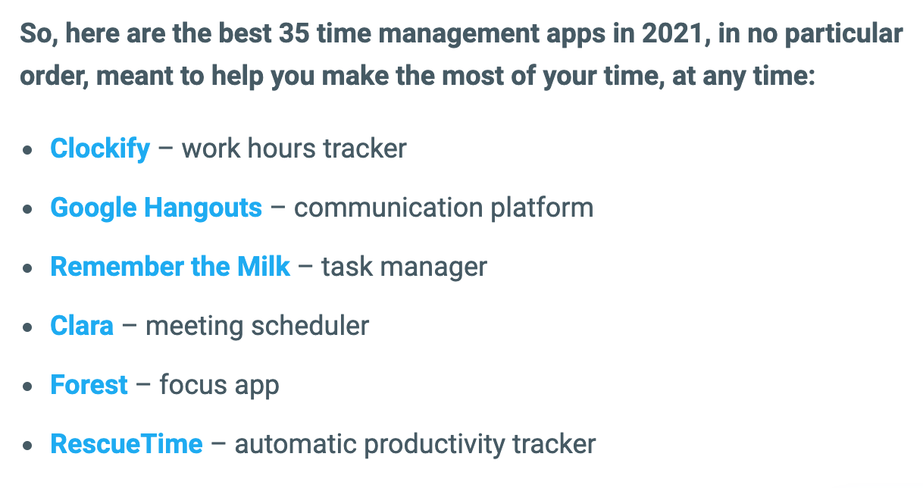
Problem Space #1: Mobile Onboarding
4
Mobile apps solve problems for users
Via:
https://bit.ly/3doHn6e

Slide 6
Problem Space #1: Mobile Onboarding
5
But they also solve problems for organizations
User reach
Improved user experience
Marketing
Additional revenue
Additional features for desktop apps
Internet of Things (smart stuff)

Slide 7
Problem Space #1: Mobile Onboarding
6
Do organizational goals align with user mental models though?
“[O]ne of usability's big dilemmas is the common gap between designers' and users' mental models. Because designers know too much, they form wonderful mental models of their own creations, leading them to believe that each feature is easy to understand. Users' mental models of the UI are likely to be somewhat more deficient, making it more likely for people to make mistakes and find the design much more difficult to use.” - Jakob Nielsen

Slide 8
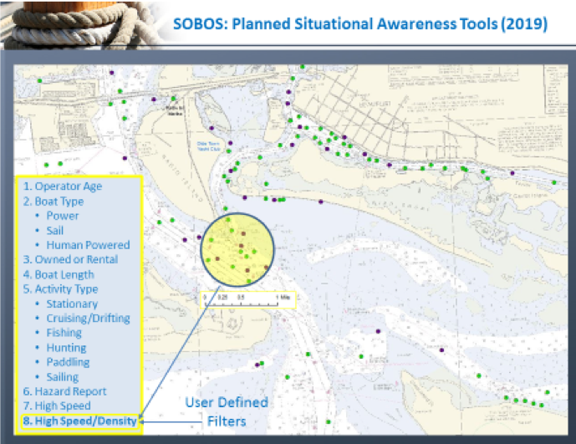
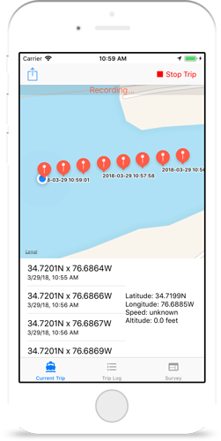
Problem Space #1: Mobile Onboarding
7
Example: Sobos.org
Avoid unsafe boaters Find lost boaters

Slide 9
Problem Space #2: Mobile UX Pedagogy
8
Developing Mobile UX Workflows for Students
In my design classes, we incorporate Cooper et al’s (2014) Goal-Directed Design process to promote designing better mobile products
Goal-Directed Design combines techniques of ethnography, stakeholder interviews, market research, detailed user models, scenario-based design, and a core set of interaction principles and patterns

Slide 10
Problem Space #2: Mobile UX Pedagogy
9
The “Phases” of the GDD Process
Ask students to consider how we go through the process with mobile in mind...

Slide 11
Problem Space #2: Mobile UX Pedagogy
10
When designing for mobile we need to consider…
Mobile Form Factors
Navigation, Content, and Control Idioms
Searching, Sorting, and Filtering
Multi-Touch Gestures
Inter-App Integration
Letting Context Drive the Design

Slide 12
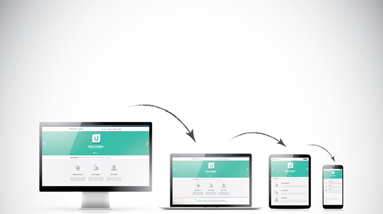
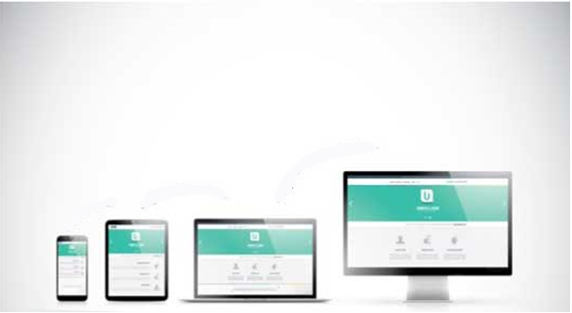

Problem Space #3: Limitations of Mobile First Design
11
Desktop First Design Mobile First Design
Scaling Down
Scaling Up
Notes:
Image source: https://www.architech.ca/responsive-vs-adaptive-web-design-for-ui-ux/

Slide 13
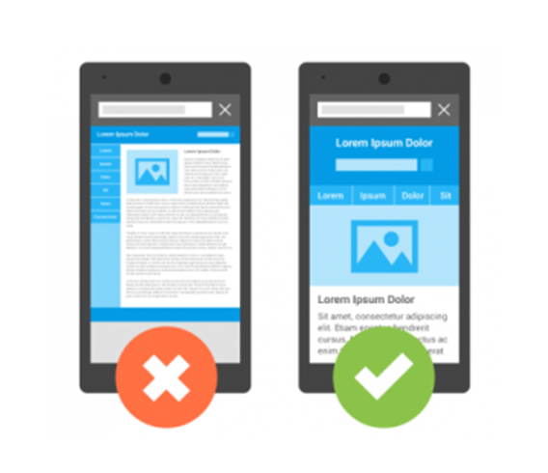
Problem Space #3: Limitations of Mobile First Design
12
Adaptive design: content resizes to fit the window
Responsive design: content & layout changes with screen size & orientation
“For a responsive design to be successful, the design must also be usable at all screen resolutions and sizes” (Schade, 2014).
Notes:
Image source: https://www.firstclasswebdesign.co.uk/mobile-friendly-website-design/example-of-responsive-and-non-responsive-website-on-mobile-device/

Slide 14
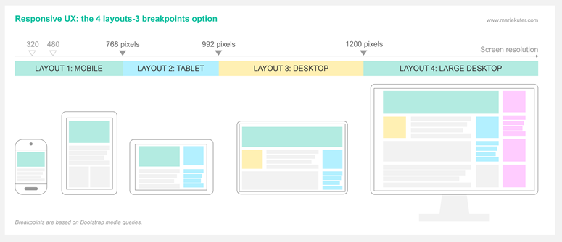
Problem Space #3: Limitations of Mobile First Design
13
Breakpoints
“Complex data or interactions can be hard to fit into modular pieces that are easy to shuffle around a page, while preserving clarity and functionality” (Schade, 2014).

Slide 15
Problem Space #3: Limitations of Mobile First Design
14
Mismatches between channel capacities
Content parity
Feature parity
Performance (e.g. connectivity issues)
Findability (e.g., hidden navigation)
Information density
Scrolling directions

Slide 16
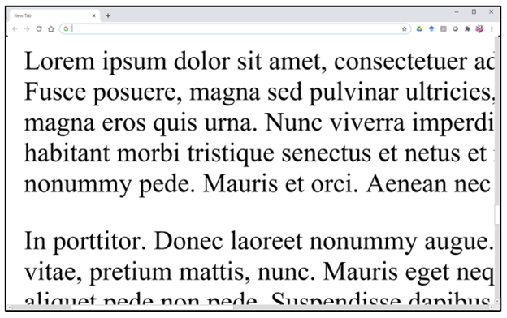
Problem Space #3: Limitations of Mobile First Design
15
“If you have a big screen, do more. Don’t do the small thing and make it big . . . that’s a terrible design” (Nielsen, 2020).

Slide 17


Problem Space #3: Limitations of Mobile First Design
16
How might adaptive design, responsive design, geolocation, AI, and other technologies be optimized to produce smooth transitions across devices?
How might mobile UX practitioners better plan for adaptability with reverse scaling (i.e., scaling up)?

Slide 18
References
Schade, A. (2014, May 4). Responsive web design (RWD) and user experience. Nielsen Norman Group. https://www.nngroup.com/articles/responsive-web-design-definition/
Simmons, W. M., & Zoetewey, M. W. (2012). Productive usability: Fostering civic engagement and creating more useful online spaces for public deliberation. Technical Communication Quarterly, 21(3), 251–276.
Spinuzzi, C. (2005). The methodology of participatory design. Technical Communication, 52(2), 163-174.
Sun, H. (2013). Cross-cultural technology design: Creating culture-sensitive technology for local users. Oxford University Press.
Verhulsdonck, G. (2017). Designing for global mobile: Considering user experience mapping with infrastructure, global openness, local user contexts and local cultural beliefs of technology users. Communication Design Quarterly, 5(3), 55–62.
Cooper, A., Reimann, R., Cronin, D., & Noessel, C. (2014). About Face: The essentials of interaction design ; the completely updated classic on creating delightful user experiences (4th ed.). Indianapolis, IN: Wiley.
Kojic, M. (2020). 35 best apps for time management in 2021. Clockify. Retrieved from https://clockify.me/blog/apps-tools/best-time-management-apps/
Mendoza, A. (2013). Mobile user experience: Patterns to make sense of it all. Elsevier Science & Technology.
Nielsen, J. (2010). Mental models. Nielsen Norman Group. Retrieved from https://www.nngroup.com/articles/mental-models/
Nielsen, J. (2020). User interface design fails. Virtual UX Conference. Retrieved from https://www.nngroup.com/videos/ui-design-fails/
Punchoojit, L., & Hongwarittorrn, N. (2017). Usability studies on mobile user interface design patterns: A systematic literature review. Advances in Human-Computer Interaction, 2017, Article ID 6787504. doi:10.1155/2017/6787504
Potts, L. (2013). Social media in disaster response: How experience architects can design for participation. Routledge, 2013.

