Slide 1
Complex Decision Making:
Confuse the issue with graphs
Michael J. Albers
East Carolina University
SCCI Feb 22-23, 2021

Slide 2
Information for everyone and information for decision makers can be very different. Yet, early in the COVID pandemic, states announced dashboard which they said were for state officials to help track the outbreak.
As a decision making tool, these dashboards fail miserably because they don’t present usable information. It’s correct, but not usable.

Slide 3
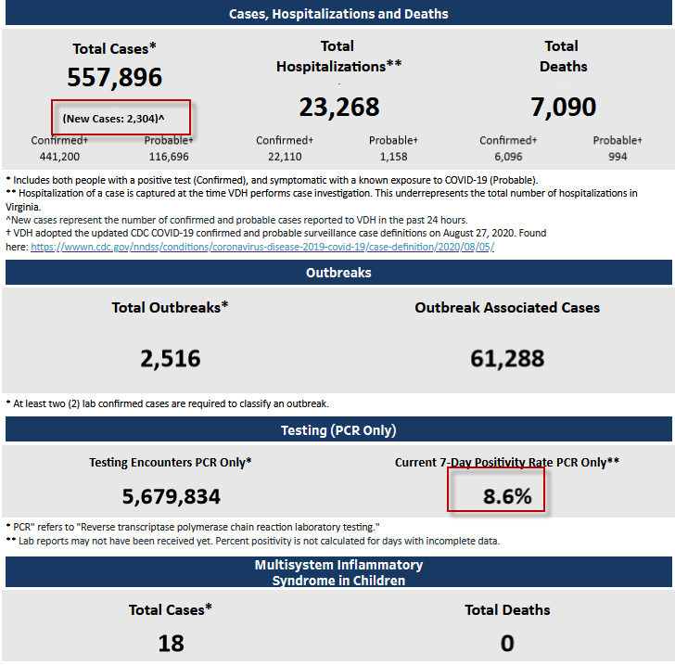
Salient information
Notes:
Across every dashboard I looked at, the most salient information is the totals: total cases, total hospitalizations, and total deaths. These also seem to be numbers most emphasized by the news media….give the public BIG. SCARY. NUMBERS.
But not really helpful to make decisions about what to do over the next few weeks. Totals over several months need to be replaced with short term changes, which reflect the current status.
On this dashboard, (boxed in red) only the New Cases and 7 Day Positivity numbers reflect current conditions. The others give no indication of recent changes.

Slide 4
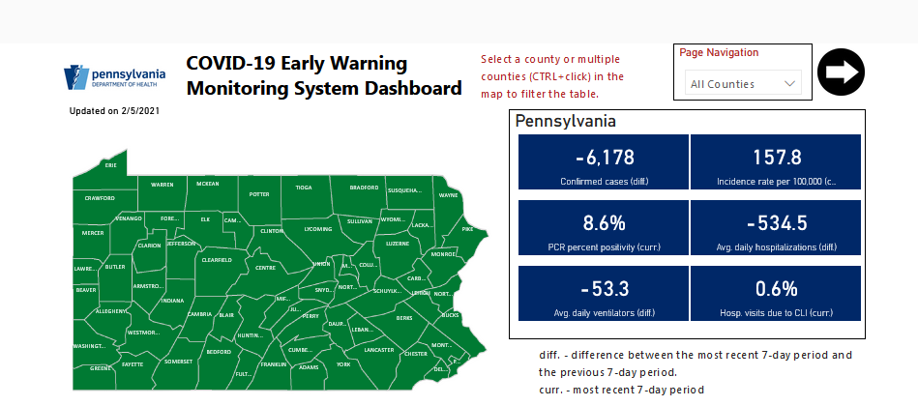
Salient information
Notes:
Pennsylvania does a better job and shows changes.
However, it also shows daily changes which tend to be volatile. Seven day would averages smooth out the volatileness.

Slide 5
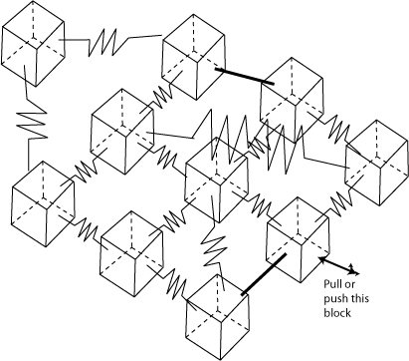
Relationships, not data

Slide 6
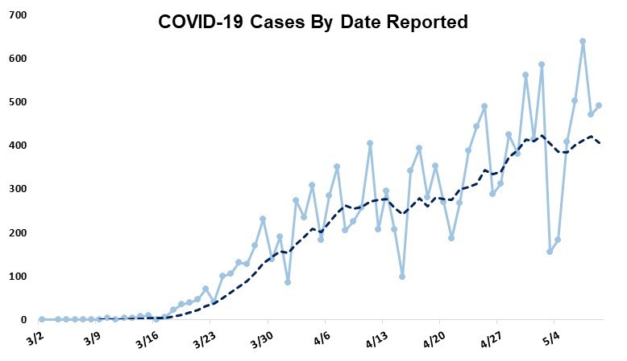
Highly variable data
Notes:
Another view of daily changes which tend to be volatile.

Slide 7
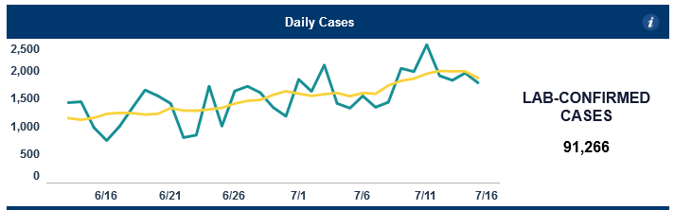
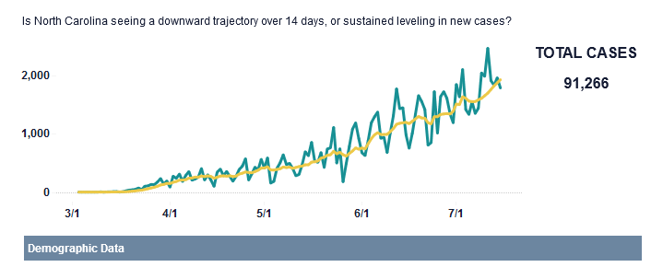
Short/long term trends
Notes:
The average line smoothes the extreme ups and downs. Very easy to over-react to any big daily swing and make choices which the data doesn’t support.
On the other hand, the most salient number is still the total.
These two graphs also show the importance of keeping the focus on the near past. The bottom shows the entire pandemic which makes current changes appear too small.

Slide 8
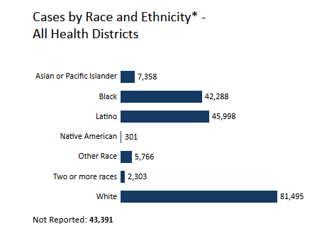
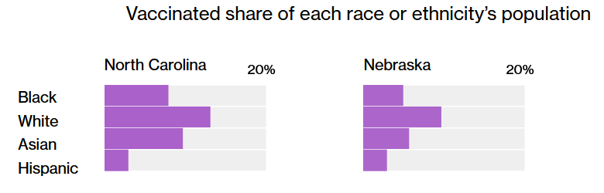
Information in context
Data, but no context
Has relationships
Notes:
Information about non-equal data sets needs to be placed in content.
Another graph focuses on BIG. SCARY. NUMBERS.
Excess cases from minority populations have been reported since the early days of the pandemic. Yet, looking at this graph, it seems Whites are having the most cases. The basic problem: Not adjusting for percentage of overall population. Virginia is 66% White and 19% Black, so the Black bar should be about 1/3 White ba, rather than half.
People read graphs as they are shown. They do not perform the mental gymnastics to make any data adjustments….in this case, population percentages.

Slide 9
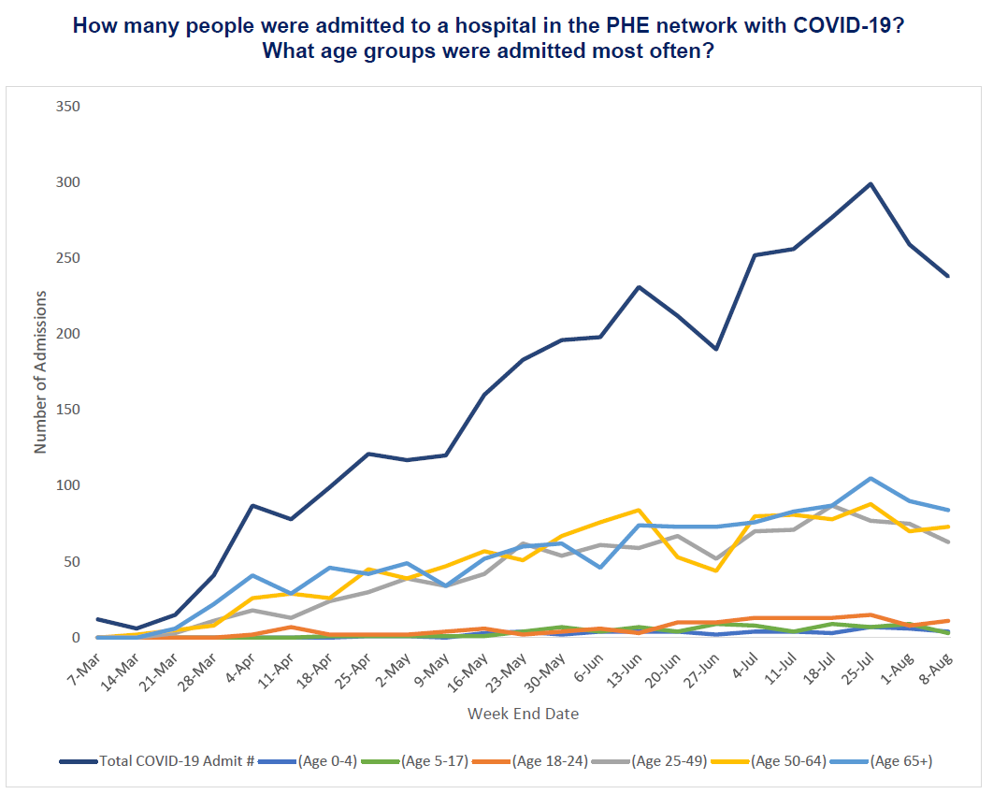
Total line? Distracting…..
Notes:
The top blue lines is a BIG. SCARY. NUMBER. Something must be done about it. We can wait to deal with the other lines later.
Oh wait, that is the total of the other lines. Having a Total value distorts the overall graph and makes the lowest values seem insignificant.

Slide 10
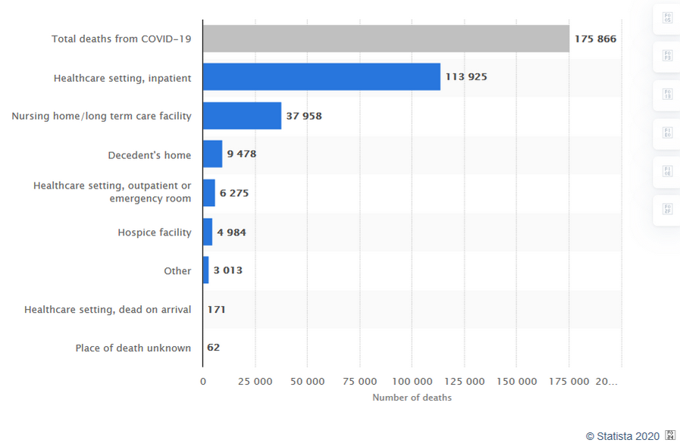
Total line? Distracting…..
Notes:
Another example of the Total line dominating the graph.

Slide 11
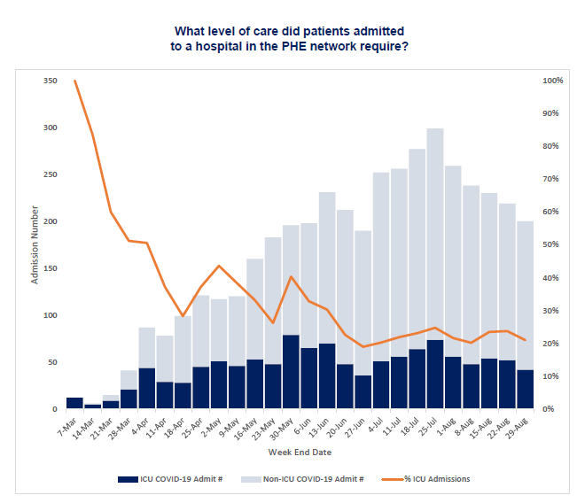
Mixing data
Notes:
Mixing data makes both harder to comprehend.
So if there are few CLS ER visits, more of them go to the ICU. As a decision making relationship, my response is huh?
If the graph requires different right and left side y-axis scales, maybe they should not be combined.

Slide 12
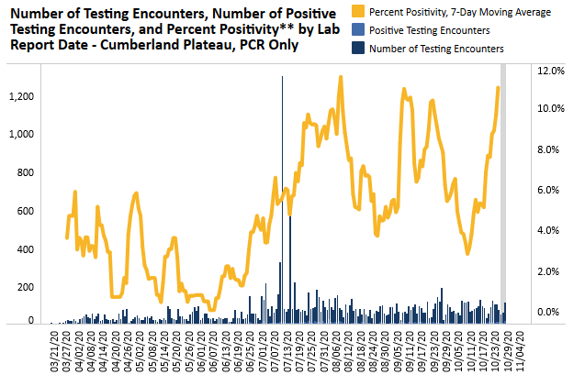
Outliers change perception
Notes:
Sometimes outliers in the data just need to be removed.
The one big number skews the scale and makes the rest of the data difficult to read or see any trends. It definitely disconnects it from the gold line, which like the previous slide is not really related to the bars anyway.

Slide 13
Summary
Graphic design profoundly affects how people interpret the information and, consequently, how they make decisions from them.
Tufte may advocate from dense graphs which require levels of analysis to fully understand, but most decision makers are not going to give any graphic that much time.
Face facts: The graphs are going into PowerPoint and covered too quickly.

