Slide 1


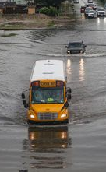
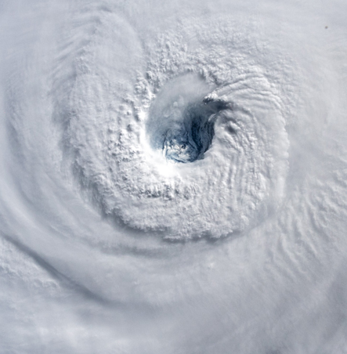

Web Content Audits: A Powerful Tool for Complex Website Design
Amanda Altamirano
Sonia Stephens
University of Central Florida
Dept. of English and Texts & Technology Program
Part of the NAS Gulf Research Program project
Why Location Matters: How Smarter Decision-Making by Renters and Homebuyers Will Increase Coastal Resilience

Slide 2








Project overview
Project goal: give renters, homeowners, and homebuyers info about natural hazards & home hazard mitigation
  Main hazards: tropical cyclones, flooding, tornadoes, extreme heat
“HazardAware” website will serve as information clearinghouse
Subtitle
Subtitle

Slide 3
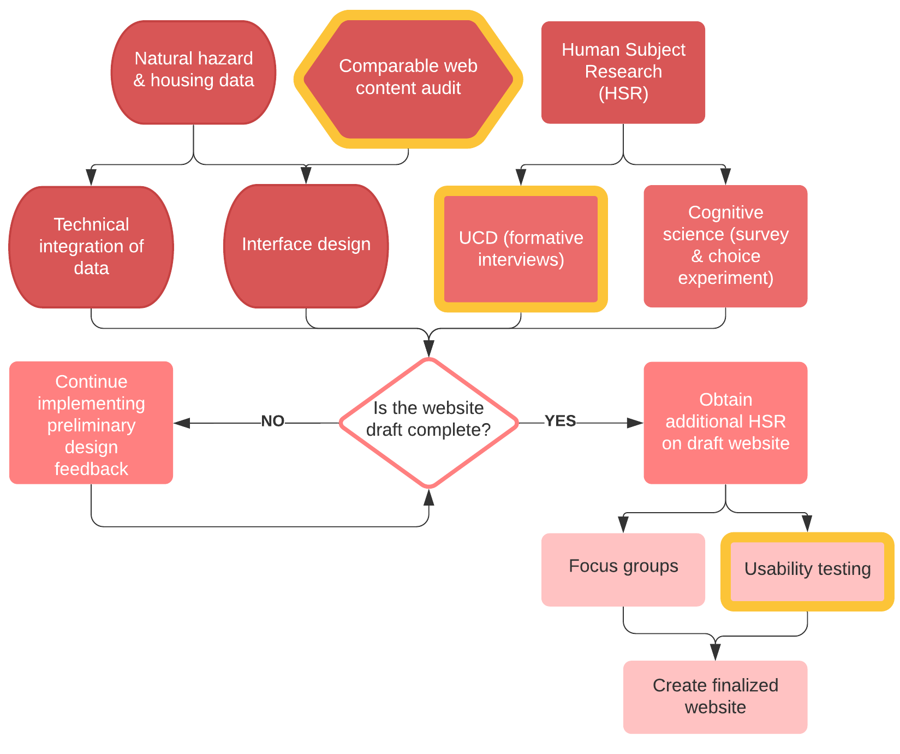
Overall website design has multiple parts.
We’re working on:
  Comparable website content audits
  Formative interviews with target users for the website
  Final usability testing
Subtitle

Slide 4
What is a content audit?
Results in a clear, tangible description of your content.
Provides the foundation for comparing existing content with either user needs or competitor content, letting you identify potential gaps and opportunities.
Subtitle
Source:
Jones, C. “Content Analysis: A Practical Approach.” 2009. UXmatters.com.

Slide 5
How is a content audit used?
What kind of content?
What’s the balance in images and words?
What about colors and interactive features?
Subtitle
Source:
Detzi, C. “From Content Audit to Design Insight: How a Content Audit Facilitates Decision-Making and Influences Design Strategy.” UX Magazine. 2012.

Slide 6
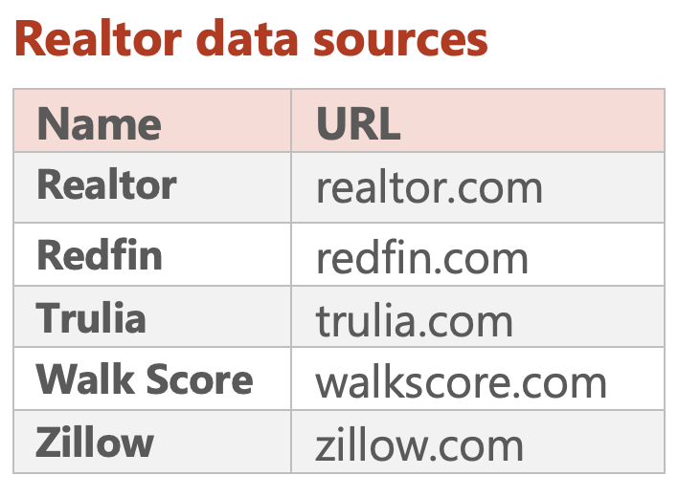
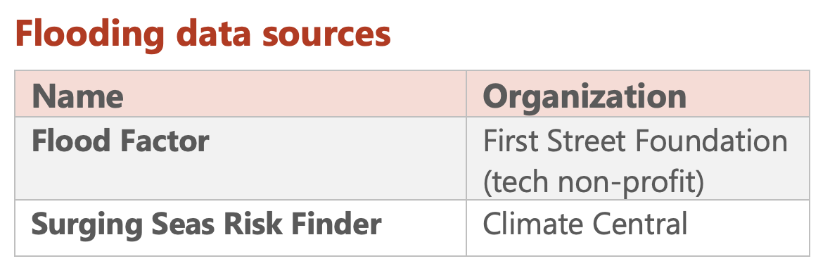
Methods
Genres reviewed: realtor and flooding risk.
Documented details at level of individual home + community.

Slide 7
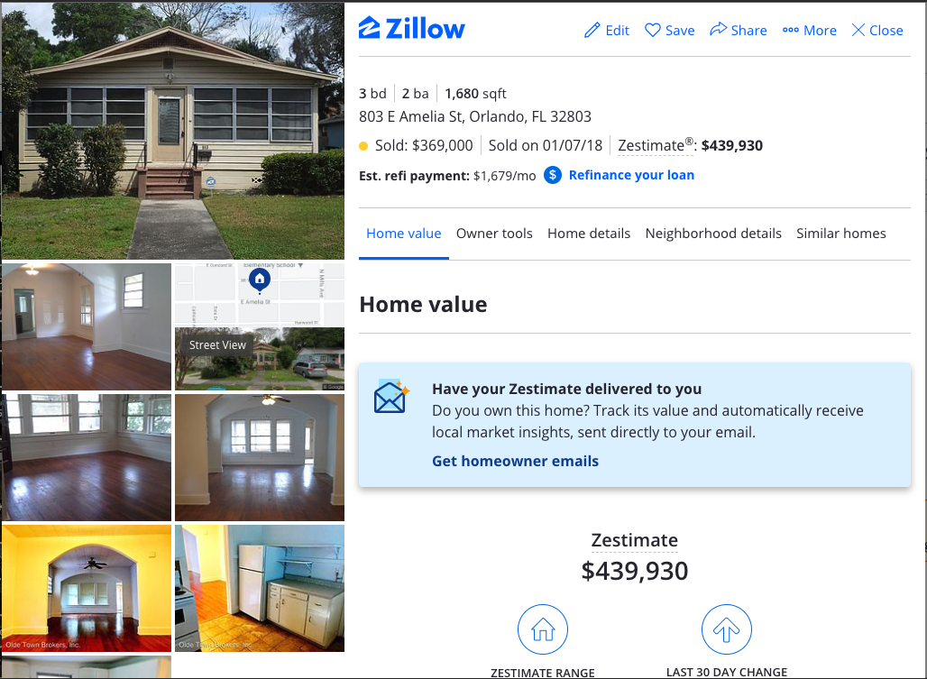
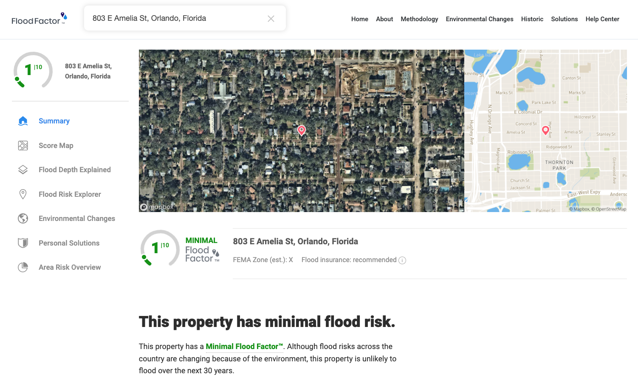
Example data sources
Subtitle
Source: www.zillow.com
Source: www.floodfactor.com

Slide 8
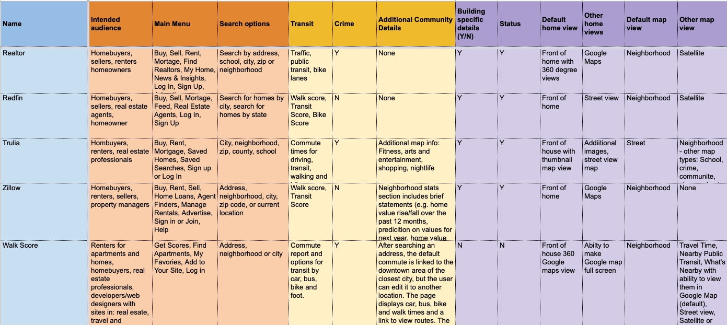
Example: Realtor genre
Navigation
Community
House

Slide 9
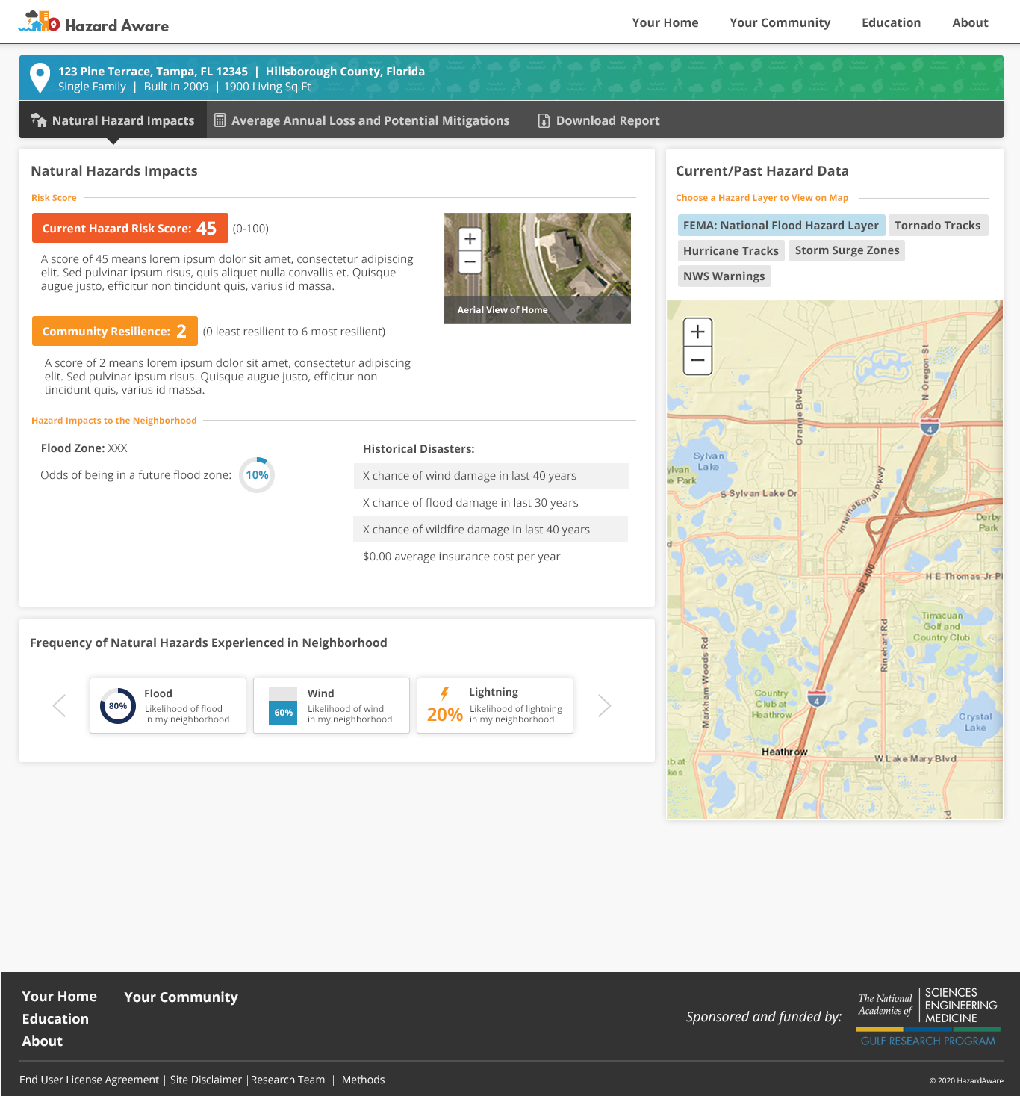
Results: Informing interface design
Wireframes for UCD
“Mitigation calculator” tool design
Preliminary website design
Subtitle
Draft design for HazardAware

Slide 10
Results: Information visualization & structure
Visualizing risk
  “Risk Score” design
  Data mapping
Information architecture
  Prioritizing natural hazard types
  Educational content
  User-generated PDF report
Subtitle

Slide 11
Conclusion
Content audits simplify complexity
They enabled us to:
  Communicate website features and functionality to the broader project team.
  Articulate some of the issues between website features and data limitations.
  Create systematic report results to streamline collaboration with creative project teams.
Subtitle

Slide 12


Discussion
What are your questions about using web content audits to inform complex or interdisciplinary website content?
What methods have PTCs used to bridge disciplinary and/or methodological divides within interdisciplinary project teams?
Contact us:
Sonia Stephens: sonia.stephens@ucf.edu @terpsinoe
Amanda Altamirano: aalta@knights.ucf.edu @aalta3
Subtitle

